Slide 1
Wireless - Core
Routing:
2 Separate locations
2 Cisco Nexus 7706 switches with Fab3 fabric cards and M3 line cards
Uplink switch for all wireless core devices: controllers, firewalls, service switches(authentication, dhcp, monitoring)
Router for all wireless management networks and all centrally managed wireless client networks (uwnet, eduroam, uwnet-wired, iot)
Peered with the campus core
Firewall
2 PA 5260 firewalls, active/standby

Slide 2
Wireless - Controllers
Controllers:
AOS 6.4.4.15
Master/Standby + 2 local controllers
4 Aruba 7240 controllers
Supporting remaining ap-125 access points
AOS 8.7.1.9
MC1
2 10K HW Mobility Conductor appliances
9 Aruba 7240 controllers
Primarily serving academic buildings
Connected to legacy core switches
MC2
2 10K HW Mobility Conductor appliances
8 Aruba 7280 controllers
Primarily serving residential buildings

Slide 3
Wireless –Net Services
ClearPass Policy Manager
Cluster of 10 appliances (1 publisher, 1 standby publisher, 8 subscribers)
2 dedicated isc-dhcpd servers
Airwave
Netinsight
VMW Edge Network Intelligence
Aruba UXI sensors, NetBeez
Fido, GNMIS

Slide 4
Wireless –Net Services
AP-125
AP-203H
AP-205H
AP-224
AP-225
AP-275
AP-303H
AP-318
AP-324
AP-325
AP-344
AP-345
AP-375
AP-503H
AP-505H

Slide 5
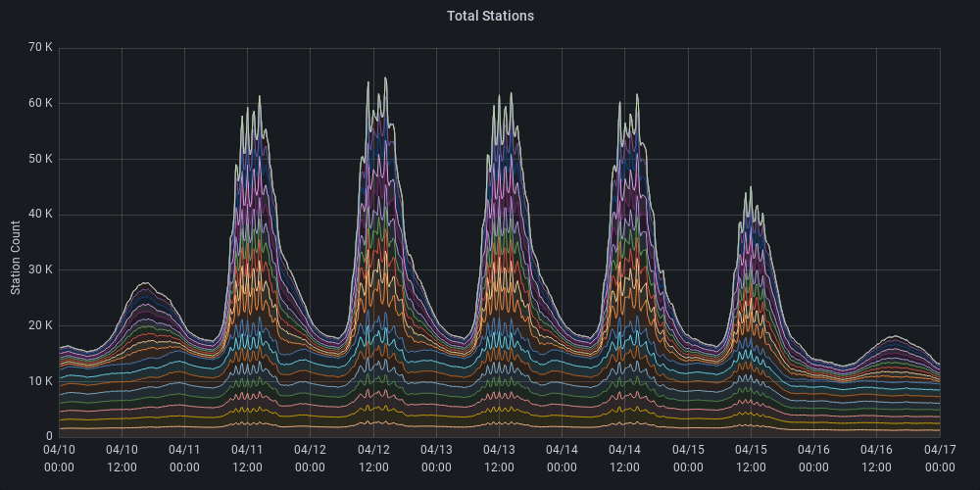
Wireless - Clients

Slide 6
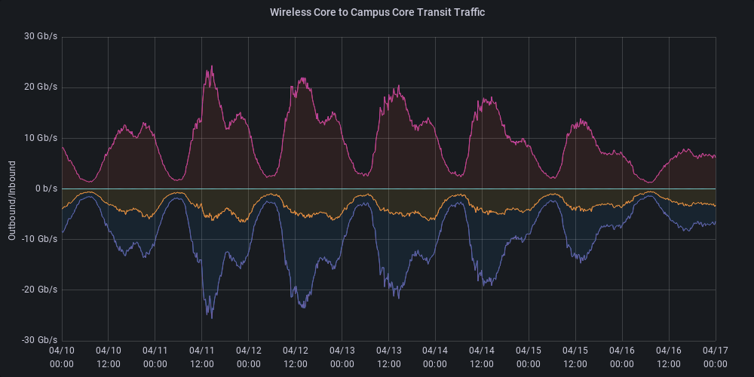
Wireless - Traffic

Slide 7
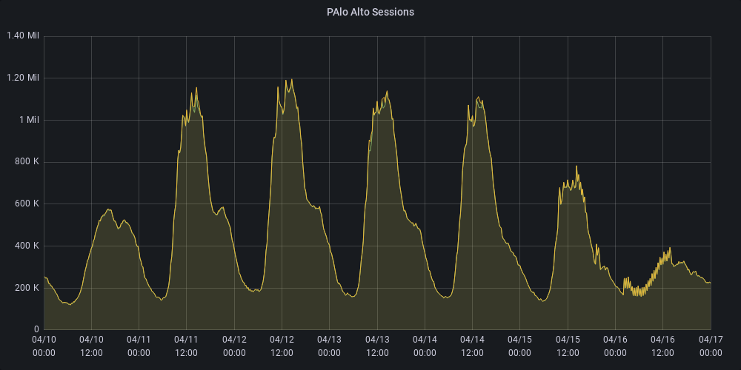
Wireless – FW Sessions

Slide 8
Wireless – FW Sessions

Slide 9
Campus Wireless Upgrade
Started in 2017
Approximately 8000 AP’s for the entire campus
Philosophy shifted from a “Coverage” model to a ”Density” model (move from emphasizing covering the largest area to supporting the most users)
Barriers
ISP fiber (MM → SM), Added POE requirements, Edge switch upgrades, TR power requirements
slow progress when using only campus resources for infrastructure upgrades
Currently supporting about 18000 AP’s with about 279 remaining AP-125’s

Slide 10
Current Efforts
Replacing all 7240 controllers with 7280’s
Expanding both Mobility Controller domains to 10 controllers
Decommission the 6.4 environment
Instantiate 3rd Mobility Controller Domain to accommodate additional ap growth
Complete physical migration of all controllers to N7706 cores

