Slide 1
2022 uwsys.net l2+ update
Michael Hare
[man of many hats]
The unapologetic return of pointless pictures in a PowerPoint

Slide 2
Talk Overview
sysnet2020/gb all hands 2019 redux: 5 minutes
operational updates: 15 minutes
architecture going forward: 15 minutes
DoS: 10 minutes
monitoring improvements: 10 minutes
5+10+10+15+10+5 = 55
Time allocated = 45
Slide deck at https://stats.uwsys.net/other/2022-uwsysnet-meeting/

Slide 3
What I said was going to happen at sysnet all hands 2019 in Green Bay vs what we actually did. https://stats.uwsys.net/other/2019-uwsysnet-meeting/hare-sysnet2020-updates-cloud-rpki.pptx
Non exhaustive sysnet2020 redux

Slide 4
More direct packet routing: “not yet”
2019 slide 7: "Each PE will have the top N (N=1000?) routes [based on flow stats] and will route directly to the correct egress node directly over MPLS.“ ….
Didn’t happen yet. Your traffic follows default route to either Minneapolis, Madison, Milwaukee or Chicago for sorting. We can lose Madison AND Milwaukee core routers and still be online.

Slide 5
IS-IS + Segment Routing: “not yet”
2019 slide 9 to 22: "IS-IS + Segment Routing". We tested IS-IS + Segment Routing in the lab in 2019 and it was going fine, but we were unable to migrate sysnet2014 production to this new paradigm before sysnet2020 rollout due to several factors. JunOS bugs were primary factors. So we are still OSPF/LDP/RSVP

Slide 6
* IS-IS + Segment Routing
Disclaimer: Pending competing priorities and testing outcomes
Summer/fall 2022: Repeat/confirm IS-IS lab test [IS-IS w LDP/RSVP].
IS-IS migration “winter break 2022/2023 | summer 2023”
JunOS 20.4 is EOL 6/2024 so it’s probable summer 2023 will be lab testing of JunOS $NEXT and “winter break 2023/2024 | summer 2024” will be focusing on code upgrades.
So realistically Segment Routing migration may not occur until “winter break 2024/2025 | summer 2025”.
This is not the time to fail fast. Slow/methodical is better here considering we would be replacing the very foundation of how IP and MPLS works in AS3128.

Slide 7
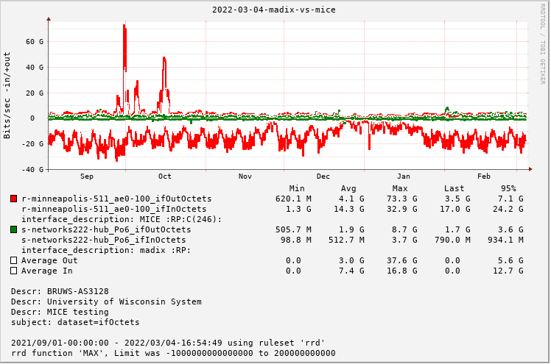
2019 slide 6: Given the relative importance of madIX compared to other exchanges like MICE, we didn't place an MX router at 222 for madIX [https://kb.wisc.edu/ns/6636].
https://stats.uwsys.net/cgi-bin/shorten.fcgi?i=6118&c=f58408762fcb772c

Slide 8
* Private Cloud
“private” cloud extension via Internet2 [2019 deck slide 36]
Seemed like a good idea at the time: lower egress fees from cloud providers, but most people want to IPSEC anyway [$$$] and the cloud provider charges you a fixed rate per Mbps per hour whether use it or not for private interconnects.
Exceptionally limited use cases: research computing hack workaround

Slide 9
Operational updates
Definitions from Oxford Languages
“fall guy”
noun
INFORMAL, NORTH AMERICAN
a scapegoat.
"he contends that he is innocent, that he was set up as a fall guy"

Slide 10
Strict filtering of [most] internet peers based on IRR data. prefix and as-path via in house automation {BGPQ3 + perl}.
Exceptions: peers with > 20k prefixes.
BGP graceful shutdown: you send 65535:0, I set localpref=0
Localpref=0 for planned maint: more graceful than just yanking a route
Our new OOB network combines LTE with Ciena Way Side Channel [WSC] management network OSPF links. BGP boundaries between OOB private ASN and production. POTS is gone. Very nice to have multihomed > 9600 baud during router reboots.
Support for trusting DSCP markings for VPNs or global table

Slide 11
Major EVPN issues from Jan 2020 to March 2021. JunOS 20.4 looking better
Solid Optics [3rd party provider] issues
3rd party pluggables save $$$, but no tech support from Juniper
Issues mostly with 100G SR4 in MX10003, mostly at deployment, although some refuse to link after linecard reset/reboot. Thankfully latter has been remotely fixable by setting/unsetting software loopbacks
Further lab testing between SO, other third party options and official Juniper parts proposed
ospf rLFA deployment failures
Remote Loop Free Alternate is supposed to speed IGP convergence during topology change.
Instead in JunOS 18.x it appeared to cause 80s+ delay [at times] in IGP convergence and major outages during topology changes.
JTAC case on 18.X failed; got the standard “you should upgrade” response
Rolled back the change, decided to wait until we are on IS-IS SR

Slide 12
uwsysnet.slack.com
uwsysnet.slack.com
uwsysnet.slack.com
ARIN shut down their IRR services for folks that have not signed the LRSA. We migrated to the merit.edu RADB for purposes of IRR. No RPKI for you.
We had that strange Google outage via MICE in late fall 2021. On the plus side, uwsysnet.slack.com has been invaluable.

Slide 13
NTP - “I don’t have time for this now”.
Late March 2022 UW Madison NTP server event/failure took out two service addresses
affected/noticed: UW Whitewater, UW Parkside, UW River Falls, ?
Does anyone besides Madison and Whitewater operate a stratum 1?
Should AS3128 be operating client facing NTP service?
Operating stratum 1 quorum as AS3128 = $$
All AS3128 compute is currently VM only and in Madison and Milwaukee. Ideally we’d have something non VM based in MSN, MKE, EC.
Raspberry PI as stratum2/3? Could blend existing as3128 “local” sources and internet sources, maybe operate one stratum-1 clock in the EC region?

Slide 14
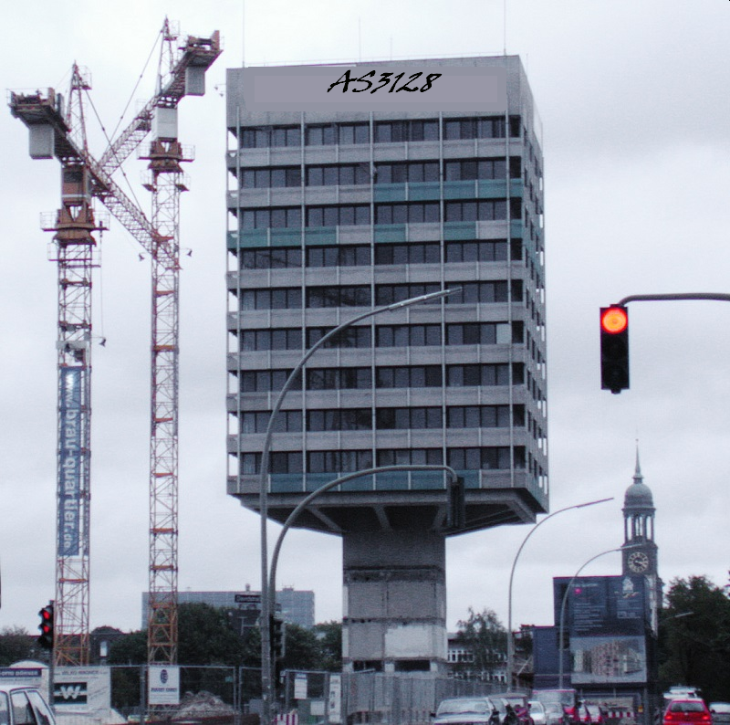
AS3128 layer2+ architecture going forward

Slide 15
BGP > STP
Decommissioning STP/VRRP in favor of BGP whenever possible.
1x100G interconnects between 4 year PEs wanted
sysnet2020 migrations for VRRP campuses were more complex and disruptive than BGP based. Complex config = mistakes, mistakes + layer2 redundancy = loops
PaloAlto firewall migration to BGP since 2020: Platteville, Parkside, Oshkosh. {special thanks to Dan Dargel @ UW Platteville for providing co-design/testing/assisting other campuses)
If you aren’t running BGP to AS3128, let’s talk

Slide 16
Port count and other issues on MX204
On MX204 1G costs the same as 10G. 1G has caveats [1G LACP officially unsupported, auto negotiation issues]
MX104s have 30 physical interfaces [20x1, 10x10].
Typical MX204 deployment has 18 physical interfaces [2x100 + 16x10]. 2x100 + 2x40 + 8x10 ‘possible’, but requires consolidation.
We are using 3750X for 8/5 support ports to save MX204 ports
Some consolidate VPN services to save ports. Some combine global and VPN services to enable 40G handoffs {QOS recommended}

Slide 17
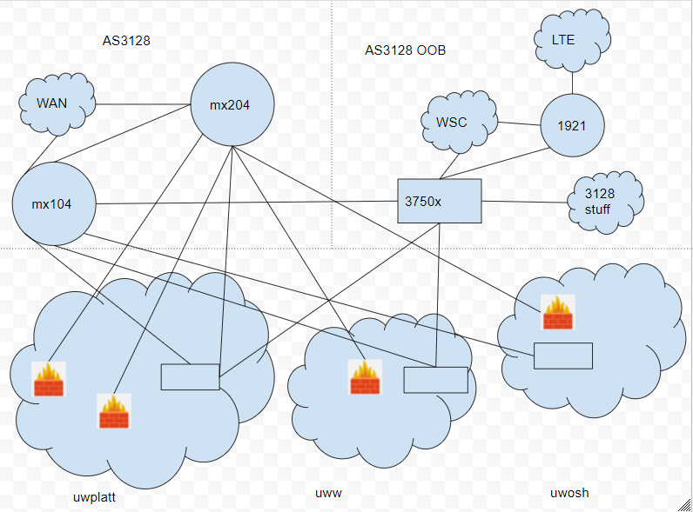
UW Platteville still has their MX104s
Separate ports per service. Clear delineation, extra $.

Slide 18
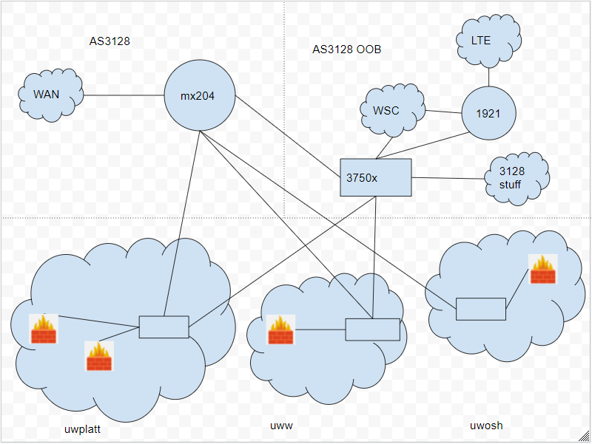
Consolidating allows us to pull the MX104s.
Campuses already have switches.
AS3128, not really

Slide 19
Which path do we go?
r-uwgreenbay-is-2 mx204 deployment due to 13x10G branch campus aggregation.
Mx204, maybe not $$$ but still $.
Personal opinion: in most cases, campuses should invest in switching as it has more utility than AS3128 buying more routers

Slide 21
DoS
We had a call on 2022/04/07 => https://stats.uwsys.net/other/2022-04-07-ddos/
I’ve done some lab testing with traffic generator and our current configs. Some changes may be warranted re: scalability at small packet sizes and high PPS rates.

Slide 22
DoS Results
The longer a juniper filter is in # of terms, the lower the pps rate.
Our current ASBR antispoof-in filtering stance is not line rate below 128 byte packets. 67% line rate at 64 byte packets. IMIX is ~400 bytes. Is it OK to be less than line rate during extreme events? TCP should back off, UDP is presumably the problem.
Removing the TCP SYN and UDP fragment "per UW" rules from antispoof-in lowers term count from 65 to 39. Roughly 84% of line rate at 64 byte
Adding 20 flowspec rules = 9% drop in line rate performance. Disclaimer; in the lab flowspec is NOT optimized and runs on all interfaces. In production, it runs only on untrusted interfaces.

Slide 23
DoS Recommendations
It is unsustainable to keep adding "per UW" knobs at the ASBRs.
Many flowspec rules on the ASBR seems to be a bad idea. Alternatives may be
Running flowspec rule on a PE but not leaking to ASBR
A non flowspec managed single ACL term with multiple CIDR matches would be more performant but less granular.
UW specific flowspec should probably be reserved for active mitigation/redirection, not "always on" nuisance filtering
To improve performance Flowspec runs on only untrusted ingress interfaces => https://kb.wisc.edu/uwsysnet/54311
Someone else needs to decide if a reduction in pps at the core is OK if it solves problems for campuses. For example {I think} Dan Dargel indicated a dshield top 20 block reduced their firewall session count by 40%.

Slide 24
DoS Recommendations, continued
I redeployed the SYN policer. The ASBRs do a first pass of DoS filtering on ingress with less terms. Mark on ASBRs as discard eligible dscp=1. A second pass on the PEs at egress handoff to campus. Maintains some of the benefits of per UW policing but with distributed work.
Goal is to redeploy fragment protection in the same way.
Exceptions to consolidation:
143.235/16 [its on all the PEs].
If we can’t trust DSCP on leased circuits, those campuses would also have to be an exception. Currently the only wildcard is BadgerNet and no campus is fully dependent on BadgerNet at this point.

Slide 25
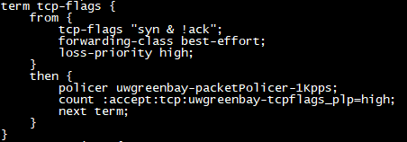
DoS results, continued {example}
ASBR ingress
PE egress

Slide 26
* DoS results, continued
Of those 39 remaining terms,
+1: block bogons
+2: reset QoS and allow for “by IP” prioritization of internet source IPs. These could be removed if we gave up that feature
+8: ssdp/ntp/chargen/redirects/Memcached protection. I reduced to by removing the bypass for port 53. DNS will retry.
+2: as3128 spoofing/control plane protection
+4: dns fragment protection bypass
+2 the shared replacements for fragment protection and syn protection
+19: category counters: 3 proto [icmp|udp|tcp], 7 tcp flags, 1 ‘all’, 5 packet size categories, 3 apps [udp rpc, fragment, tcp dns]. I moved the 3 proto to flow based processing and removed a few others
+1 final accept clause

Slide 27
* DoS results, continued
-2: Ssdp/Memcached
removed the bypass for port 53. DNS will retry.
-7 proto [icmp|udp|tcp], 1 ‘all’, 3 apps [udp rpc, fragment, tcp dns]
Augmented flow tracker to get these stats in a “good enough” fashion.
Tcp flags, packet size: no good solution, flow data not granular enough

Slide 28
Monitoring Improvements

Slide 29
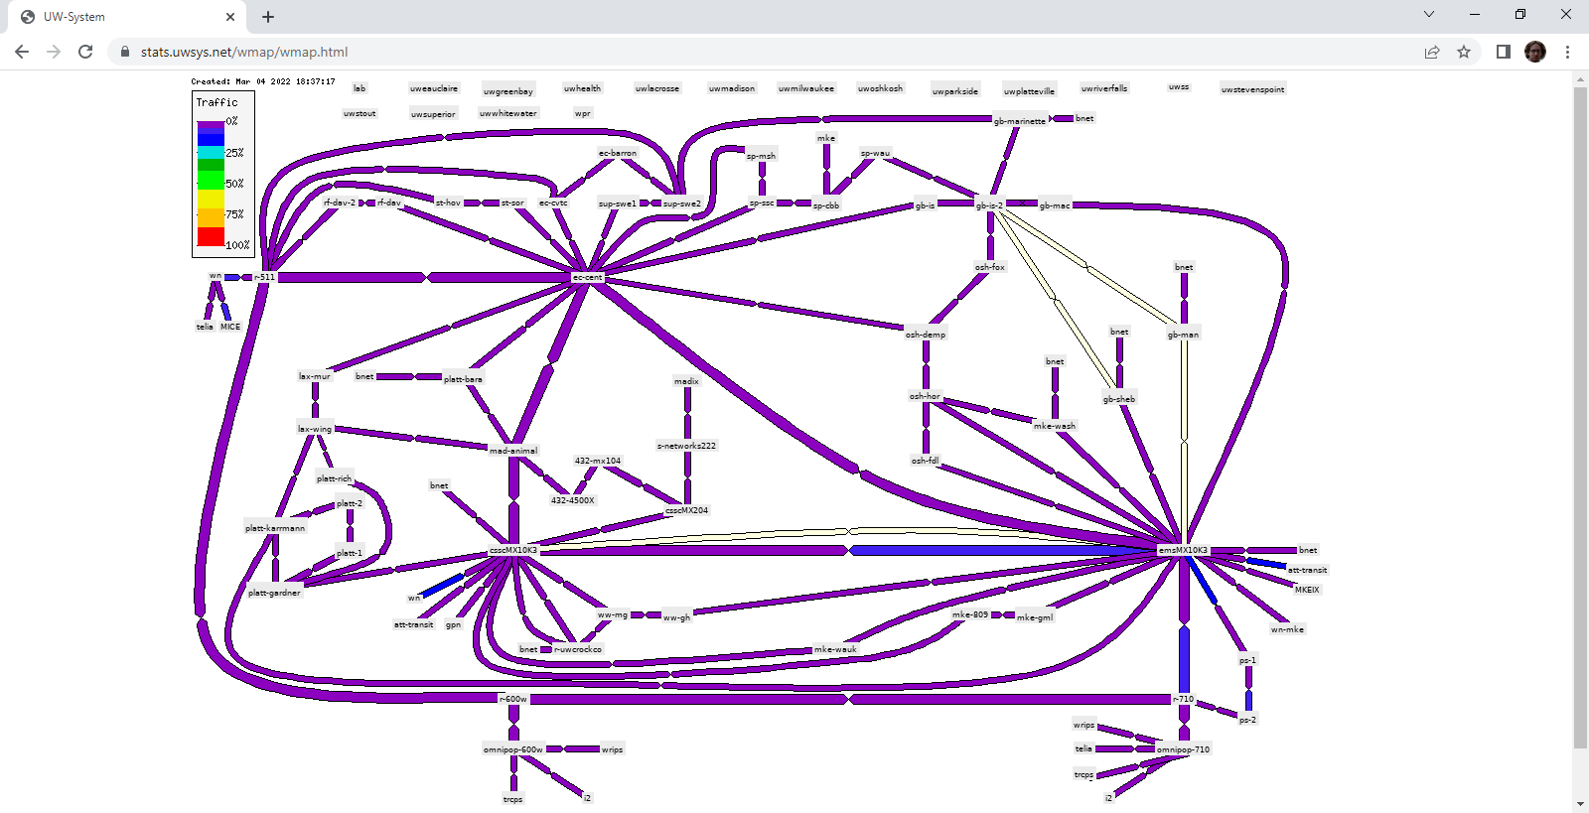
per sitecode and per device automation for netmap => https://kb.wisc.edu/uwsysnet/110581

Slide 30
Things monitored
sysnet2020 deployed DC battery plants… nearly everywhere
SNMP monitoring for stats, emails for events
Forward Error Correction [FEC] and Physical Coding Sublayer [PCS] collection via screen scraping from Juniper gear. See ‘ifErrors’ before they happen.
FEC
https://stats.uwsys.net/cgi-bin/shorten.fcgi?i=6119&c=312d7c7e2267cdf7
https://stats.net.wisc.edu/cgi-bin/rrd_reports.cgi?report=jnx-xml-FEC
PCS
https://stats.net.wisc.edu/cgi-bin/rrd_reports.cgi?report=jnx-xml-PCS
https://stats.uwsys.net/cgi-bin/shorten.fcgi?i=6120&c=29d60f07685988b7

Slide 31
Escalations and managing complexity
Campuses have multiple locations, redundancy models, services, and sometimes multiple institutions are receiving service at a location (such as DR reciprocity agreements).
Engineers have found value documenting how various connections form service redundancy groups, because things are getting complicated
As we have added checks and alarms, the turbulence on the main FIDO page grows. Not everyone wants to see the details on every last thing that happens with respect to the main FIDO display.

Slide 32
Fido_sla.fcgi. What it is
https://fido.uwsys.net/cgi-bin/fido_sla.fcgi
Tracks ifOperStatus, BGP and l2circuit status for “interesting” interfaces and subinterfaces
Groups subinterfaces into service/redundancy groups based on operator defined YAML
Overall summary, current impacted items, quick links and summaries per sitecode/connector/UW
A different view of existing polling [FIDO framework]. FIDO main view focuses on showing what's broken whereas this focuses on showing what’s known by us and how they are related to each other.

Slide 33
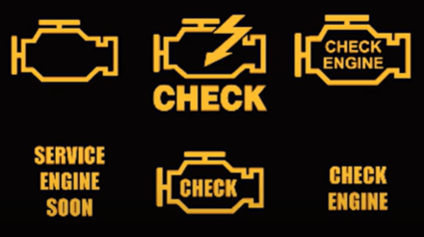
Fido_sla.fcgi. What it is not
It is not a FIDO replacement and is not expected to show every incident. It is less detailed by design.
To avoid complexity correlates/organizes events by configured redundancy groups, so display might appear ‘noisy’ when something happens.

Slide 34
Ideas I have
Connection tags anchored to subinterfaces. Service tag is a logical grouping of connection tags. Enables handling differentiation for service degradation vs outage. Tags as an anchor for attributes such as “service level”, escalation hold down, KB files, etc
“Service level” ideas: 24x7 phone, 8x5 phone, electronic {email?}, none.
Categorize connection/service response levels in tandem with each UW and annotate which contacts are valid for which level of escalation.
Suggestion: email escalation to list managed by each campus so staleness of our data is less of a factor?

Slide 35
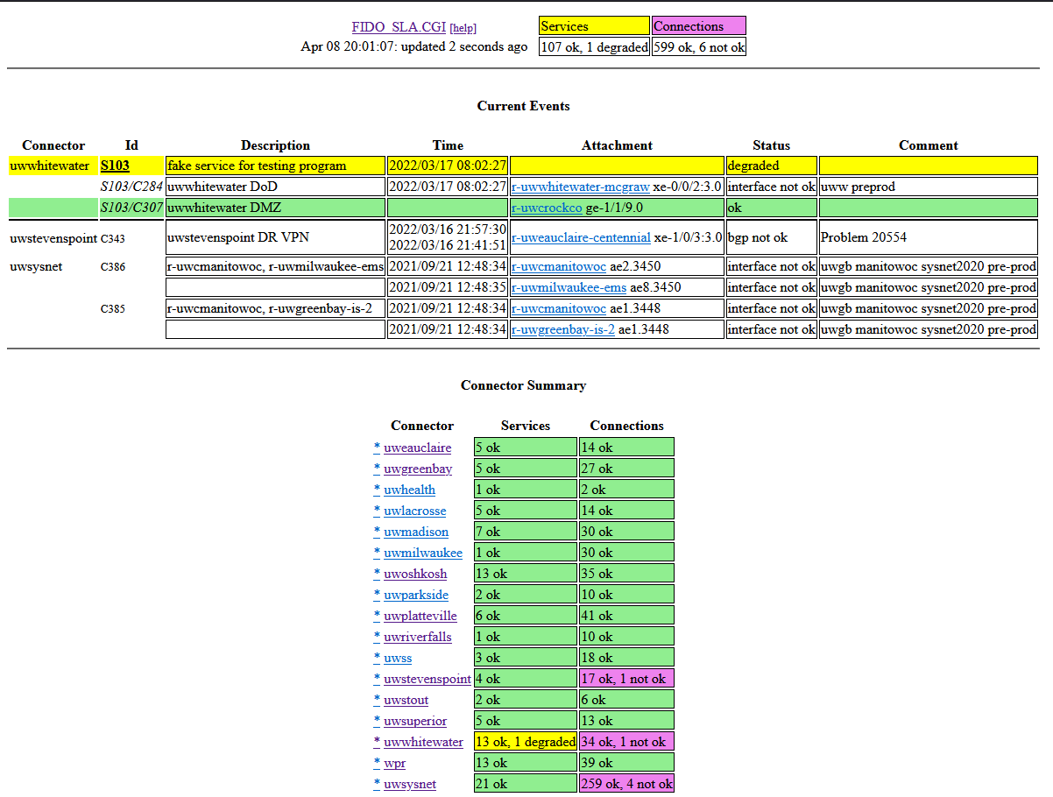
Is this interesting at all? Anyone want to give it a shot?

Slide 36
Escalation Qs
Is phone/email still what’s expected or have times changed?
But we cannot realistically support 13 different choices [UW A wants twitter, UW B wants ms-teams, UW C wants Slack, UW D wants TikTok, etc etc], but if there was a common agreed upon electronic alternative to email, I think we should consider it.

Slide 39
UW Madison (AS59)
AS59 commodity border
2x2x200 to AS3128
madIX uses AS59 IX addressing, but is no longer connected to AS59
Simplification of AS59 upstream peering: less redundant peering = simplified operations
AS59 research/HTC border
2x2x200 to Chicago
Peering with Internet2, ESNet and a few legacy B1G peers
Discrete research border means less risk for 400G migration and less risk for “normal” internet traffic
Unusual challenges
icecube cloud compute via “private” cloud
periodic bursts to 70Gbps to commodity cloud providers = traffic engineering woes

Slide 40
This was AS59 to Google

Slide 41
