Slide 1
IT as a Service (ITaaS)
Network Meeting – May 2022

Slide 2
IT as a Service - Vision
Commoditize and Optimize the Common Core
Isolated Model
Unified Model
Institution 1
Institution N
Institution 1
Institution N
…
Retains
Full control
Mission-Focused IT
Mission-Focused IT
Mission-Focused IT
Mission-Focused IT
…
Duplicated
Hardware
Licensing
Management
Labor
Overhead
Optimized
Hardware
Licensing
Management
Labor
Overhead
Core IT Operations
Core IT Operations
Core IT Operations
Foundational IT
Foundational IT
Foundational IT

Slide 3
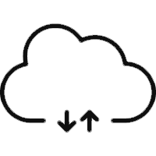
ITaaS Service Portfolio
IT Services that serve the missions of the university by strategically enabling teaching, research, and public service
Mission Focused IT
There is differentiation of academic programs across the institutions, and local flexibility is needed to support those differences.
Core IT Operations
Core IT Service offerings to support common collaboration, security and productivity required by all institutions
Commodity IT services can be delivered by a unified team, composed of existing institutional staff, that combines for benefits of shared knowledge and scale with the benefits of close local customer connection.
Foundational IT
Scalable infrastructure services and platforms to power enterprise applications, access and integration across the System
Foundational infrastructure services are not differentiating but must be high quality and cost effective. To avoid unnecessary duplication, leverage UW-Madison services to achieve further scale and increased quality while ensuring existing services are not harmed.

Slide 4
ITaaS Service Portfolio
Academic and Research Computing Services
Teaching and Learning Services
Custom Application Development Services
Mission Focused IT
Decision Support Services
Local Campus IT
Academic Lifecycle and SIS Services
Campus Operations Applications
IT Professional Services and Consulting
Workplace Services
Future Options
IT Service Desk Services
End-User Compute Lifecycle Management
Initial Focus
Collaboration Services
Core IT Operations
Unified Team at UWSA
Server and Database Administration Services
Security Services
Wireless and Local Area Network (LAN) Services
Foundational IT
Enterprise Application and Platform Services
Integration Platform Services
UW-Madison Partnered Services
Common Identity and Access Management Services
Infrastructure Services (VMWare Hosts, Storage, Backup)

Slide 5
ITaaS Guiding Principles
Integrity – We act honestly and transparently.
Respect – We treat everyone with respect, cultivate an inclusive and constructive environment for all, and always assume good intent.
Growth Mindset – We strive for excellence by empowering our staff to design the best solutions, continually improving along the way.
Our Customers – We exist to serve and protect our customers. Our goal is to consistently deliver superior outcomes and make a difference for our customers.

Slide 6
IT as a Service - SLA Structure
ITaaS SLA
Establishes the high-level relationship between the Provider (UWSA) and the Customer (campus). Creates a standard service methodology across all ITaaS services. Topics covered include:
Subscribed Services
Customer-specific Pricing and Billing
Service Management
Incident Management
Service Requests
Prioritization
Service Support Metrics
Service Uptime and Availability
Service Roadmap
Change Management
Relationship Management
Escalation
Accountability of Actions
Service Performance
Terms of Agreement
Service Exit
Appendices
Each service covered in the SLA has its own service definition attached as an appendix to the main agreement. Each appendix covers the following topics:
Service Description
What’s Included
General Pricing and Billing
Related Services
Service Level Targets
Service Notes
Roles and Responsibilities
Appendix A
Systems & Engineering as a Service (SaaS)
Appendix B
PeopleSoft as a Service (PSaaS)
Appendix C
Incident Response as a Service (IR)
Appendix D
Monitoring, Detection and Response (MDR)
Appendix E
PeopleSoft Development as a Service
Appendix F
ITSM Platform as a Service

Slide 7
Service Offerings, Status, and Participation
SLA | Service | Status | Owner | MSN | MIL | EAU | GBY | LAC | OSH | PKS | PLT | RVF | STP | STO | SUP | WTW | UWSA
IT as a Service | Systems & Engineering as a Service | Live | Chris Spadanuda
 | PeopleSoft Administration as a Service | Live | Adam Paulick
 | Security Incident Response | Live | Jeff Harrison
 | Security Monitoring, Detection, and Response | Live | Jeff Harrison
 | PeopleSoft Development | Live | Ty Letto
 | IT Service Management Platform | Live | Stacy Scholtka
 | Network as a Service | Under Development | TBD
 | Threat Intelligence | Under Development | Jeff Harrison
 | Vulnerability Management | Under Development | Jeff Harrison
Enterprise Directions Council | Digital Learning Environment | Live | Renee Pfeifer-Luckett
 | Integration Platform (Informatica) | Live | Lisa Bender
 | Web Conferencing (Zoom) | Live | Stacy Scholtka
 | Workflow Platform (BP Logix) | Live | Lisa Bender
 | SysNet (Wide Area Network) | Live | Mike Schlicht
 | Enterprise Analytics Platform | Under Development | TBD
 |  |  |  | Legend |  |  | In Use
 |  |  |  |  |  |  | Under Development
 |  |  |  |  |  |  | Early Interest
 |  |  |  |  |  |  | In Partnership With

Slide 8
Systems and Engineering as a Service (SaaS)
Server Administration
Provide virtual infrastructure, hosting of VM's, backup, monitoring, security, compliance
Identity and Access Management
Manage Active Directory and associated identity systems and technology processes
Microsoft 365 and Azure
Manage collaboration suite and Azure workloads

Slide 9
Goals
Provide value to campuses through the benefit of shared knowledge and infrastructure
Provide full support and management of common systems
Standardize and document common processes
Identify opportunities to expand efficiencies and improve services
Meet internal audit requirements and UW System Administration Information Security Policies
Gain efficiences of scale

Slide 10
Today
Waiting on hardware delivery
Completing detailed discoveries
Planning and designing architecture
Mitigating technical debt
Developing standard operating procedures
Supporting current environments

Slide 11
Monitoring, Alerting, Inventory- SolarWinds
Monitor Infrastructure and applications on multiple domains.
Interface with CMDB for Inventory
Configuration management for easy view of changes
Alerting: email, scripts, API’s, escalation
Grouping: Ability to group monitored resources for reporting, dashboards, and alerting.

Slide 12
Patch Management - Ivanti
Windows and Linux patching
Reporting
Ability to run tasks remotely
Automated scheduling
Roll back and exclusions

Slide 13
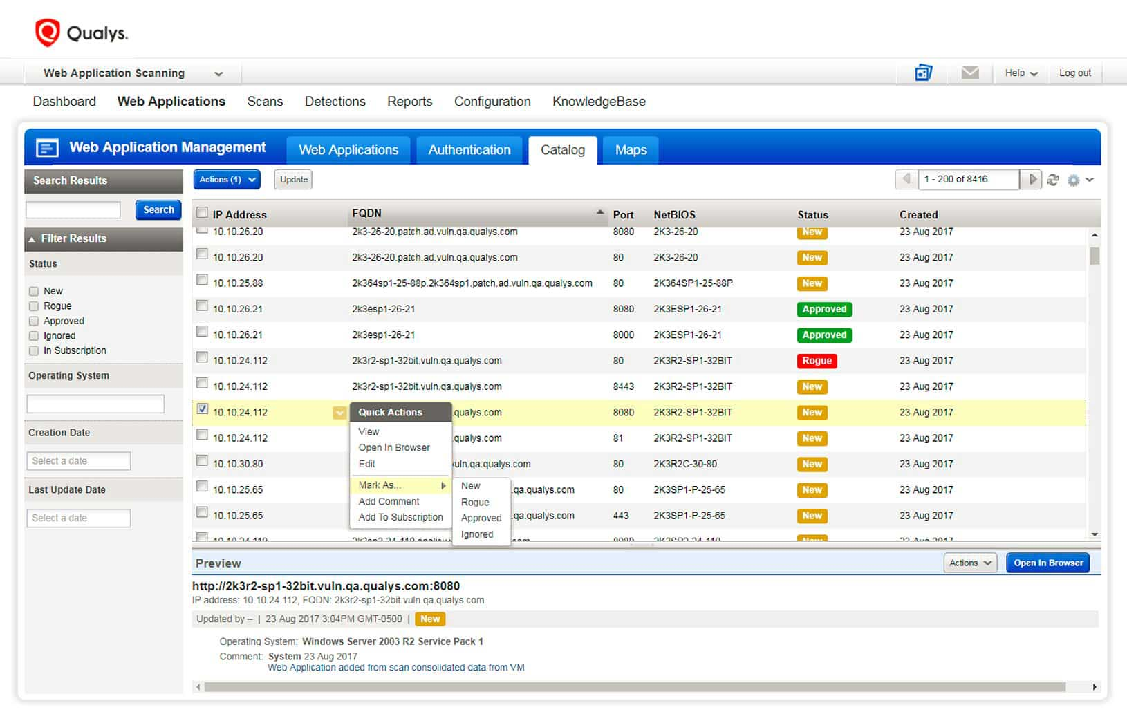
Vulnerability Scanning - Qualys
Discover and assess vulnerabilities in real time
Prioritization of vulnerabilities
Reporting
Combined efforts of SEaaS and Security teams

Slide 14
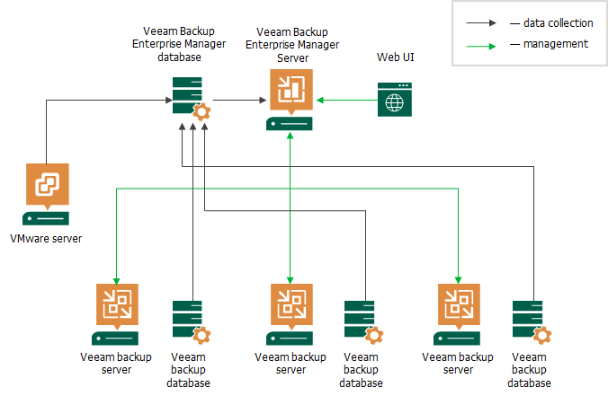
Backup & Disaster Recovery - Veeam
Virtual machine backup and restore
Virtual machine replication to alternate datacenter
Data stored in multiple locations
Backup and DR testing, meeting audit requirements
Options available for on-prem server backups

Slide 15
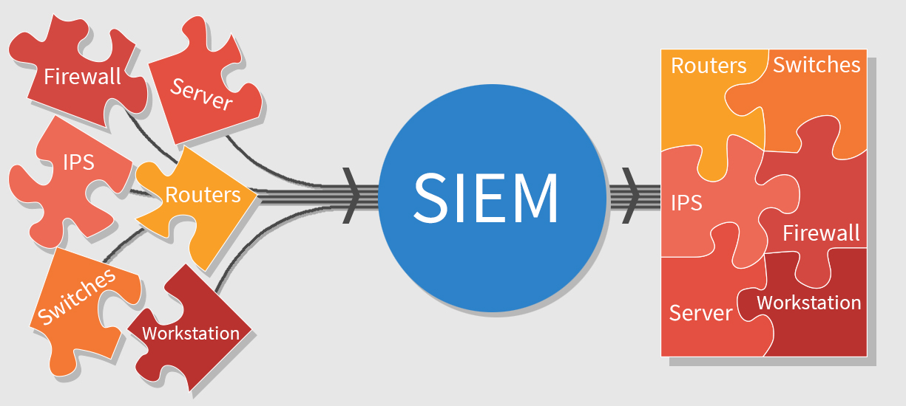
Logging and Security Analytics

Slide 16
Identity Management

Slide 17
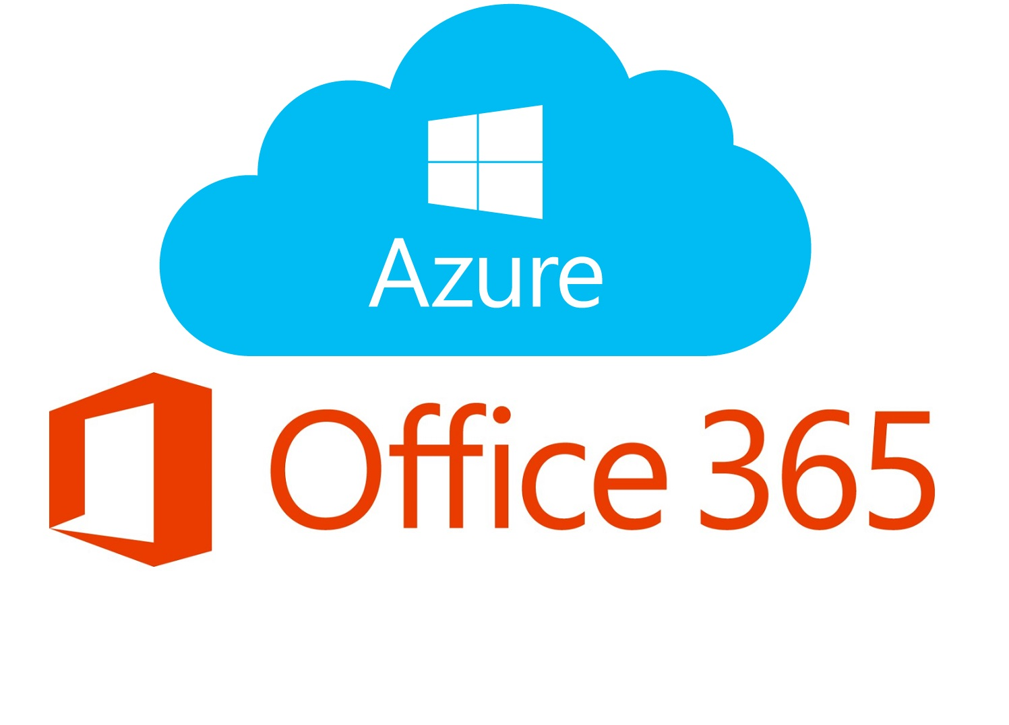
Office 365 & Azure
Management and support of Office 365
Management and support of Azure
Security Posture

Slide 18
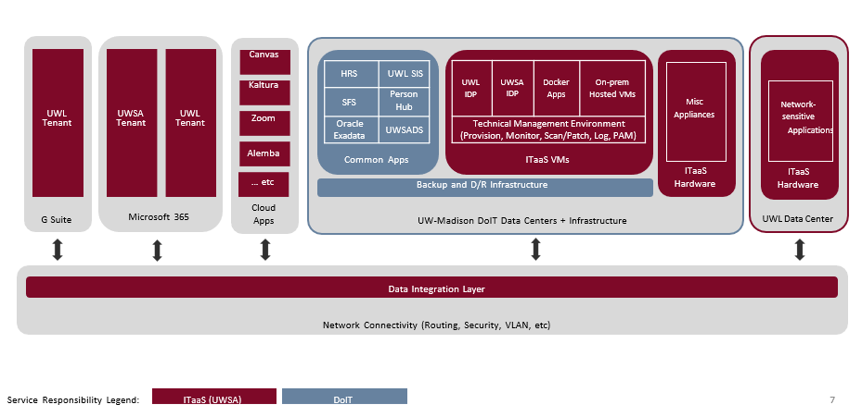
Architecture

Slide 19
ITaaS Data Center Network
Jason Nero (UWSA)
Cassidy Miles (UW-La Crosse)

Slide 20
ITaaS Data Center and Delivery Network
Need for an end-to-end network that could deliver ITaaS offerings
Collaborative effort to make this project happen
UW System Administration
UW-Madison
UW-La Crosse
SysNet
Others

Slide 21
Design Consulting Assistance
Outside consultants were leveraged to provide insight into real world practices
Capital Data provided VMware and NSX Design expertise
Capital Data also had a deep understanding of UW-Madison’s VMware environment
CDW-G will provide expertise for SD-WAN and DR / Failover network design

Slide 22
Guiding Principles
The creation of this network needed to be many things
Scalable – provide a solution that can grow as the demand increases
Flexible – solution needed to allow for different needs of each campus
Repeatable – ability to use a “template” to provide a consistent experience
Simple – reduce any unnecessary complexity wherever possible

Slide 23
Network Overview
Server and network infrastructure will be identical at DET and OneNeck data centers
UW-Madison services will be available via SysNet as needed (Oracle Exadata, Bucky, etc)
VMware tools, backup, and replication services will be provided by UW-Madison
Each Campus will have a pair of ITaaS managed routers to connect to data centers for the purpose of tunneling specific traffic.

Slide 24
Network Overview
Campus routers will provide secure method of transport via SD-WAN for access to
SMB file shares
Legacy thick client applications
Applications accessing sensitive data with no native encryption
All public services will be accessed via the Internet (not SD-WAN tunnel)
All services will use 143.235.x.x IP address space avoiding any possible address conflicts

Slide 25
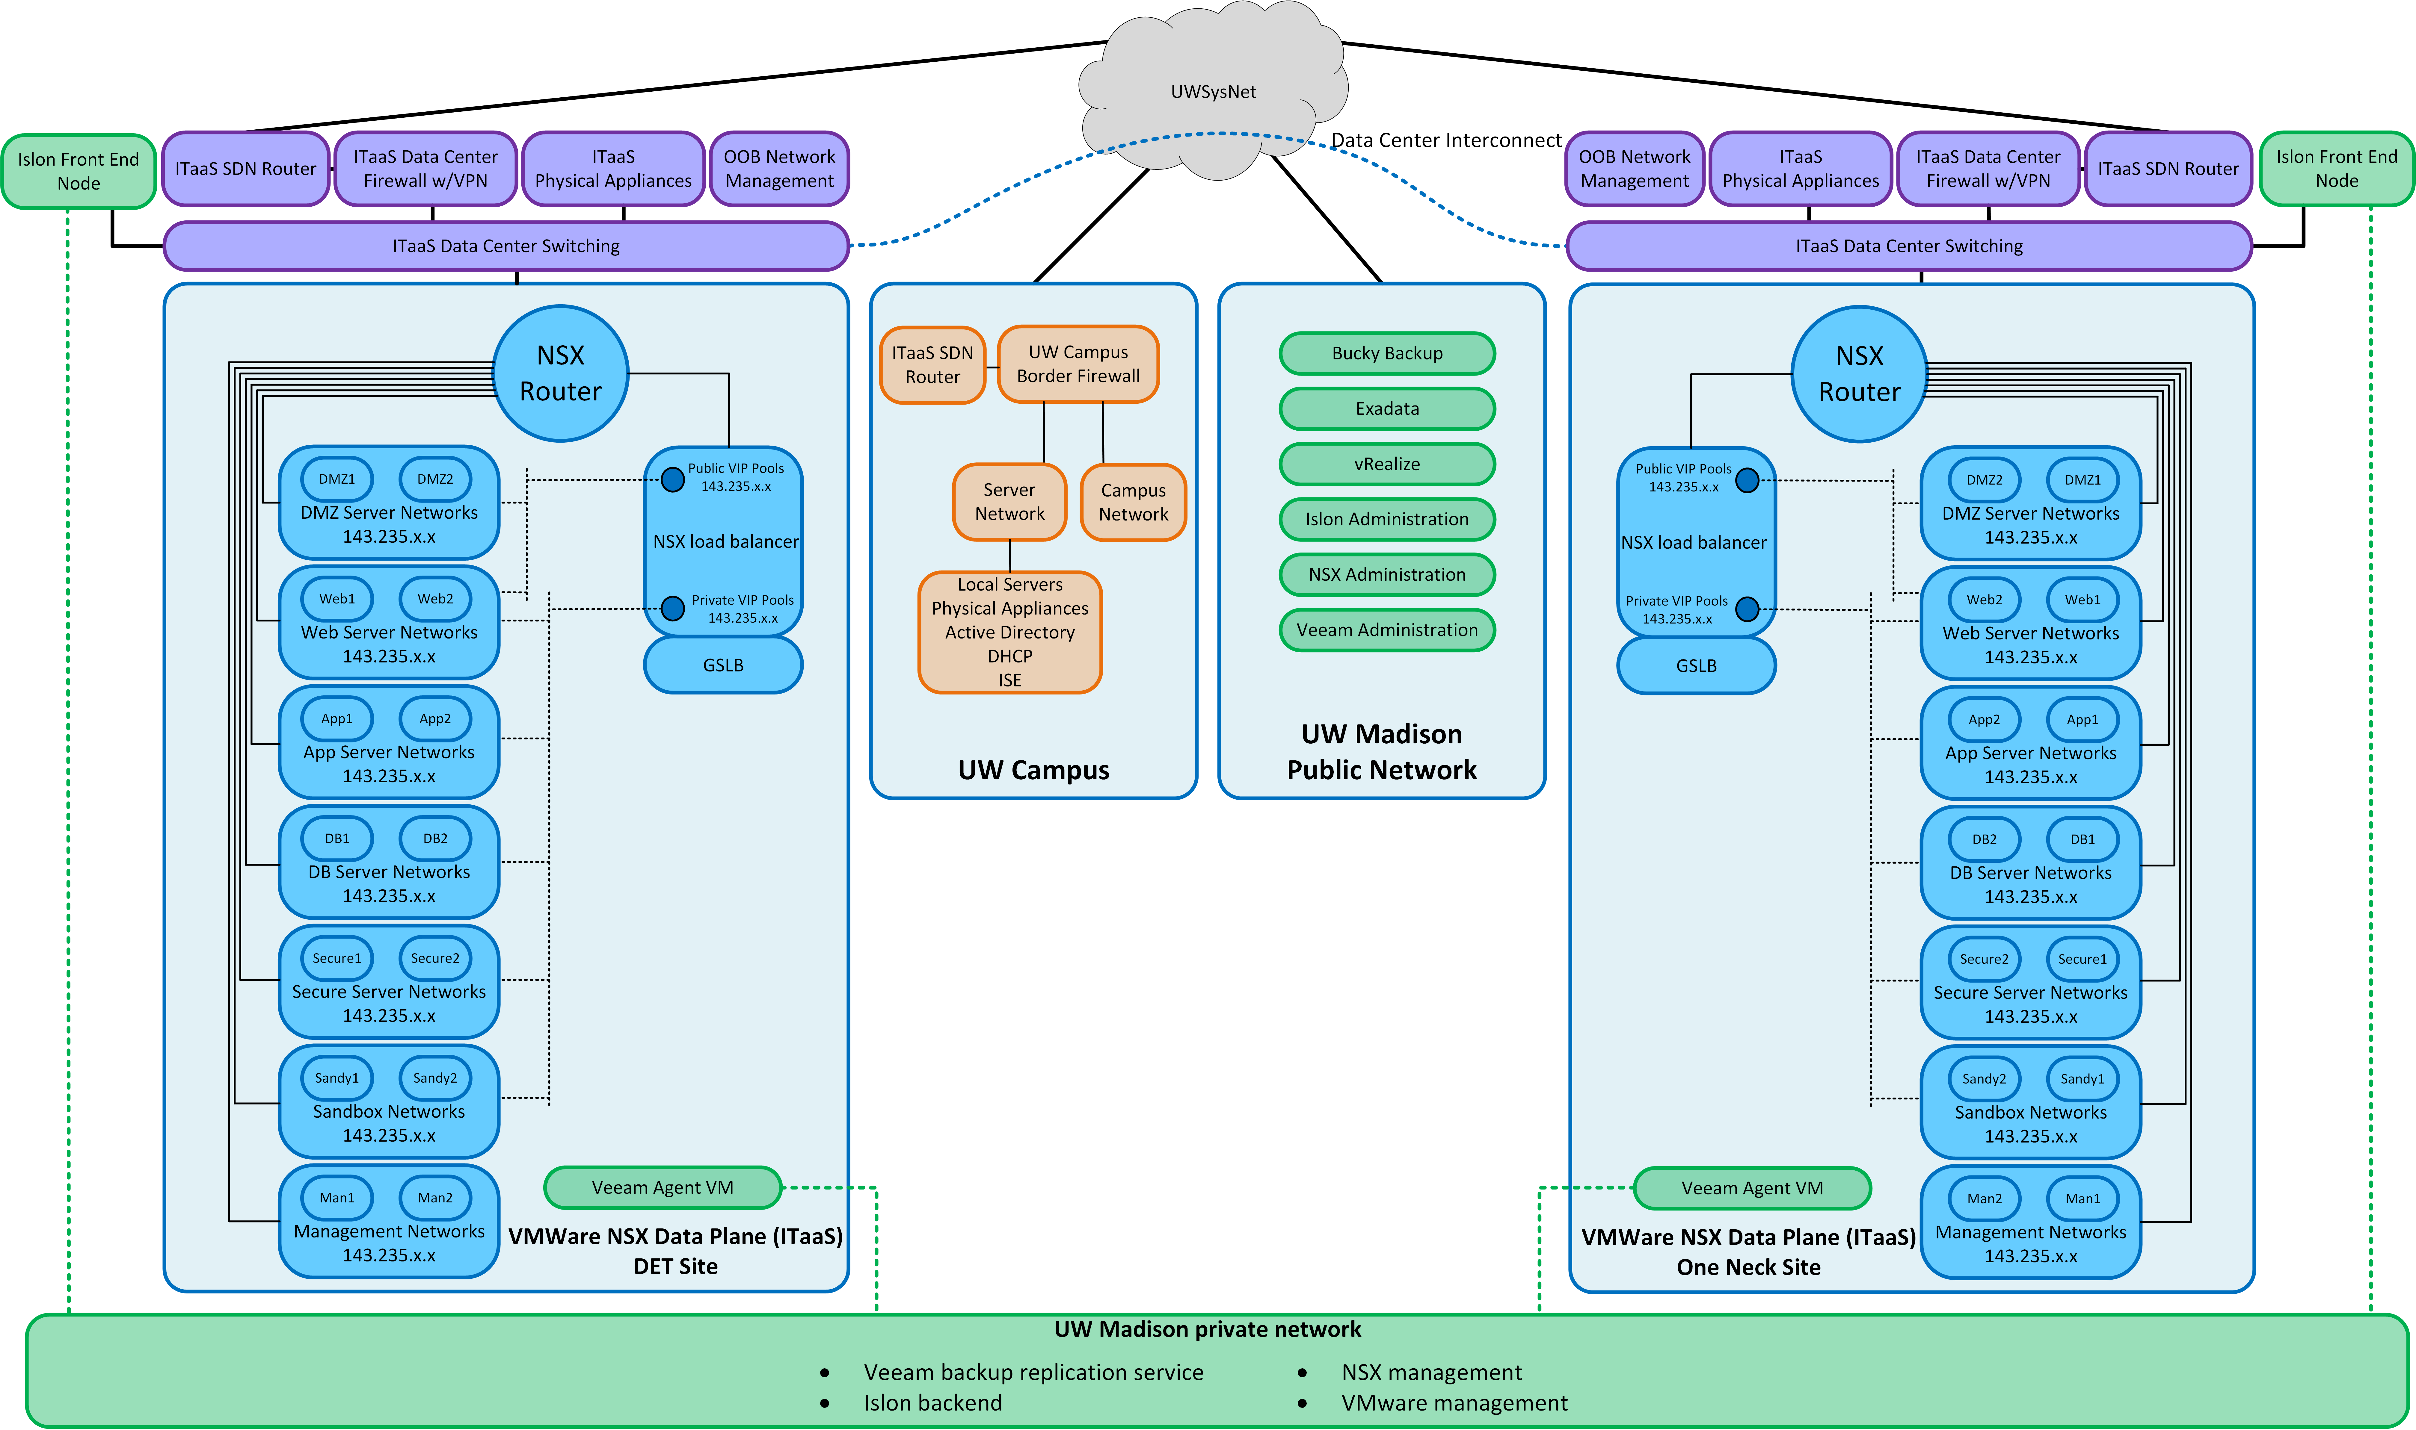

Slide 26
Network Hardware Details
Each data center will have the following network gear
A pair of Juniper MX204 routers managed by SysNet
A pair of Cisco 8500 Routers with SD-WAN at the edge
A pair of Cisco Firepower 4112 Firewalls provide North-South access control
A pair of Cisco Catalyst 9500 switches will provide connectivity for the environment

Slide 27
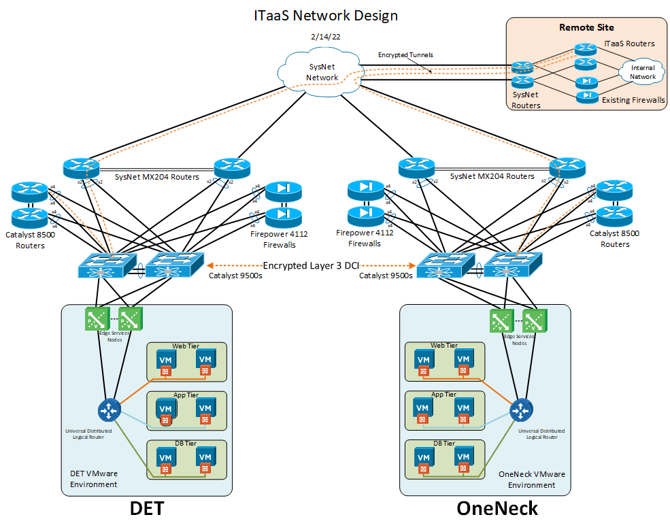

Slide 28
What Is VMware NSX-T?
NSX is a Software Defined Networking (SDN) solution for data centers
Can provide switching, routing, firewalling, load balancing, GSLB, and much more
Can provide micro-segmentation for fine grain East-West control
Can provide high availability for workloads across data centers including cloud providers

Slide 29
NSX Networking
NSX Edge services nodes are the bridge between the physical and virtual networks
Within NSX, several zones will have servers attached based upon their use
Access between zones will be controlled by the distributed firewall within NSX
Services can pass through the Avi Networks load balancer within NSX if required for HA
Server failover between sites will use Global Server Load Balancing (GSLB) within NSX

Slide 30
What Is GSLB?
GSLB by definition is the act of load balancing across distributed servers / sites
GSLB works by modifying DNS records to point to the preferred service / site
Health checks are preformed to ensure service is available
During a failure the DNS record is updated to point to the secondary service / site
Uses very short DNS TTL (5-60 seconds) to force clients to request frequently

Slide 31
Out of Band Management
Management network connectivity using Cisco 1100 series terminal services gateway
Connects management interfaces and serial console access to equipment
Remote access via SysNet and LTE as a backup
Access to these devices will be heavily restricted

Slide 32
Where Are We Today?
Waiting for server and network hardware (August - September)
Still working through details with CDW-G on DR / failover and SD-WAN design
Discussing setting up a simplified environment in UW La Crosse with existing hardware
Exploring training on NSX and SD-WAN components

Slide 33
Questions?

