Slide 1
FY22 UW System Network Fiber Update
Patrick Christian
5/25/2022

Slide 2
Fiber Topology Vision 2022

Slide 3
Fiber Topology Vision 2022

Slide 4
Fiber Topology Vision 2022

Slide 5
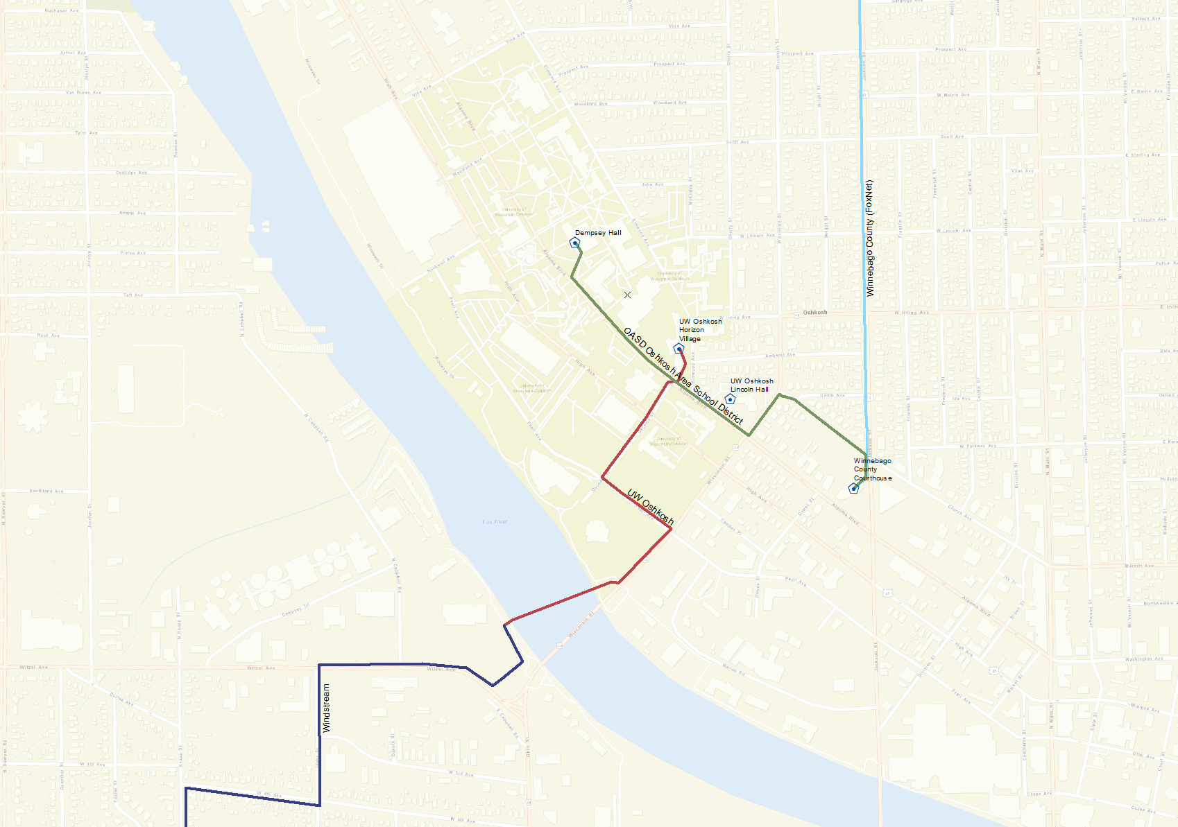
Fiber Topology Vision 2022
Notes:
Fiber crossing concern at Osceola & Algoma Blvd
Lose Windstream fiber from Oshkosh-Fond du Lac-Madison in 2029

Slide 6
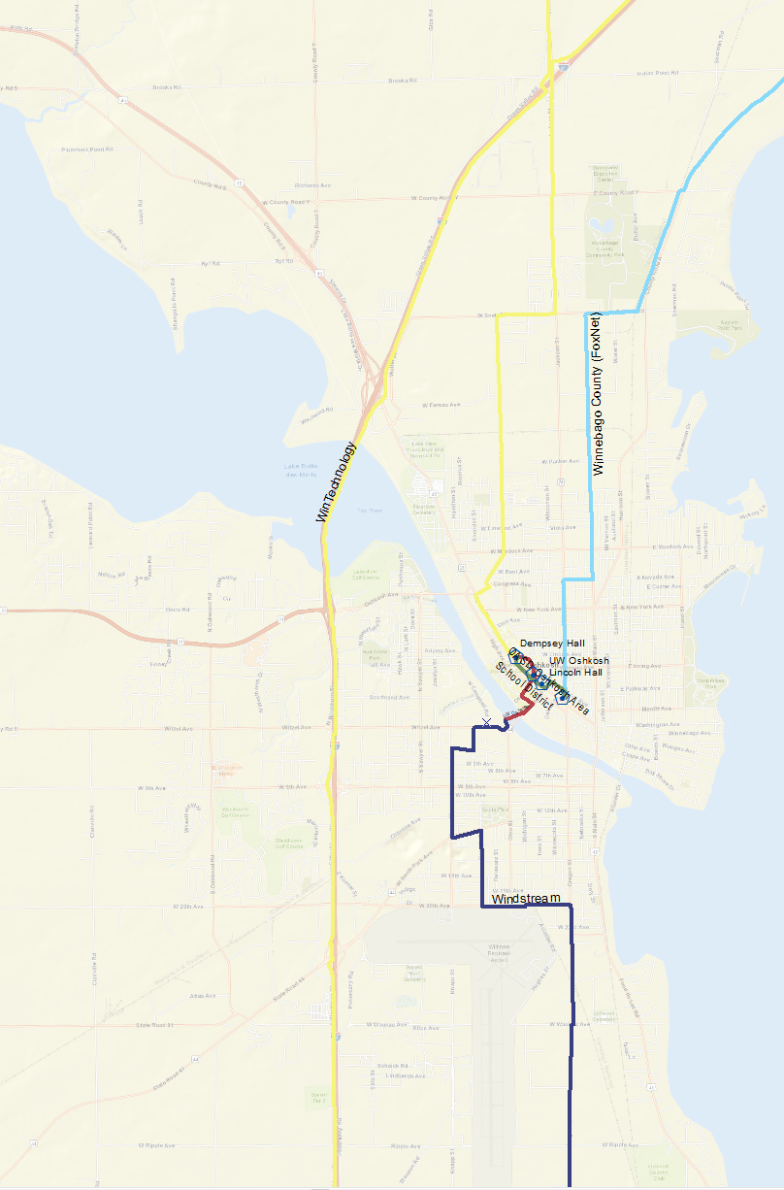
Fiber Topology Vision 2022
Notes:
Looking to diversity UWO’s northbound path from its southbound path
Plan to get on WIN fiber from Dempsey heading north to go south to Fond du Lac

Slide 7
Fiber Topology Vision 2022

Slide 8
Fiber Topology Vision 2022

Slide 9
Questions?
  patrick.christian@wisc.edu

