Slide 1
SysNet DDoS Service
Will Boettcher
Patrick Christian
Tim Czerwonka
Michael Hare
5/25/2022

Slide 2
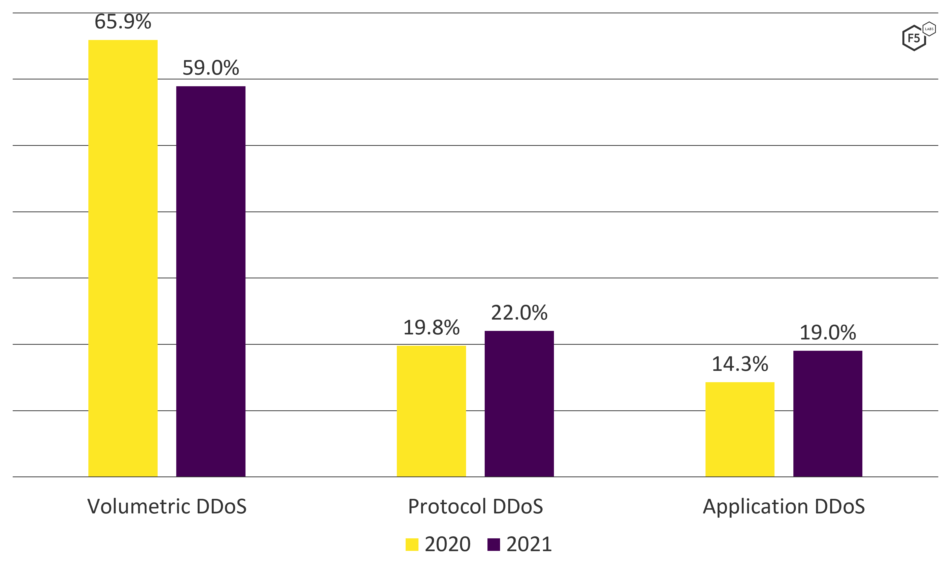
SysNet DDoS Service: Attack Types
Source: https://www.f5.com/labs/articles/threat-intelligence/2022-application-protection-report-ddos-attack-trends#:~:text=The%20overall%20number%20of%20DDoS%20attacks%20declined%203%25%20between%202020,most%20attacked%20sector%20in%202021
Notes:
* 3 main categories of DDoS attacks: Volumetric (overflow capacity), Protocol (exhaust network resources) & Application (exhaust app resources)

Slide 3
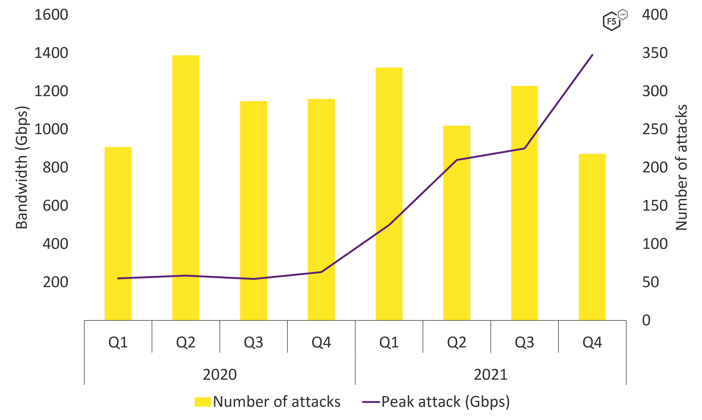
SysNet DDoS Service: Larger Attacks
Source: https://www.f5.com/labs/articles/threat-intelligence/2022-application-protection-report-ddos-attack-trends#:~:text=The%20overall%20number%20of%20DDoS%20attacks%20declined%203%25%20between%202020,most%20attacked%20sector%20in%202021
Notes:
* Mean attack size in 1Q2020 was 5Gbps & 1Q2021 is 21Gbps

Slide 4
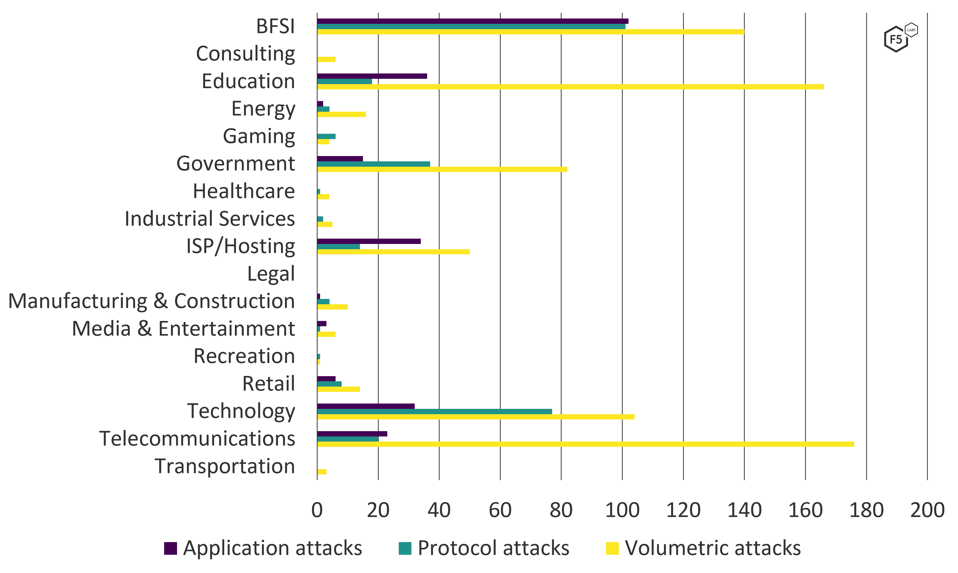
SysNet DDoS Service: Distribution
Attacks by Industry Sector
Source:F5 Threat Intelligence
Notes:
* Mean attack size in 1Q2020 was 5Gbps & 1Q2021 is 21Gbps

Slide 5
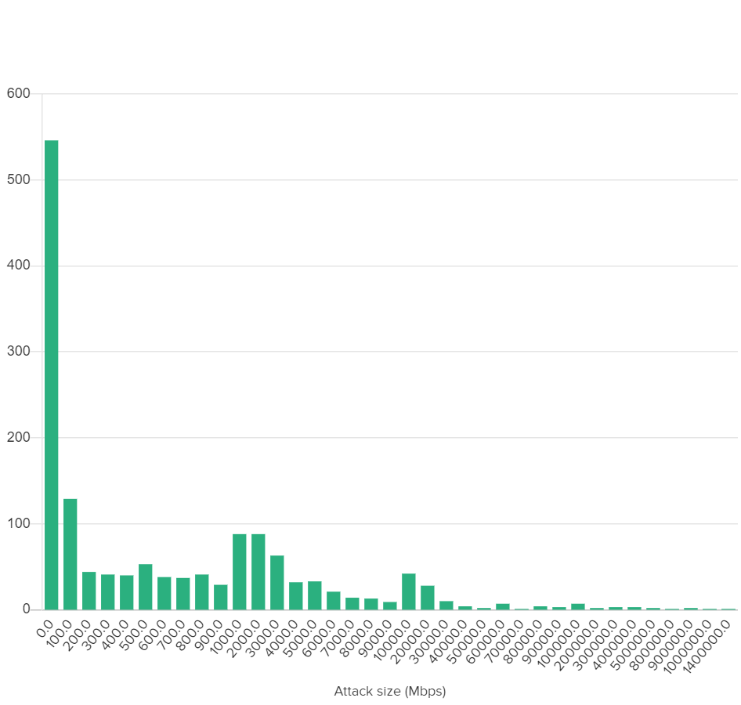
SysNet DDoS Service: Distribution
Frequency Distribution of DDoS Attacks
Source:F5 Threat Intelligence

Slide 6
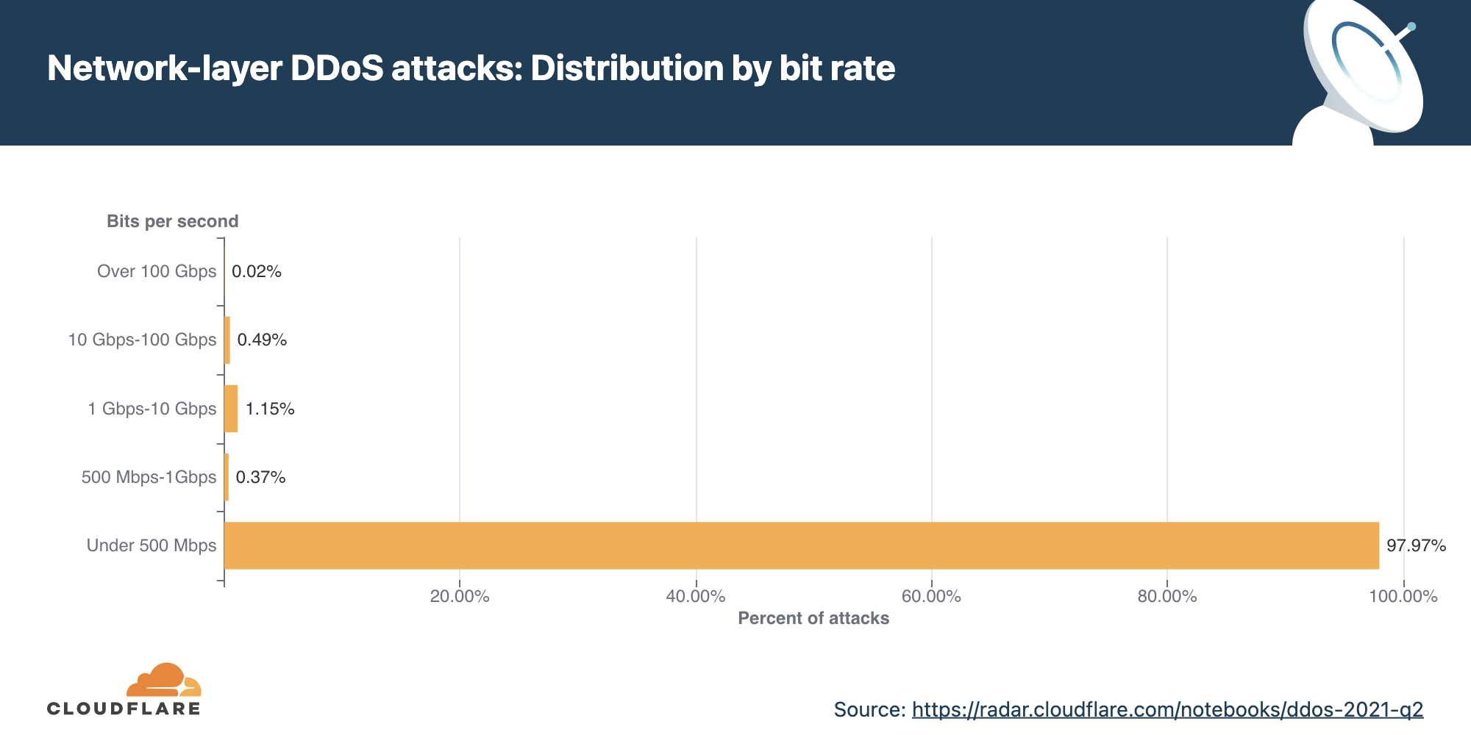
SysNet DDoS Service: Distribution

Slide 7
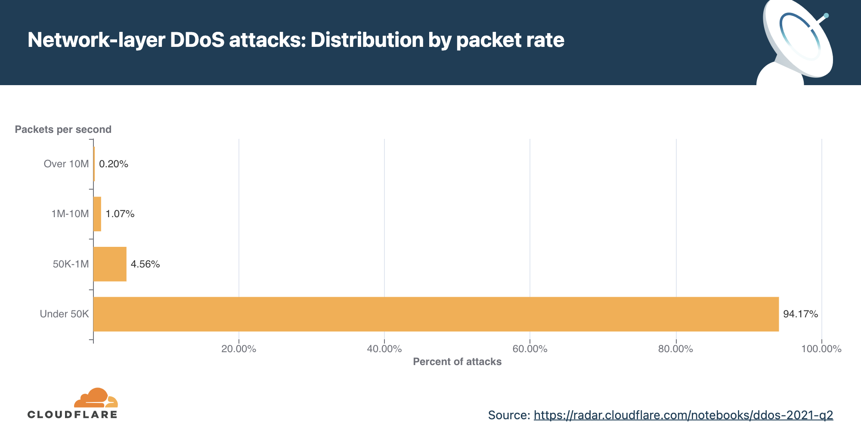
SysNet DDoS Service: Distribution

Slide 8
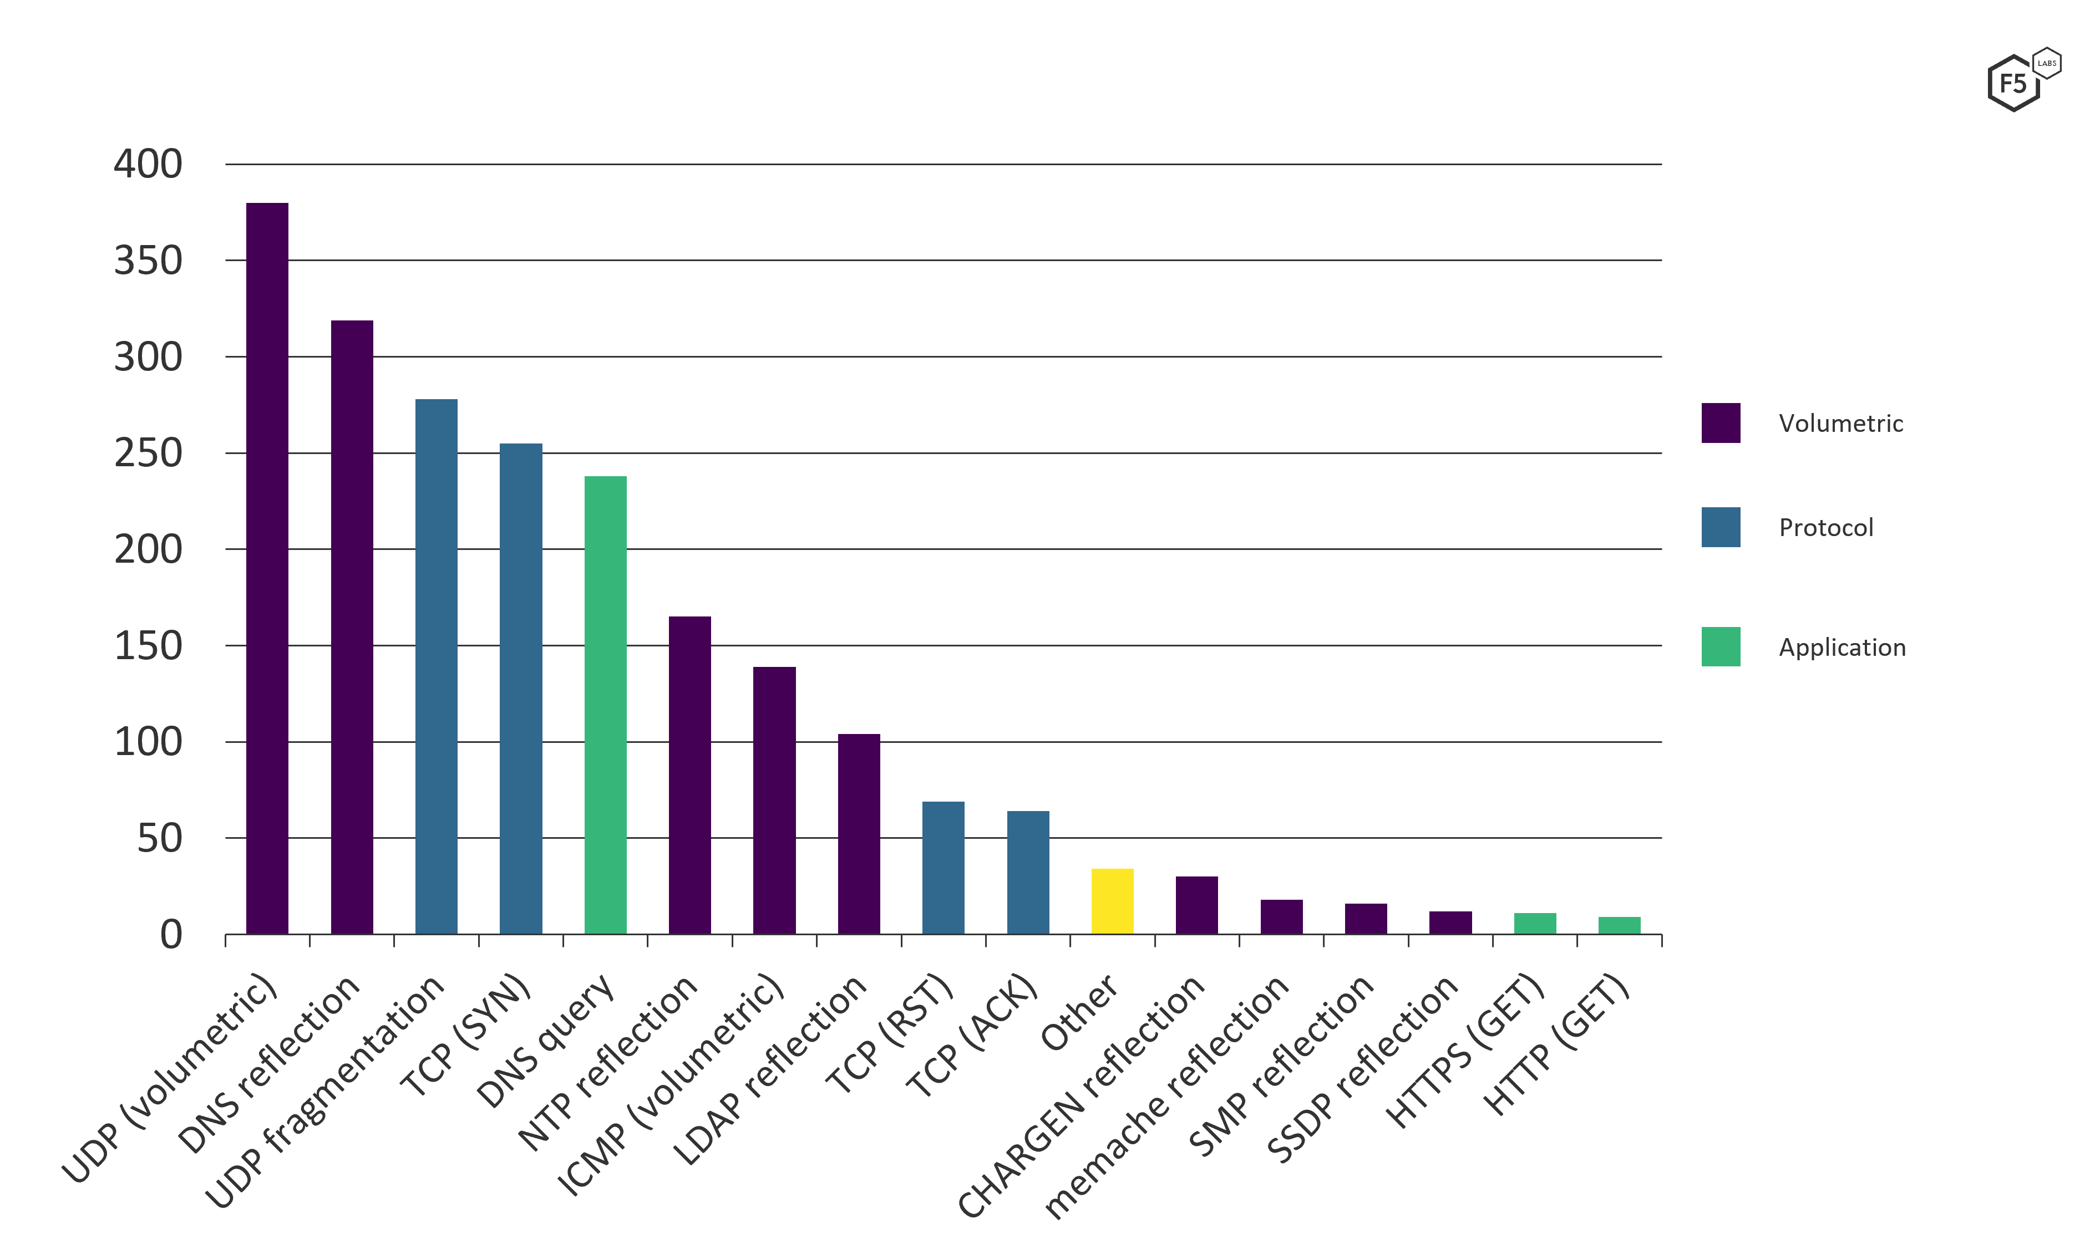
SysNet DDoS Service: Distribution
Frequency Distribution of DDoS Attacks
Source:F5 Threat Intelligence
Notes:
* Mean attack size in 1Q2020 was 5Gbps & 1Q2021 is 21Gbps

Slide 9
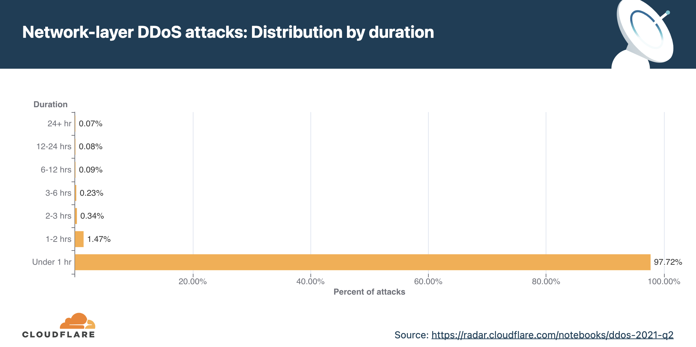
SysNet DDoS Service: Distribution

Slide 10
SysNet DDoS Service
Problem statement:
SysNet has observed an increasing amount of DDoS attacks. We’ve deployed access controls to police/filter common attacks for campuses who have agreed to this service. HOWEVER, the network has a 1-5% chance of a big attack taking 1 or all of us completely offline. In addition, SysNet campuses are starting to observe TCP SYN attacks causing resource exhaustion at much lower rates which we have limited capabilities to mitigate
New SysNet network can deliver 100Gbps to a 4yr campus & 10-30Gbps to branch campus
SysNet has experienced many DDoS attacks since it began in 2014
Most attacks <15 min in duration & < 2Gbps; largest is ~30Gbps @ UWEC (SysNet 1mo study); many are dorm gamer attacks
Most if not all campuses have had service affecting events
SysNet performing policing/filtering using Juniper access controls though some attacks difficult to block with existing coarse tools
Notes:
*

Slide 11
SysNet DDoS Service
Why are we doing this project?
Mandatory: Mitigate volumetric attacks (1-5% risk) to protect our respective business activities from financial, operational & reputational risk
Desired: Reduce significant protocol attacks (e.g. TCP SYN)
Out-of-scope: Application (layer 7) attack (we think this is best handled by individual campuses & other products)
Project scope
Research, procure, test & implement a cloud-based scrubbing service capable of cost-effectively offering protection for all IPv4 & IPv6 space SysNet (AS3128)
Project goals & deliverables
R&D: build knowledge on marketplace offerings
Procure: develop RFP for scrubbing service
Deploy: Test & implement service (technology & process)
Timeline (now – 3/31/23)

Slide 12
SysNet DDoS Service: RFP criteria

Slide 13
SysNet DDoS Service : RFP criteria

Slide 14
SysNet DDoS Service: RFP criteria

Slide 15
SysNet DDoS Service: RFP criteria

Slide 16
SysNet DDoS Service: RFP criteria

Slide 17
SysNet DDoS Service: RFP criteria

Slide 18
SysNet DDoS Service: RFP criteria

Slide 19
Questions?
will.boettcher@wisc.edu
patrick.christian@wisc.edu
tim.czerwonka@wisc.edu
michael.hare@wisc.edu

