Slide 1
AS3128 DoS mitigation
Michael Hare
April 2022

Slide 2
Agenda?
What changed to cause recent activity?
What has happened since my first email in March 2022
What should we be doing?
Some low-capex budget ideas I’ve brainstormed
Cloud scrubbing

Slide 3
What changed to cause recent activity?
Sometimes the POTUS visits a campus, such as UW Superior
We’ve had fragment policing as an opt-in since ~2016, but UW Superior hadn’t opted in
UW Superior was force opted in
I know that SYN floods are the next most common type of attack that can impact a campus and we had no tools against them
Documentation for our service was abysmal to non existent, which does not exude confidence.
Cybersecurity: it’s not my day job.

Slide 4
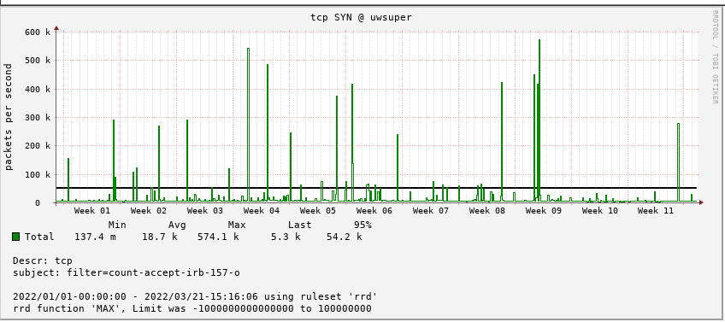
SYN floods, UW Superior
https://stats.uwsys.net/cgi-bin/shorten.fcgi?i=6178&c=d330cd5a54224f7c

Slide 5
SYN floods, UW Superior
I looked at some of the many netflow events re: UW Superior SYN floods and noticed a pattern
I worked up a document describing my process
https://stats-1.uwsys.net/other/private/kb117080%20-%20DoS_%20investigating%20a%20SYN%20flood.pdf
Option “A” [policing SYNs by source subnet] was born
https://stats-1.uwsys.net/other/private/kb117092%20-%20DoS_%20TCP%20SYN%20flood%20protection.pdf
I recognized I had little documentation of our existing services, so I worked on that too
https://stats-1.uwsys.net/other/private/kb117071%20-%20UW%20System%20DoS%20Guide.pdf

Slide 6
SYN floods, everywhere
I looked at other campuses and saw the same source subnets doing the same activity
“Why is this happening?” is outside the scope of what I can deal with, unless you want to stop advertising your routes to the internet.
I offered “option A” to anyone who wanted it
I started brainstorming low capex solutions that would help in situations that “option A” might not
This is about the time I sent my first “hi, what’s up” email to discussion

Slide 7
What has happened since my first email in March 2022
Several campuses have enrolled in option A
I’ve received quite a bit of feedback from Dan Dargel and Dan Peterson and have incorporated those ideas and questions into https://stats-1.uwsys.net/other/private/kb117092%20-%20DoS_%20TCP%20SYN%20flood%20protection.pdf, which is just as much a working document as it is a way to share documentation

Slide 8
Walk through these docs, or talk about “What should we be doing?” at this point
?

Slide 9
Ways we could spend time
Talk about historic service info [fragment and amplification policing]
Talk about SYN option A?
Talk about other SYN options in https://stats-1.uwsys.net/other/private/kb117092%20-%20DoS_%20TCP%20SYN%20flood%20protection.pdf ?
Talk about firewalls; various mitigation settings, ruleset order, null routes, etc?
Talk about what others are doing?
Talk about cloud scrubbing?

Slide 10
Choose your own adventure. I’ll watch the webex later and take notes

Slide 11
Suggested Palo Alto links by Dan Dargel
"Understanding DoS Protection - Palo Alto Networks" - PDF download
https://knowledgebase.paloaltonetworks.com/servlet/fileField?entityId=ka10g000000UAhuAAG&field=Attachment_1__Body__s
"What are the Threat IDs for Scan and Flood associated with Zone Protection?“
https://knowledgebase.paloaltonetworks.com/KCSArticleDetail?id=kA10g000000PPklCAG&lang=en_US%E2%80%A9
"Packet Buffer Protection“
https://docs.paloaltonetworks.com/pan-os/10-1/pan-os-admin/zone-protection-and-dos-protection/zone-defense/packet-buffer-protection

Slide 12
FastNetMon links
Community (free):
https://github.com/pavel-odintsov/fastnetmon
Advanced:
https://fastnetmon.com/product-overview/
Comparison:
https://fastnetmon.com/compare-community-and-advanced/

Slide 13
Block lists
https://feeds.dshield.org/block.txt
https://opendbl.net/

