Slide 1
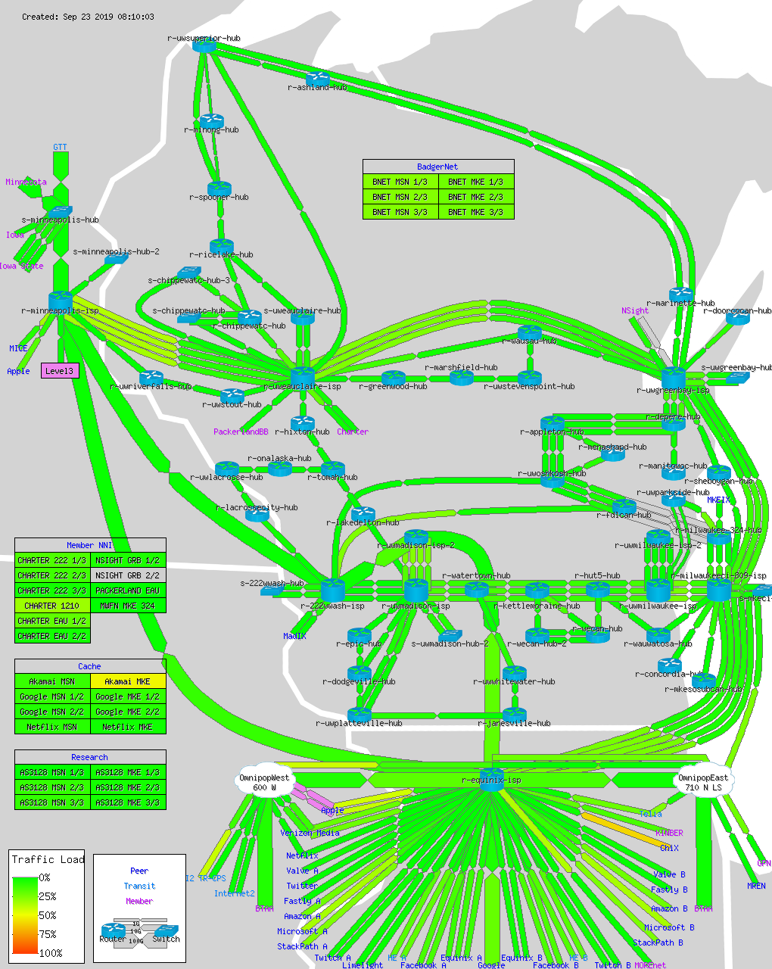
WiscNet Network Update Fall 2019
Ben Chase
Josh Gorton

Slide 2
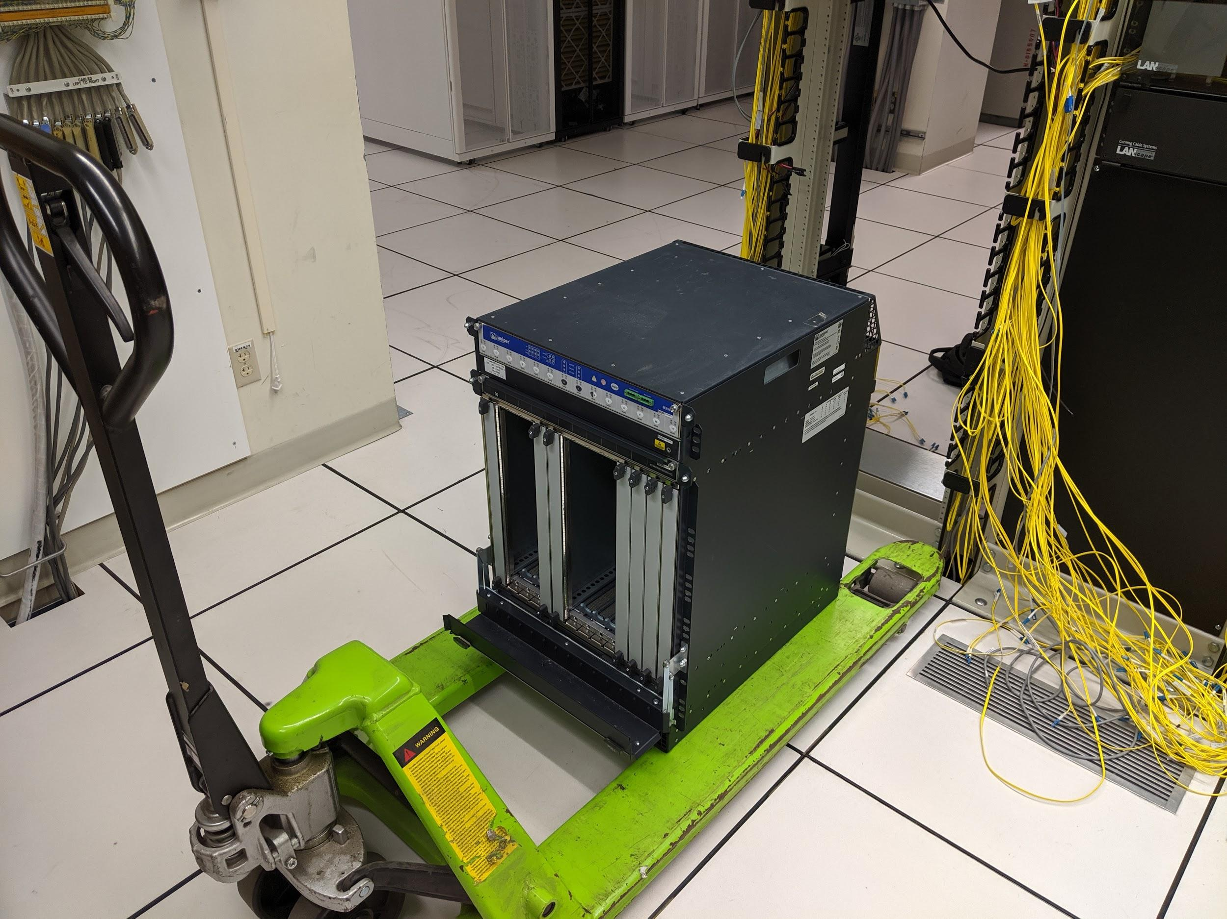
WISCNET NETWORK UPDATE
New Hardware
Backbone Upgrades
WRIPS Update
Tools
Projects
Reorg

Slide 3
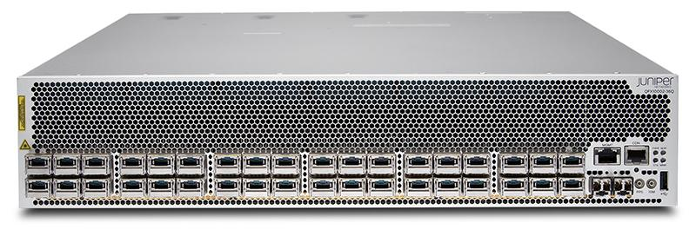
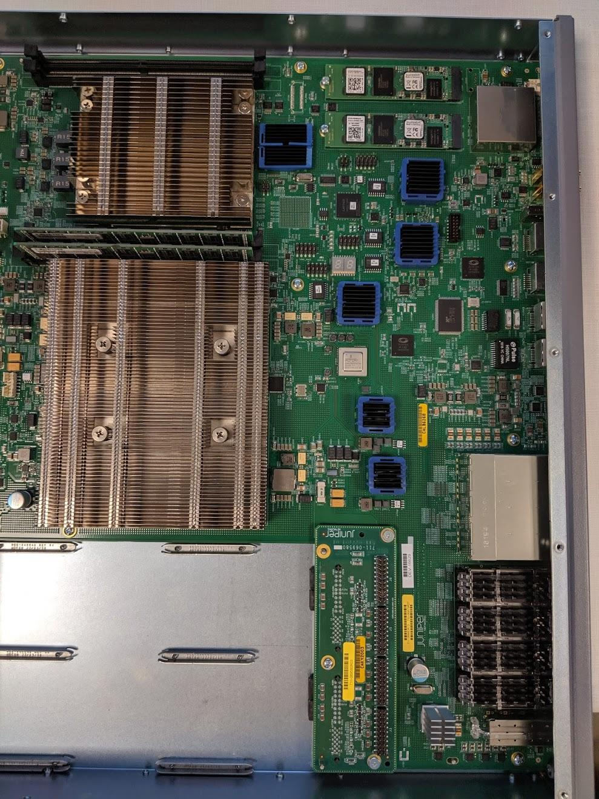
WISCNET NETWORK UPDATE
New Hardware
Juniper QFX10002-36Q
36x QSFP+, 12x QSFP28
Handling new GTT 100G Transit Share
3x Juniper Q5 chips (500Gbps per chip)
Smaller sibling of the QFX10002-72Q
Juniper MX204
4x QSFP28, 8x SFP+
Handling East/West 100G Backbone
100G E, 100G W, 100G/10G down
1x Juniper Trio (Eagle) chip at 400Gbps
Member agg sites with an MX204 have redundant hardware
Comparing to previous 100G hardware
MX204 is 23% the purchase cost of an MPC7E-MRATE
MX204 is 15% the yearly support cost of an MPC7E-MRATE

Slide 4
WISCNET NETWORK UPDATE
Backbone Upgrades
MX forklifts, additions, or SCB/RE upgrades
SCB-MX, RE-S-2000, and DPCE retired
New QFX5100
New Transit Share
Other/not shown
Additional fiber OOB deployments
New 100G backbone links
Highway 41 progress

Slide 5
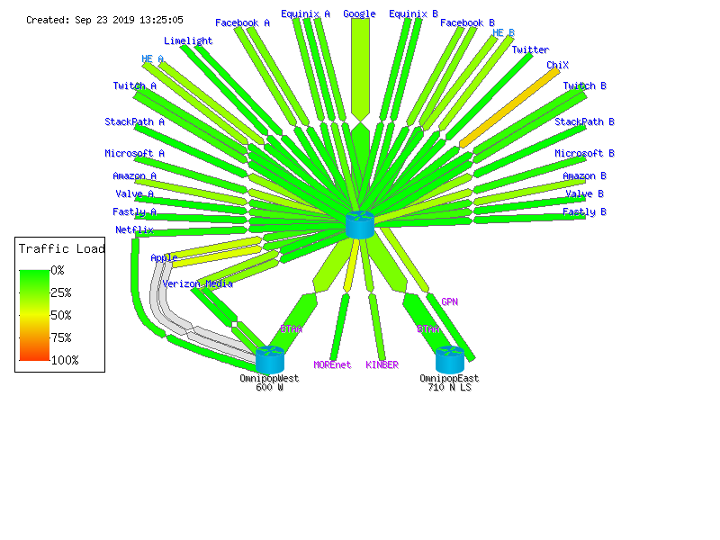
WISCNET NETWORK UPDATE
WRIPS Update
URL: https://weathermap.wiscnet.net/weathermap/wiscnet-wrips.html
Minneapolis 100G MPC7E-MRATE likely moving to Chicago
100G Targets
Routing at 600W
Equinix Renewal
AMSIX US Sale
Chicago IX

Slide 6
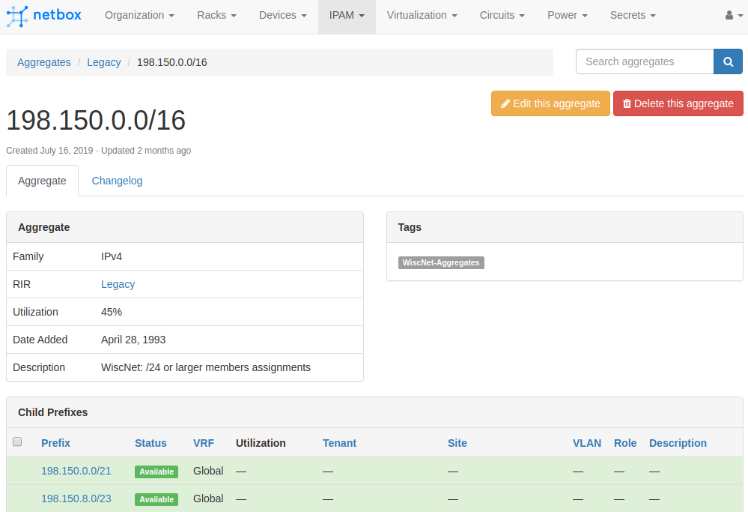
WISCNET NETWORK UPDATE
Tools
WiscNic status:
IPAM replacement: Netbox

Slide 7
WISCNET NETWORK UPDATE
Projects
DDoS scrubbing/monitoring
Telia, GTT
Kentik, Viavi, ThousandEyes...
Additional transit port in Minneapolis
Telia
Highway 41
Waiting on amps for the last span
100G backbone in Milwaukee
Waiting on hardware
DNS
Member portal
Hardware evaluations
MX10k
QFX51*0
Other?

Slide 8
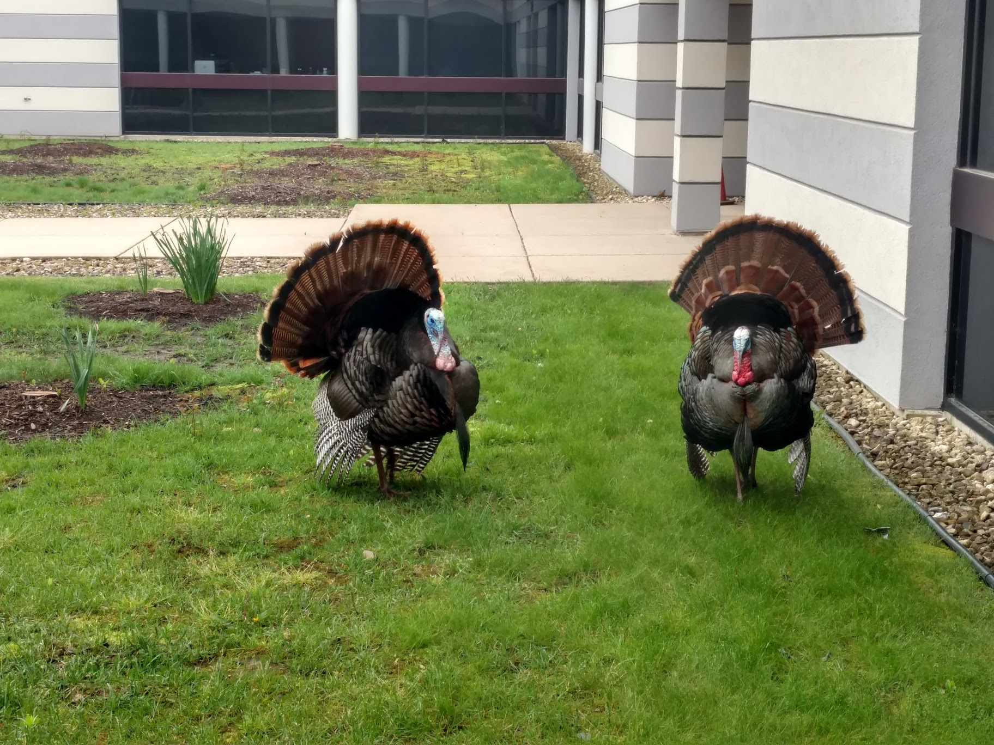
WISCNET NETWORK UPDATE
Reorg
Dave Lois - CEO
From four teams to three:
Member Engagement
John Pederson - Organizational Strategist and Director
Member Platform
Brian Remer - CTO
Member Success
Kika Barr - COO
Current staff count: 21
24/7 NOC: Outsourced to iNOC
Accounts payable/receivable being
outsourced to Burndt
Office turkey season is starting

Slide 9
WiscNet Network Update Fall 2019
Brian Remer, Chief Technology Officer, brian.remer@wiscnet.net
Engineering Team:
Ben Chase, Network Engineer, bchase@wiscnet.net
Chris Wopat, Senior Network Engineer, wopat@wiscnet.net
Josh Gorton, Network Engineer, joshg@wiscnet.net

Slide 10
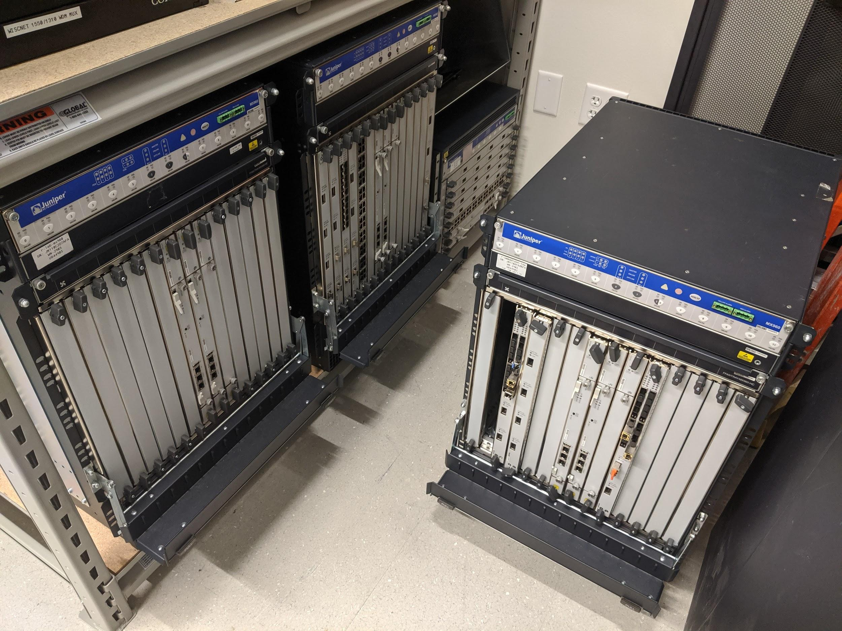
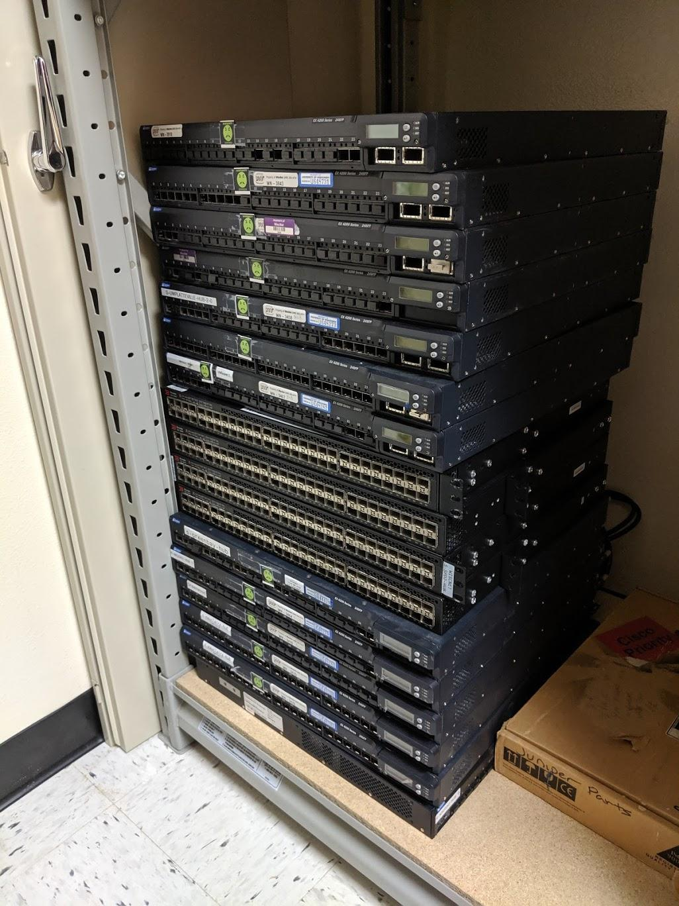
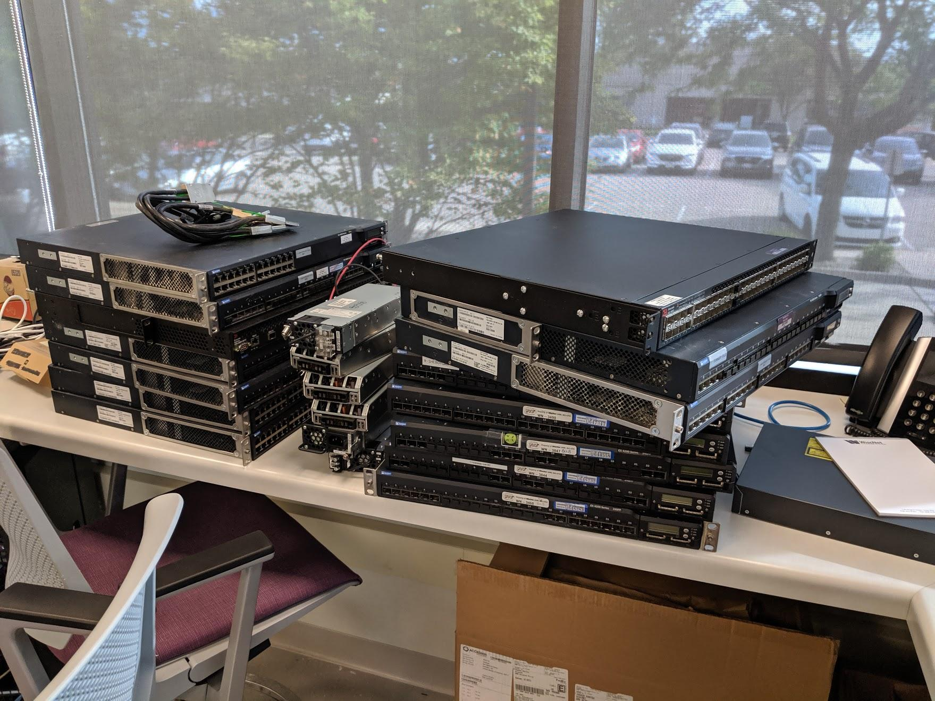
WISCNET NETWORK UPDATE
Bonus slide - MX/DPC/EX4200/Brocade status

