Slide 1
UWSysNet Transport Updates
Dan Parenteau & Jeremy Sarauer
9/24/2019

Slide 2
SysNet vs SysNet2020
Then (SysNet):
Fairly tight timeline both in terms of design and implementation.
Mix of technologies (DTN and ATN)
Shared network (integrated with BOREAS Eau Claire to Madison)
Shared Management (DNA)
Greenfield Deployment
Branch Campuses - Out of Band.
Fixed Grid

Slide 3
SysNet vs SysNet2020
Now (SysNet2020):
More time to design and (hopefully) implement
Same technologies everywhere
Separate network from BOREAS
Possibly Separate Management
Brownfield Deployment
Branch Campuses - In Band
Flex Grid

Slide 4
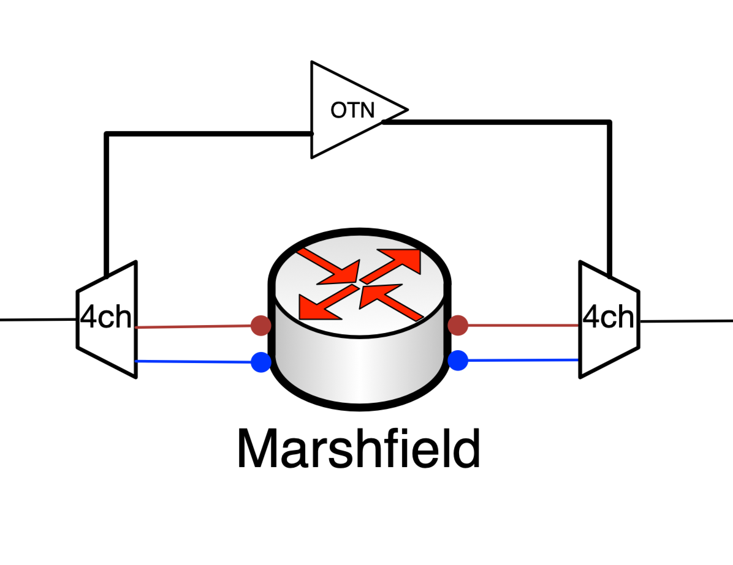
Branch Campuses

Slide 5
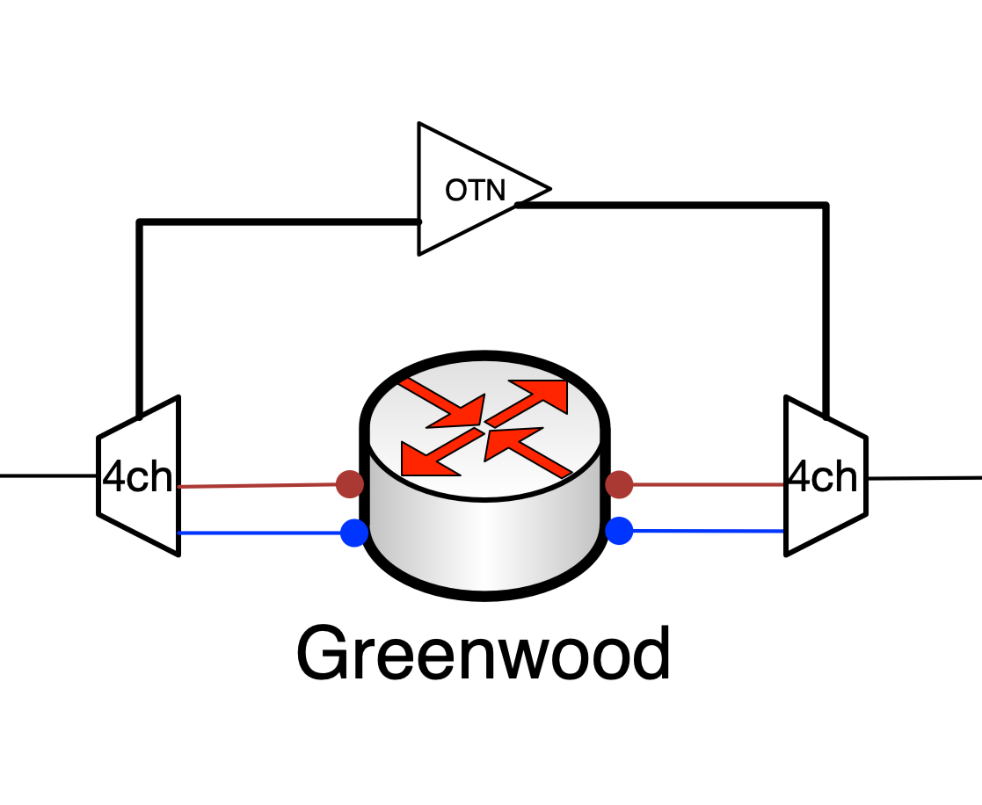
Branch Campuses

Slide 6
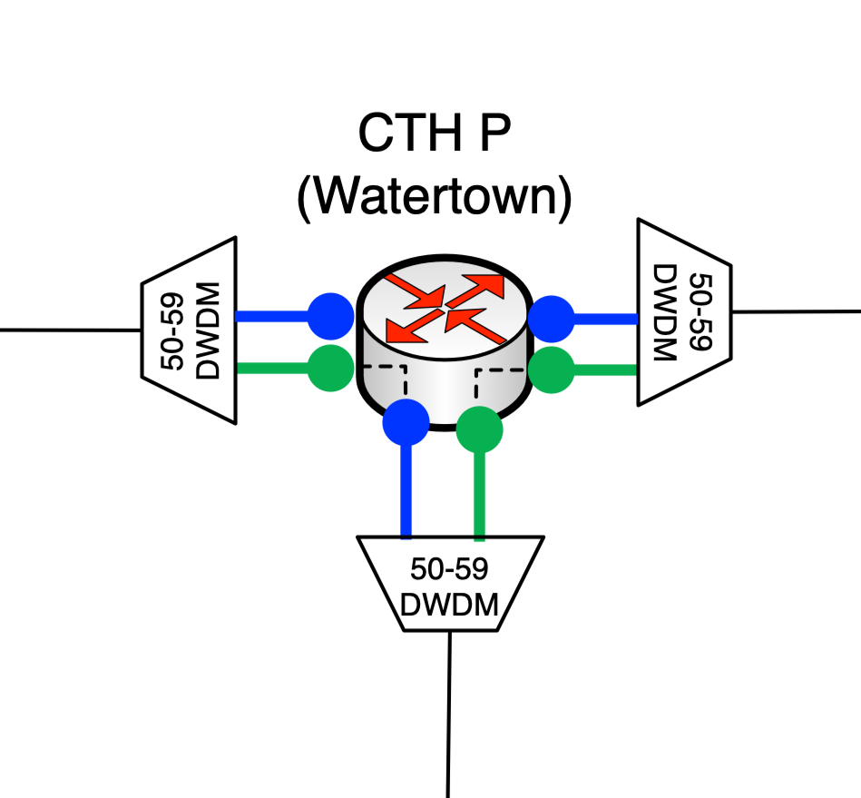
ATN Locations

Slide 7
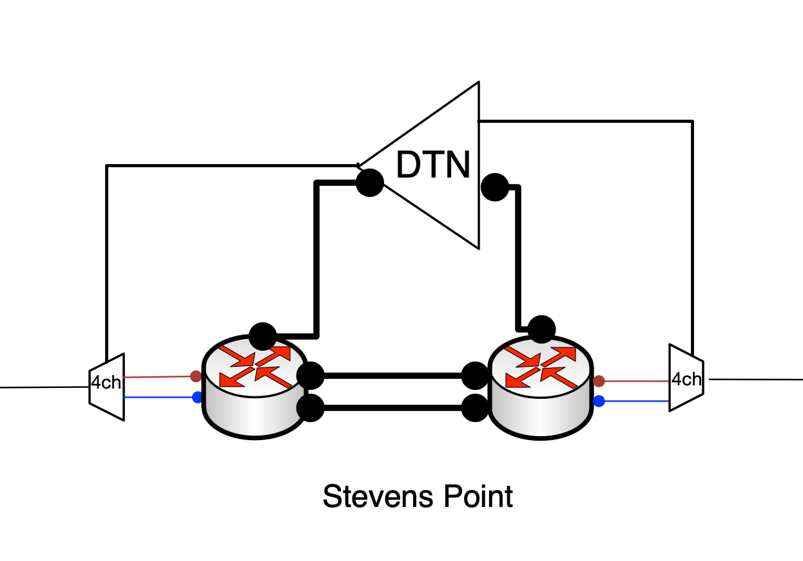
DTN Locations

Slide 8
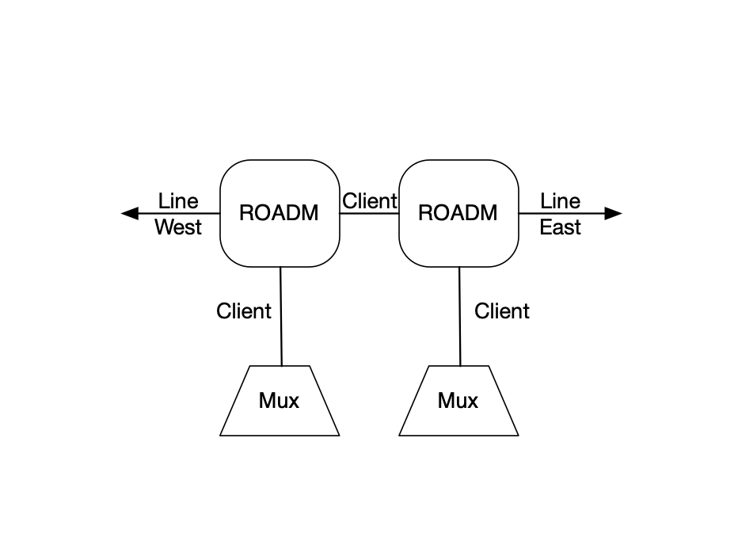
ROADM

Slide 9
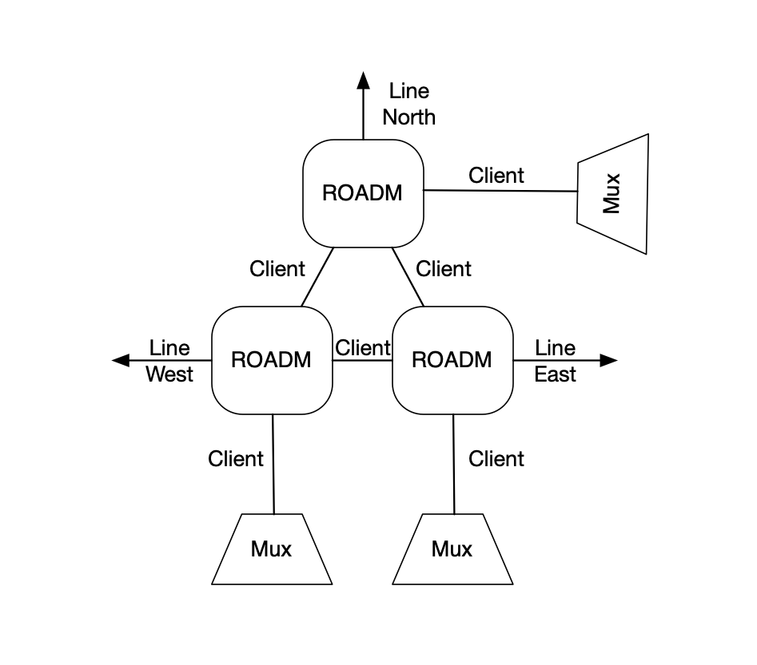
ROADM

Slide 10
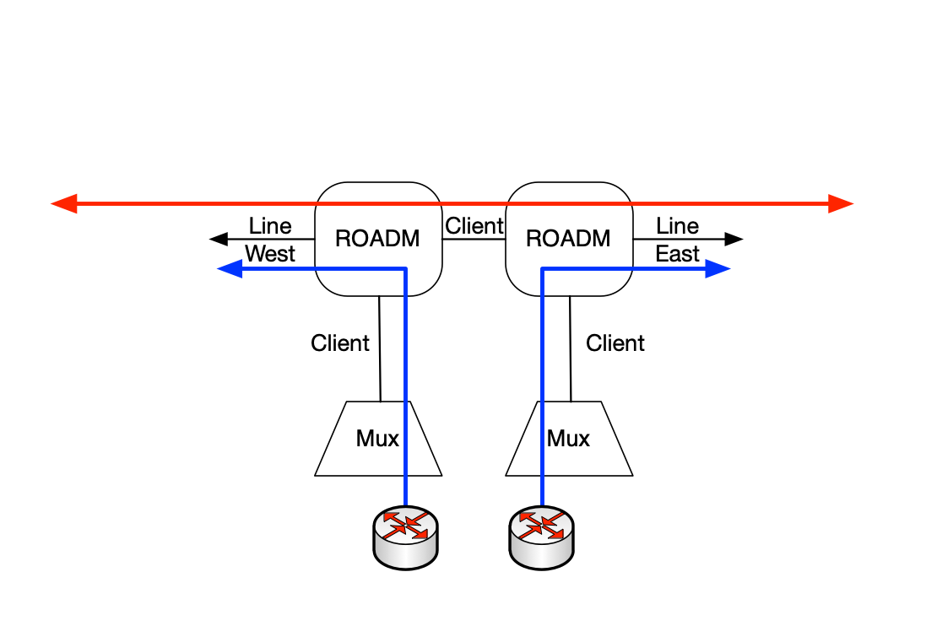
ROADM

Slide 11
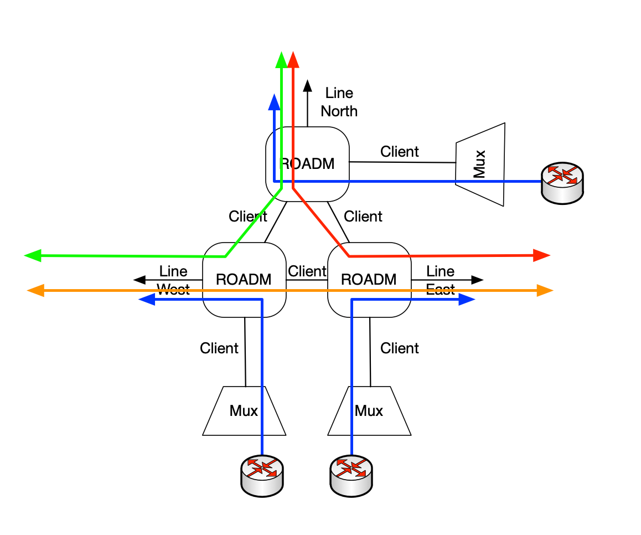
ROADM

Slide 12
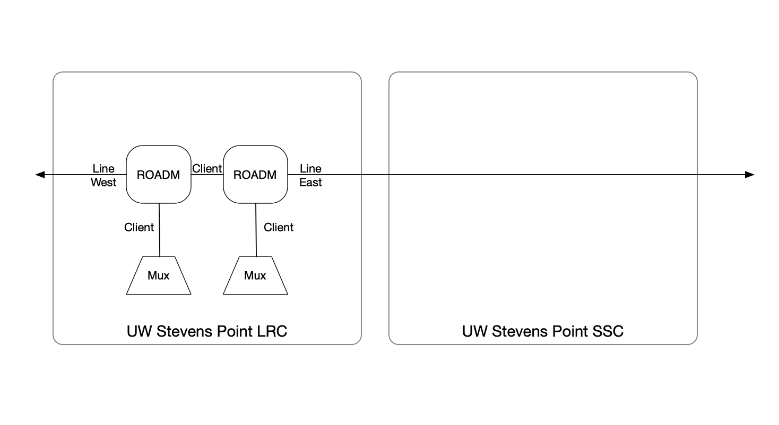
ROADM Single Site

Slide 13
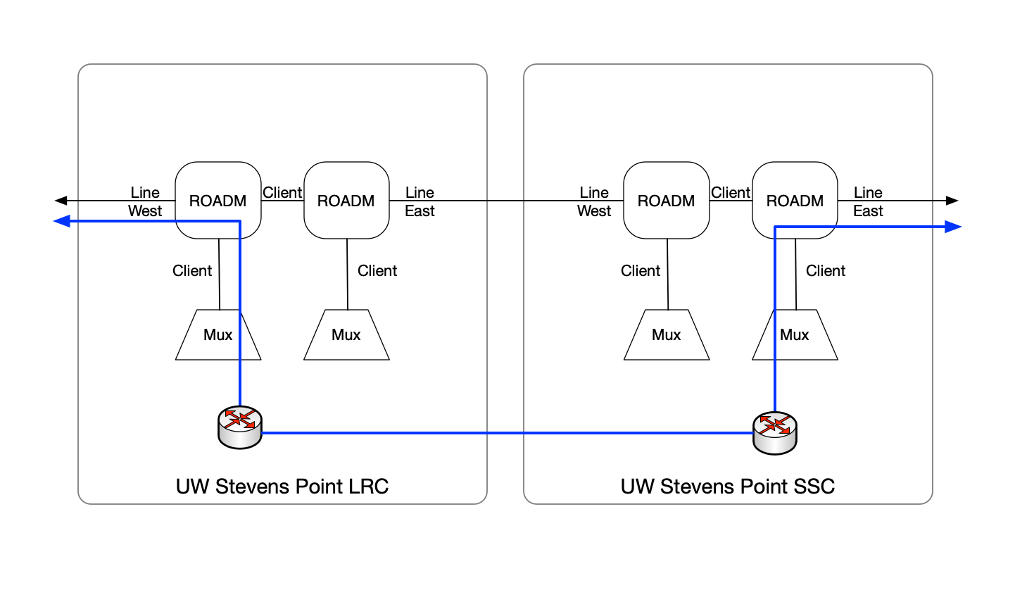
ROADM Dual TID

Slide 14
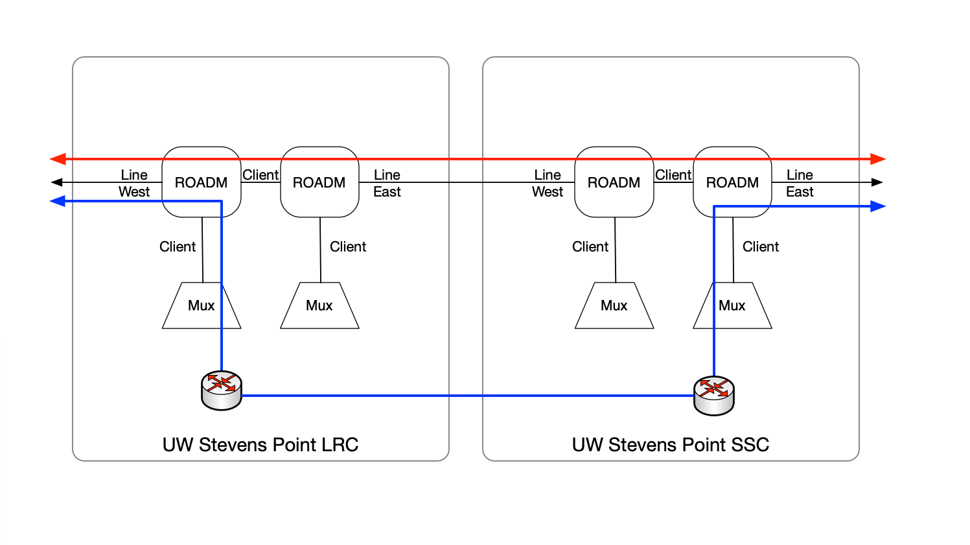
ROADM Dual TID

Slide 15
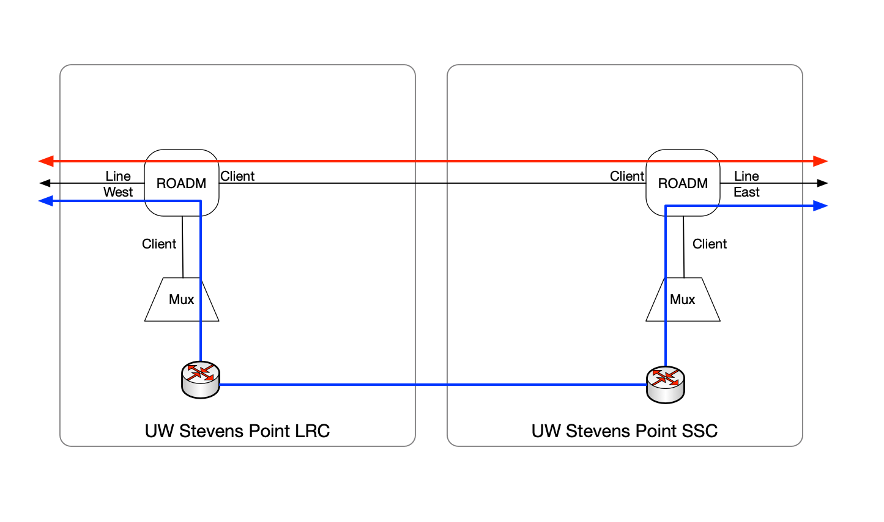
ROADM Split TID

Slide 16
Alien Waves
Wikipedia: an alien wavelength is a "colored" optical signal that is originated from equipment not under the direct control of the transmission network operator
We absolutely require that the system support them!
We absolutely don’t look forward to implementing them!
Notes:
We want integrated first party transponders with instrumentation and FEC.

Slide 17
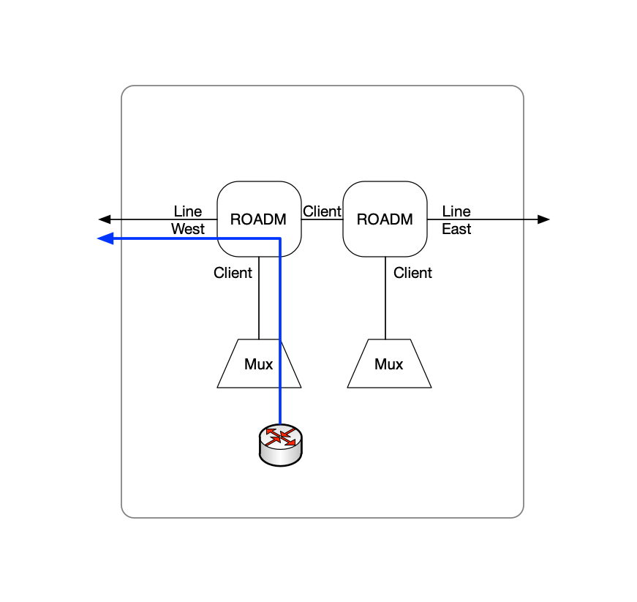
CDC (Colorless, Directionless, Contentionless)

Slide 18
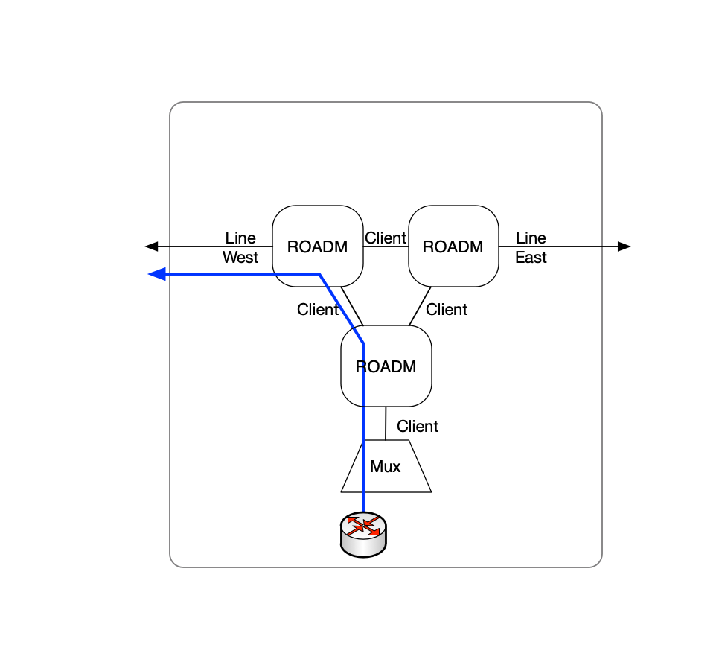
Directionless

Slide 19
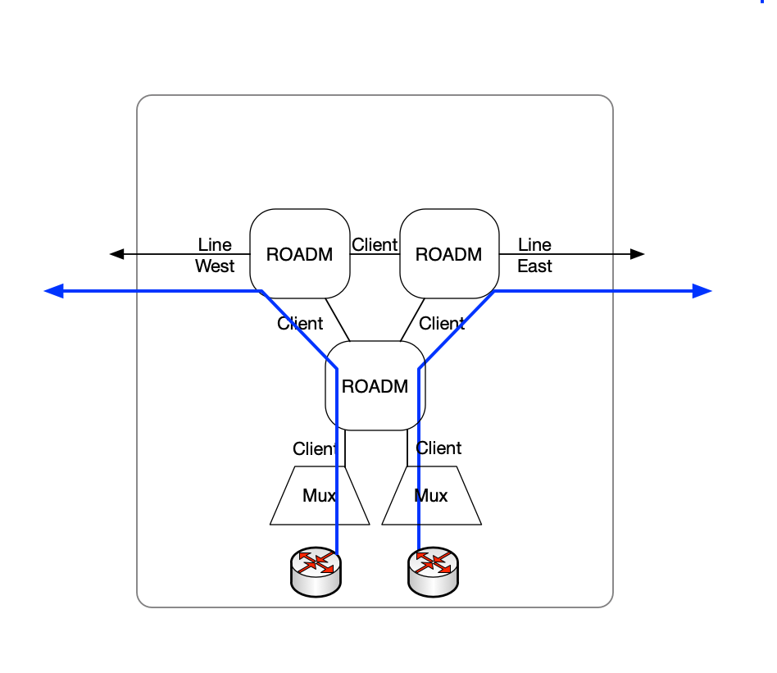
Contentionless

Slide 20
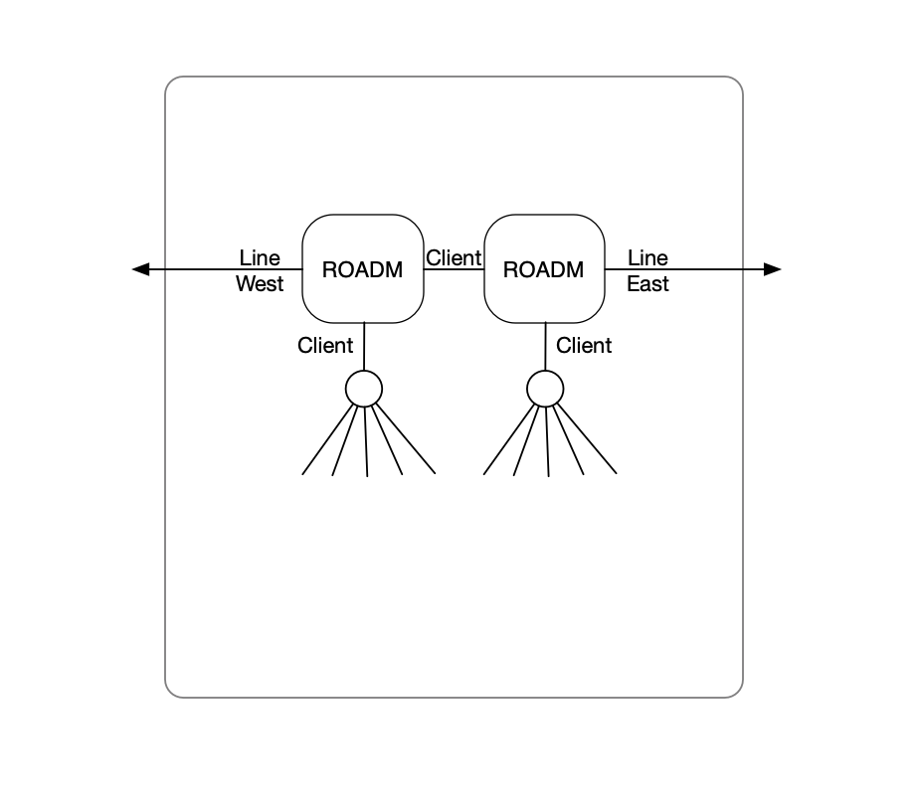
Colorless

Slide 21
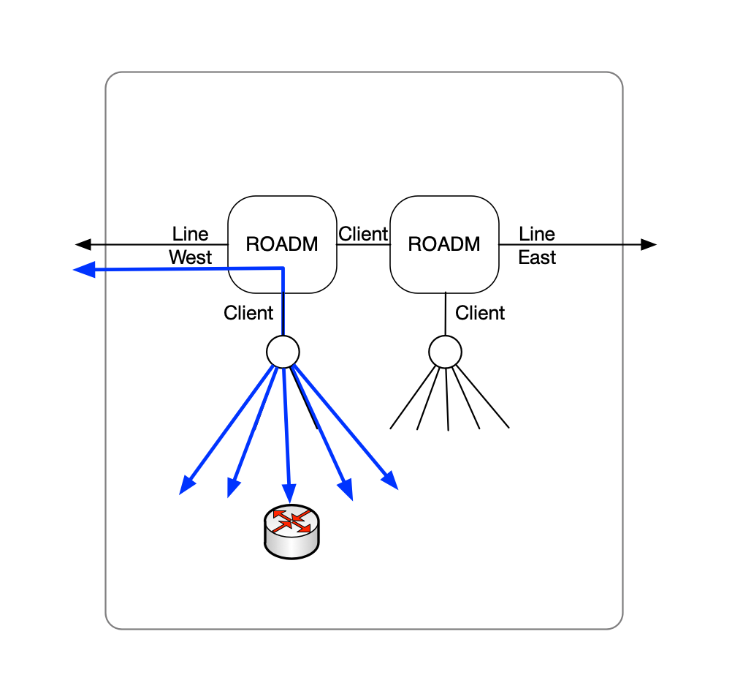
Colorless

Slide 22
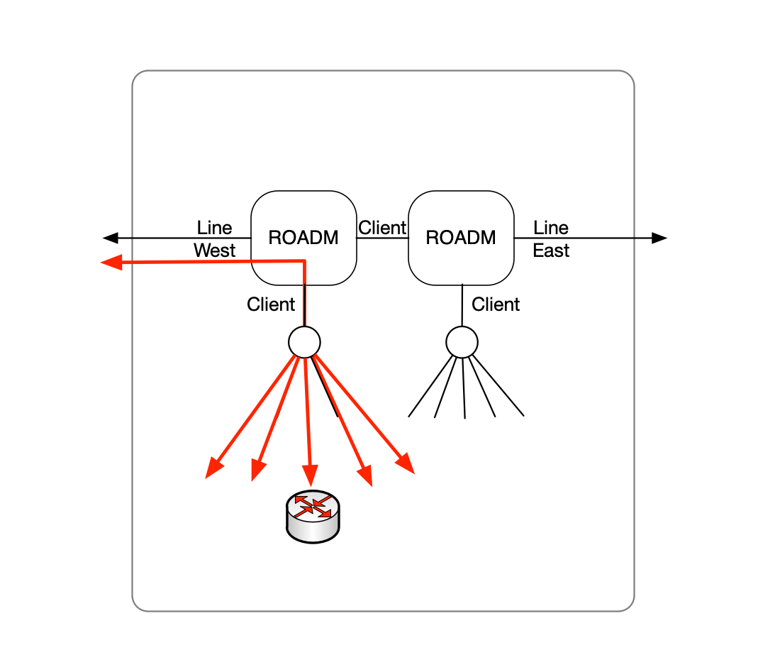
Colorless

Slide 23
Transport Vendors
Infinera
Comfort Level with Hardware, Software and Management
Goldilocks Problem
DTN/XTN and ILS Maybe Too Much
XTM (Transmode) Maybe Too Little
Coriant OLS Maybe Just Riiight
Ciena
Large Market Share (Indiana, Illinois, Internet2)
Aggressive Response (Time, Budget)
Less Comfort Level
Notes:
Notes on design implications. The Infinera switching backplane, we love it, and we're not going to have it. It worked well for UWSysNet, but continuing to invest in that platform is not forward looking (don't want to waste any money).
The new world order is point-to-point, that has flexibility and limitations. Lighting up another "big pile o' waves" is no problem technically, but will have significant costs beyond areas targeted at turn up (backbone). Luckily, we take large leaps in data rates over longer intervals unlike telcos who continually add additional capacity as new customers come online. They build to ba able to grow (sometimes), we build to not have to grow.

Slide 24
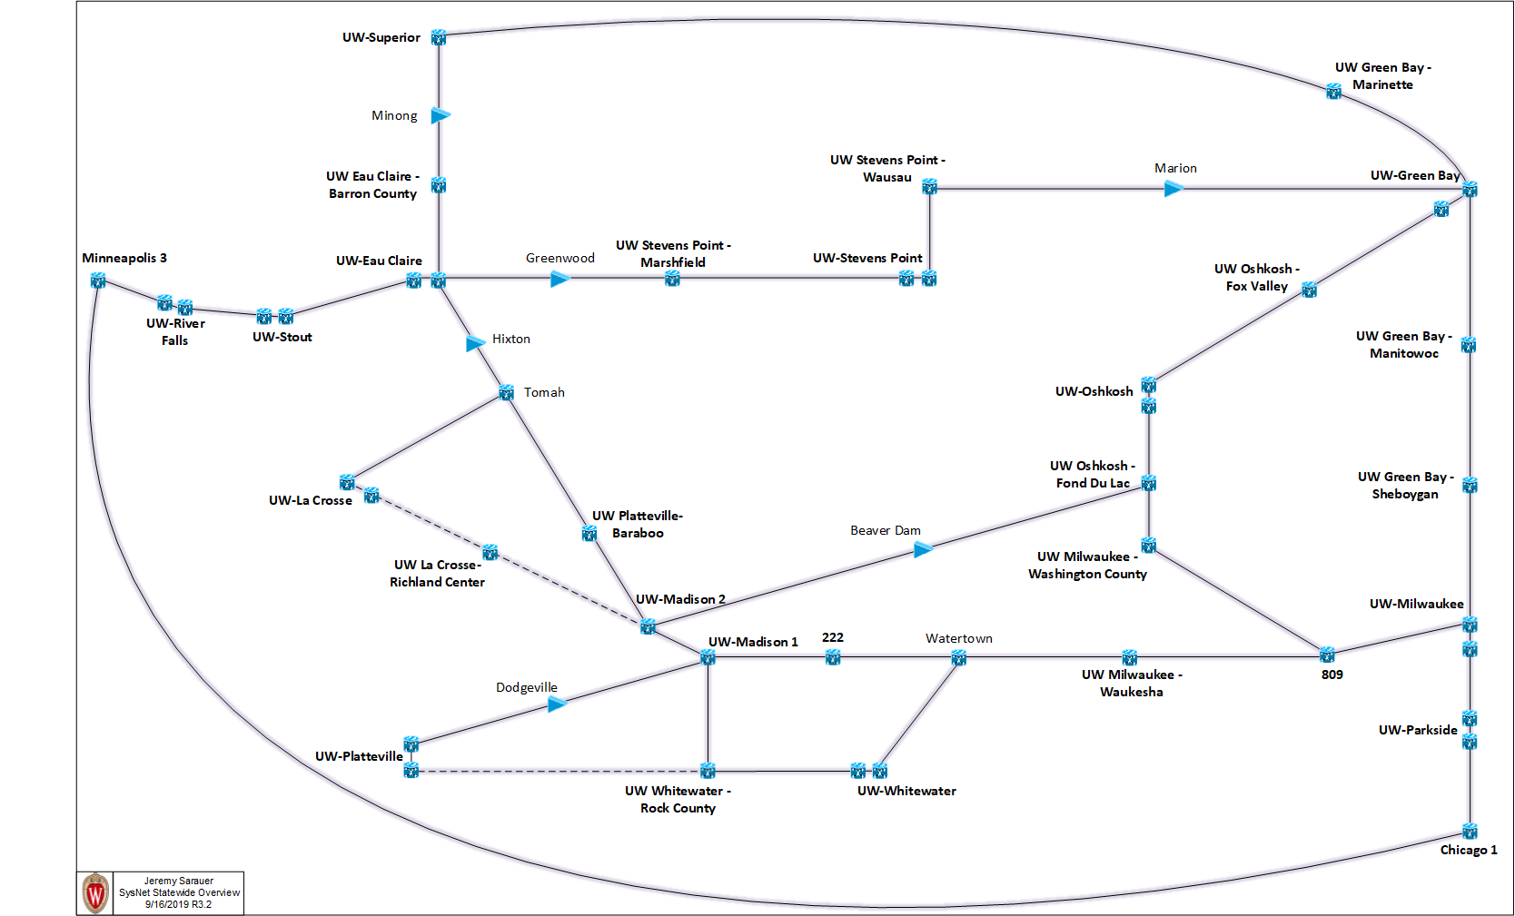
Backbone Design

Slide 25
100G Demands

Slide 26
10G Demands

Slide 27
Protection Topology

Slide 28
Questions?
dan.parenteau@wisc.edu
jeremy.sarauer@wisc.edu

