Slide 1
uwsys.net L2/L3 updates
Michael Hare
August 2018

Slide 2
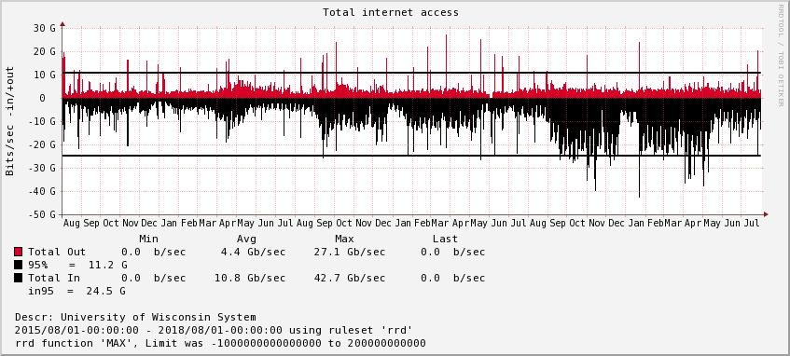
Obligatory stats
Definitive growth year over year
https://stats.uwsys.net/graphs.html

Slide 3
95% interfaces
Several campuses 95% >3G with peaks around 6G
Start planning now for your 20G upgrade
Uwsys.net has 20G (or more) to most locations but we’ll also need to consider MPLS services, centralization efforts, etc as folks bump their borders.
10G density on MX104 will begin to become a factor at some point, more on this later
Admittedly we still need to upgrade our connectivity to Minneapolis for the MICE peering exchange.
https://stats.uwsys.net/reports/current/bits_95_percent_yearly.html

Slide 4
Top origin AS, inbound (centralization is king)
In order;
WiscNet: peering/caching
Amazon: presumably compute/cloud, streaming
Level3: CDN + transit
University of Nebraska-Lincoln; presumably researched related to UW Milwaukee
Akamai, Google, Apple, Facebook, Microsoft
https://stats.uwsys.net/reports/current/flow_as-origin_bytes-in_yearly.html

Slide 5
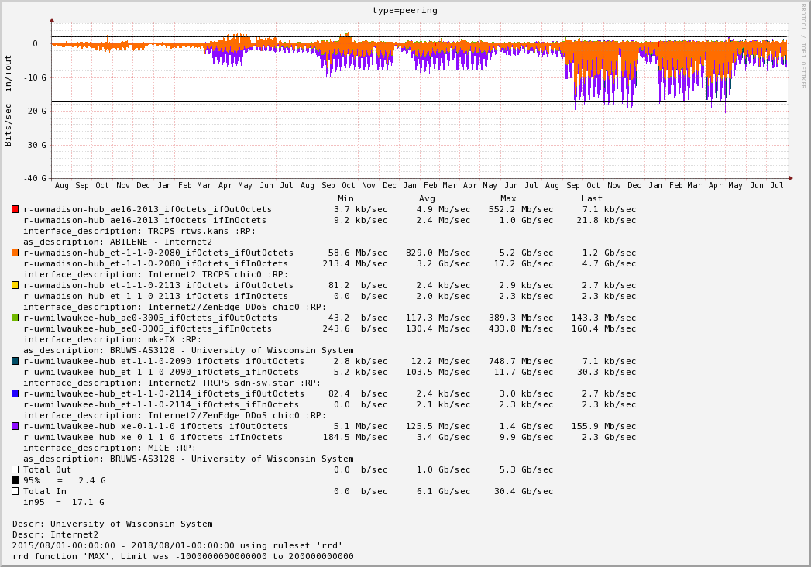
Peering
Massive growth in I2 TR/CPS usage, could be related to our lack of upgrades to MICE. Not easy to control CDNs

Slide 6
Top origin AS, inbound via TR/CPS
Substantial Amazon, Apple, Facebook coming in this way. Facebook is the main culprit (picture on next slide)
https://stats.uwsys.net/reports/current/flow_origin_as_by_interface_bytes-in_yearly.html

Slide 7
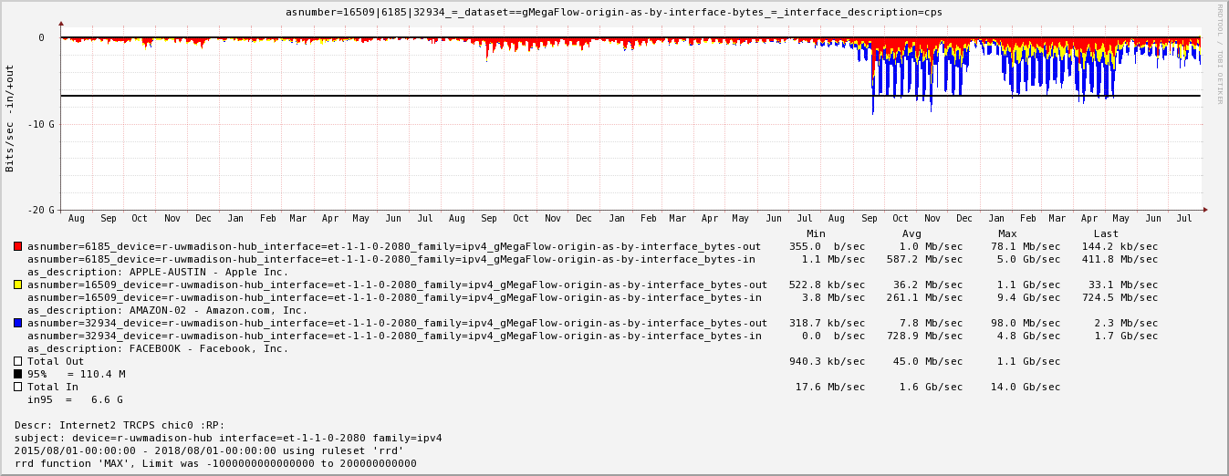

Slide 8
Other peering news
We have taken few direct steps to expand (or upgrade) our peering infrastructure and are relying heavily on Internet2 and WRIPs.
WRIPs is looking at expanding to multiple locations in Chicago via Juniper logical routers which will help a bit with redundancy.

Slide 9
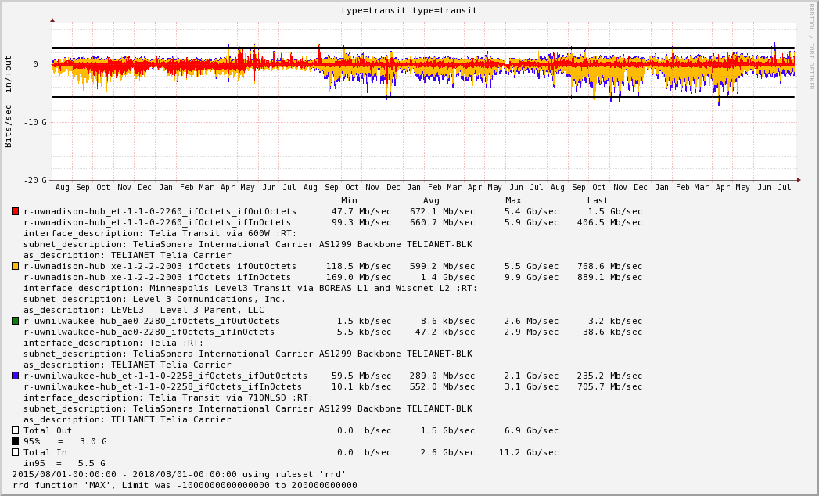
Transit
Growth likely due to CDN hosted by Level3. Getting this via settlement free peering is unlikely
(I don’t make the news, I just report it)

Slide 10
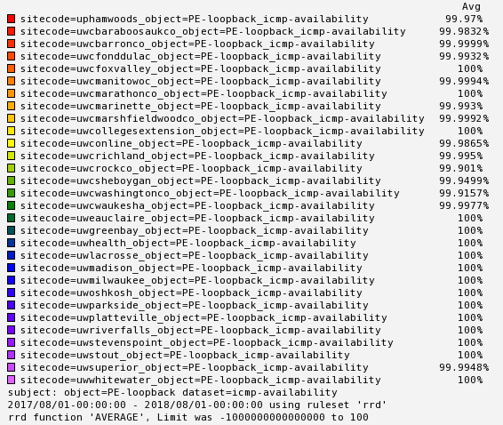
Availability
Single PE at UWCs is a source of risk/outage
Third party telcos/lack of transport diversity a major risk. UWC Rock/UWC Washington are AT&T sites and have already experienced multi hour BadgerNet3 outages since turnup ~2 weeks ago (not reflected in these stats!)
(all outages: planned or unplanned, uwsys.net or 3rd party transport)

Slide 11
Other transit news
Level3 transit (shared single 10G connection in Minneapolis via middle switch) being turned down “soon”.
Replacement is AT&T transit (pending)
Dedicated 10G from both Madison and Milwaukee to different core AT&T POPs
Transport will be long and unprotected
Uwsys.net routing group agreed this was preferable to connecting to local (Madison, Milwaukee) AT&T POPs due to concern of long term inadequate backhaul from our “small” cities.
Note: vendor selection was above my pay grade. See Mike and Pat for details.
While exact fiber topology is unknown hopefully this helps safeguard against a catastrophic boreas failure/double cut

Slide 12
BadgerNet (3)
BadgerNet(3) is simply called BadgerNet, not to be confused with BadgerNet(1) which was called BadgerNet. BadgerNet(2) was BCN.
UWC Waukesha remains on BCN pending AT&T build.
10G aggregation in Madison and Milwaukee similar to BCN
WIN is the NOC
5 of the 7 sites have a single throat to choke (AT&T). Two include Centurylink
Uptime is only ~2 weeks, reliability seems similar to BCN (not that surprising)
I suspect/fear we may need to tweak QoS, BadgerNet offered several tens of thousands of profiles, we accept default QoS profile.
We are collecting loss/jitter data as always.

Slide 13
Other network news
Still working with Juniper on MX104 flash reliability issues; more on this from TimC.
DDoS: No major changes, still relying on reactive stateless filter tricks. Contract in place for cloud ddos scrubbing via I2 but no real workflow/procedures/testing has occurred yet. For details chat with Will or Pat.
We are in the early stages for replacing POTS OOB with cellular. See Will or Pat for more details.
Future directions; better understanding needs and options for cloud connectivity

Slide 14
BGP security
We’re deploying BGP GTSM (TTL 255) where we find a willing partner. Upstream so far only Internet2 (TR/CPS + Research AS). We’ve requested BGP GSTM with AT&T and I think it’s worthwhile for us to ask WRIPs as well as Telia. If you BGP peer with us and want to do BGP GTSM, let us know.

Slide 15
JunOS code upgrades
1/3rd way through upgrading from 14.1 to 16.1. 14.1 is EOS as of June 2018 (not a typo). Major delays due to MX104 flash issues.
16.1 brings multicore support to JunOS, but not on the MX104 (Juniper’s regrettably lame business decision as MX104 PPC is slower than your phone). MX104 will forever have an unused second core inside.
Our MX2010 REs have 4 cores and JunOS has lots of processes, so this is an immediate win. (Ie, ssh/snmp/netflow no longer fights with RPD).
RPD = route processing daemon; it does all the important stuff
In 16.1 major parts of the BGP codepath became a separate RPD thread
Long story short; convergence is a lot better in 16.1

Slide 16
Other 16.1 stuff
NDP cache protection (2^64 is really big). I’m rolling this out as we upgrade. Default limit of 1024 v6 neighbors per logical interface.
BGP PIC core (preinstall iBGP forwarding next hops for PE failure) = quicker convergence
Route priority; when there are 500k updates that the RIB needs to send to the FIB, there are now knobs to decide what goes first. We could prioritize IGP/iBGP and with some efforts perhaps valuable eBGP prefixes or interfaces (as of writing doesn’t work with BGP data such as origin AS). Deciding what is important eBGP wise is not necessarily easy.
We likely won’t mess with the last two features until the flash reliability issues are resolved and we are upgraded across the board.

Slide 17
Convergence: have you noticed a change?
We have practiced procedures to minimize impact on MX2010 maintenance several times.
16.1 (multicore/multithread) is running on r-uwmadison-hub; r-uwmilwaukee-hub still needs an upgrade.
Hopefully noticeable blackhole events are less frequent … ?
Additional convergence speedups are possible [money/complexity tradeoffs]
separate P/PE functionality (ie mx2010 = core + CE + border router, Richie Rich solution is three boxes + lots of MPLS)
Out of band route reflectors: with VMX best path calculation at 4+GHZ is a possibility

Slide 18
New MPLS services
UWRF to UW La Crosse datacenter backup (psedudowire)
L3VPN for UW System presence (VOIP) on UW Madison campus
(Apologizes to those I missed, did this off the top of my head)

Slide 19
Tooling updates
Nearly all of our software is checked in via git with a global repository of redhat RPMs being built: https://www.net.wisc.edu/yum/
Before you git excited (ha ha), these are unlikely to be useful to anyone. Documentation is nearly non existent and the secret sauce is in the proper config.
If you look, you may be disappointed in the programming quality.
Several members of the uwsysnet routing team are heavily involved in InfoBlox deployment/API work. Not directly related to the network service, just an FYI and potential area where code reuse or other efficiencies could possibly be gained

Slide 20
High level Juniper updates (site)
mx204: 4x100 qsfp28 [1x100 1x40 or 4x10] + 8x10 SFP
https://www.juniper.net/us/en/products-services/routing/mx-series/mx204/
24x10G is quite a bit more than 10x10G (current MX104 support)
4x10 breakout realistically means no WDM therefore larger investment in optical infrastructure
fixed config single routing engine. we've been told the routing engine has two flash units. Given MX104 woes I’m not thrilled, RE swap easier than chassis swap
1G on next gen routers isn’t going to happen. We’ll need an aggregation method (some dwdm 1G stuff, management networks like terminal servers, etc)
If raw bandwidth is not a problem we could add a switch for aggregation to an existing MX104. We already do this in a few core locations.

Slide 21
High level Juniper updates (core)
There are a slew of new MX2010 cards but nothing exceptionally relevant based on current needs. Path forward is high density qsfp28. We'll need to consider that it could make fiscal sense to NOT invest further in the MX2010s.
mx10003: 2 slots, dataset claims 144 10GbE or 24 100GbE interfaces per chassis
https://www.juniper.net/uk/en/products-services/routing/mx-series/mx10003/
Same qsfp28/WDM/1G caveats apply here. Note: no 1G MX2010 aggregation today but there currently is some 10G DWDM

Slide 22
MPLS VPNs
A few slides about our VPN offerings follow. If you were here last time, there isn’t much new. We’ve had some philosophical recommendation shifts based on our experiences. These slides are intended to be foundational for DR/cloud discussions.
Best to read the KB for details. Content/details change as we learn/experience.
https://kb.wisc.edu/uwsysnet/page.php?id=69033

Slide 23
VPN disclaimers
The UW System MPLS Network supports IP (layer 3) and ethernet (layer 2) VPNs. We have an example of each below type in production (L3VPN, pseudowire, redundant pseudowire, e-vpn).
MPLS core provides no encryption
Never say never, but it is unlikely we will provide fiber/waves for connectivity. See KB, “Q: Can I have an optical circuit instead of using MPLS?” for specifics.

Slide 24
VPN options @ Layer 3
L3VPN: dynamic peering with uwsys.net core, private routing table. Enjoy all the benefits of redundancy at layer3. Please do this if you need multipoint to multipoint reliability as stretching layer2 networks over long distances is generally recommended against due to concerns of LAN segmentation.
Main caveat: multicast support
We have the most visibility to help if something goes wrong.

Slide 25
VPN options @ Layer 2
Pseudowire: point to point or point to multipoint (multipoint end active/passive). Simple to configure, least amount of resources required on our core. Can tunnel LLDP, LACP, BPDUs etc. Core is not involved in loop prevention. We will not (knowingly) give you two pseudowires that could form a bridge.
This is our first choice if you do not need multipoint to multipoint because it is simple to configure and unlikely to break. We will be asked to pinky swear to not form a loop. We will impose policers if you break your promise, and fellow connectors may scorn if you exhaust shared bandwidth.
E-VPN: multipoint layer2, core participates in loop prevention. No dynamic routing (or IP addresses) to setup between you and us. We have the least ability to help if something goes wrong; we can look at current state but not history or changes.

Slide 26
Other
We can likely provide a QoS profile that meets your requirements. We have a default profile, otherwise, you’ll have to communicate your needs. Because of the nature of MPLS VPNs your tos/diffserv markings should transport unscathed
https://stats.uwsys.net/other/2016-01-08%20-%20hare%20-%20e-vpn.pptx ← previous presentation of e-vpn specifics if you like gritty details

Slide 27
FIN

