Slide 1
UW-La Crosse Network
“Gartner forecasts that we will see 4.9 billion connected things by year-end, with the number hitting 25 billion by 2020.”
is the world's leading information technology research and advisory company.

Slide 2
Today’s “High Tech” Residents Hall
Door Swipe (C-Bord)
Laundry View
Environmental Controls
Building Automation
Smartphone
Smartwatches
Roku / AppleTV / Chromecast
Playstation / Xbox / Nintendo
UHD SmartTV / Lighting / Audio Devices
Laptop / Desktop / Printers
Digital Camera’s
& Growing…
Wi-Fi has become the new “dial tone” – Expected

Slide 3
Today’s “Campus Connected” Students
Media Rich Applications
Connected Devices
Wi-Fi Infrastructure

Slide 4
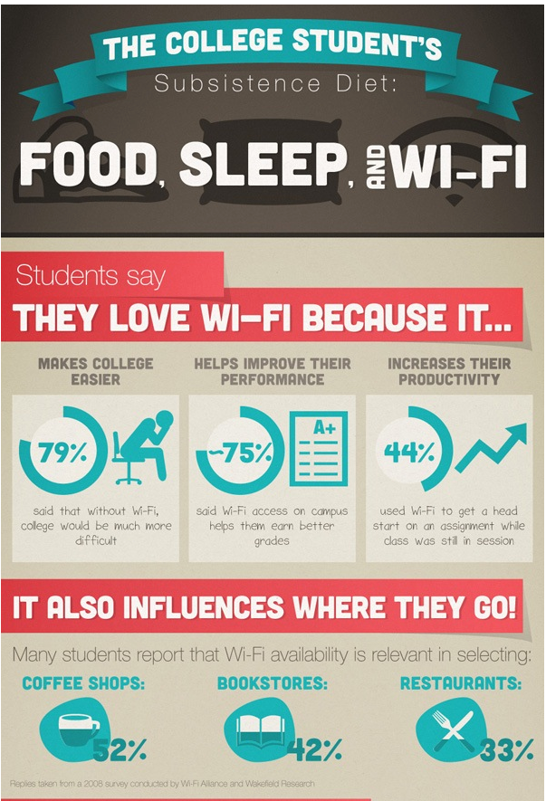
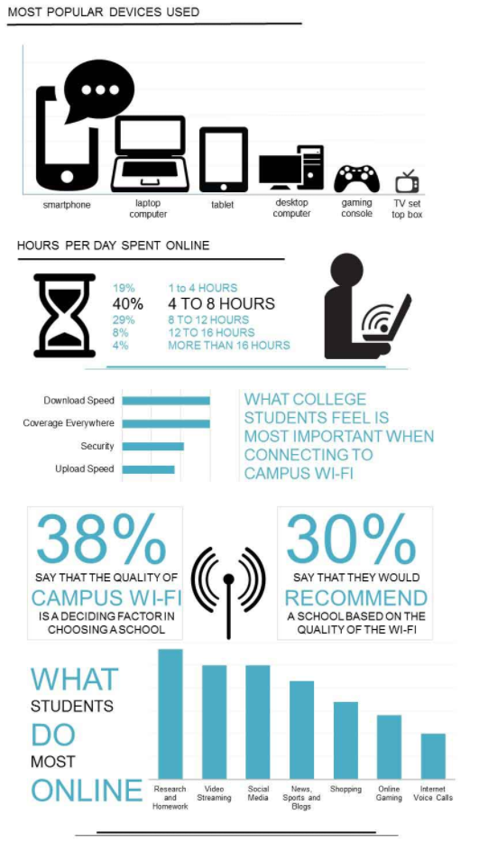
Higher ED Surveys

Slide 5
Higher ED Trends
Students Live Online
To attract and retain students, institutions with residence facilities are acutely aware of the escalating mobile connectivity demands. Streaming video devices, like Apple TV, Fire TV and Chromecast, have become as ubiquitous as gaming devices, wireless audio gear, smartphones, tablets and laptops. With wearables also quickly joining the ranks, the average per-person device count is pushing beyond five or more
It’s All About Density
As fast as higher education institutions completed projects to blanket facilities with Wi-Fi coverage, the paradigm has shifted to addressing exploding device densities. In other words, very high-density wireless deployments are moving from isolated projects in the largest lecture halls to more commonly occur in spaces wherever multiple individuals gather to live and learn

Slide 6
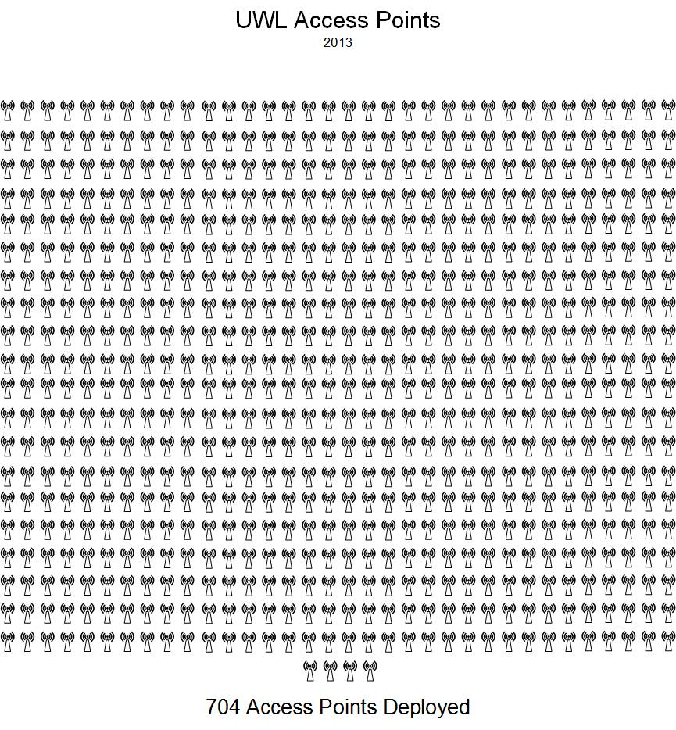
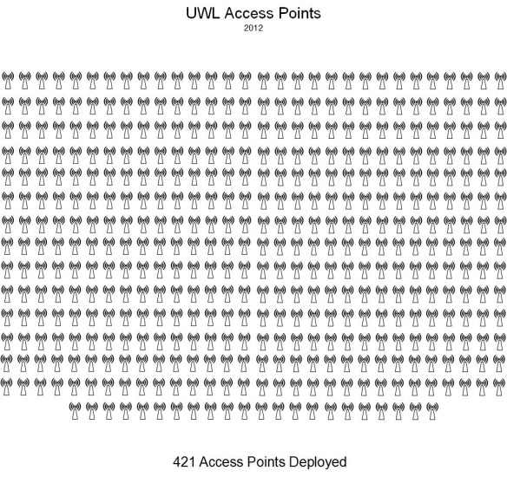
Access Point Deployment 2011-2013
152 Access Point Deployment 2011
421 Access Point Deployment 2012
704 Access Point Deployment 2013
Notes:
Starting in 2011, the campus had 152 Access Points deployed at UW-L.

Slide 7
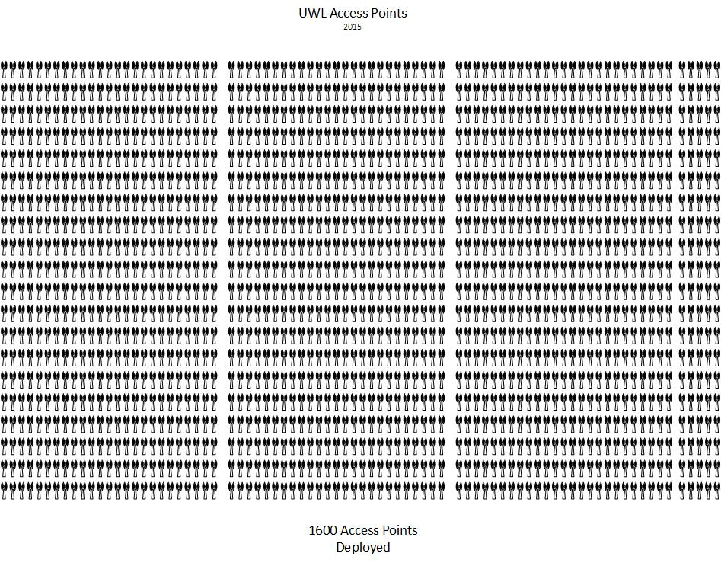
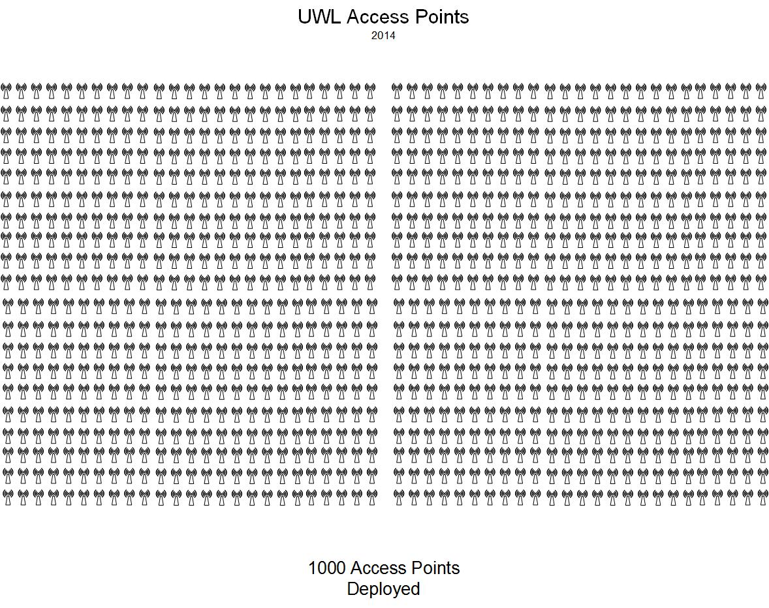
Access Point Deployment 2014-2016
1000 Access Point Deployment 2014
1600 Access Point Deployment 2015
2800 Access Point Deployment 2016
Notes:
Starting in 2011, the campus had 152 Access Points deployed at UW-L.

Slide 8
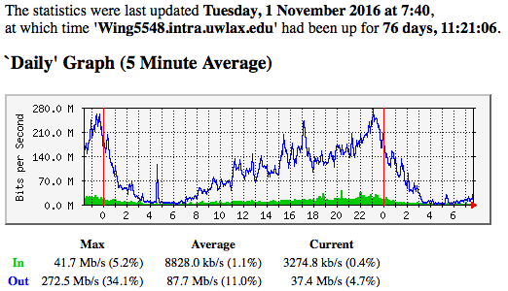
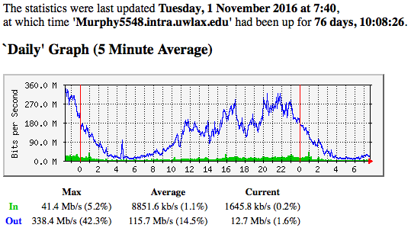
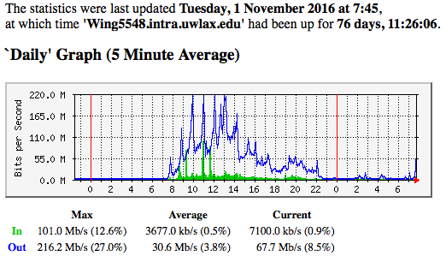
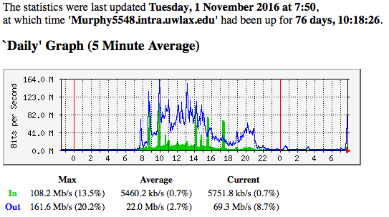
Daily - Bandwidth Usage (Eagle & Centennial)
Eagle - Wing Data Center
Eagle - Murphy Data Center
Daily Average = 203.4Mb/s
Daily Peak = 610.9Mb/s
Utilization of Eagle, with redundancy and load sharing between Wing and Murphy data centers
Centennial - Wing Data Center
Centennial - Murphy Data Center
Daily Average = 52.6Mb/s
Daily Peak = 377.8Mb/s
Utilization of Centennial, with redundancy and load sharing between Wing and Murphy data centers

Slide 9
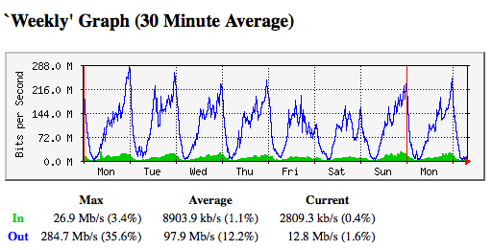
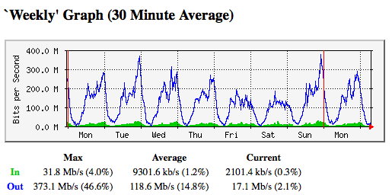
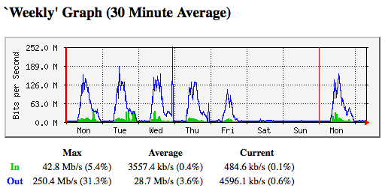
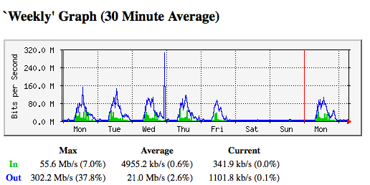
Weekly - Bandwidth Usage (Eagle & Centennial)
Eagle - Wing Data Center
Eagle - Murphy Data Center
Weekly Average = 216.5Mb/s
Weekly Peak = 657.8Mb/s
Utilization of Eagle, with redundancy and load sharing between Wing and Murphy data centers
Centennial - Wing Data Center
Centennial - Murphy Data Center
Weekly Average = 49.7Mb/s
Weekly Peak = 552.6Mb/s
Utilization of Centennial, with redundancy and load sharing between Wing and Murphy data centers

Slide 10
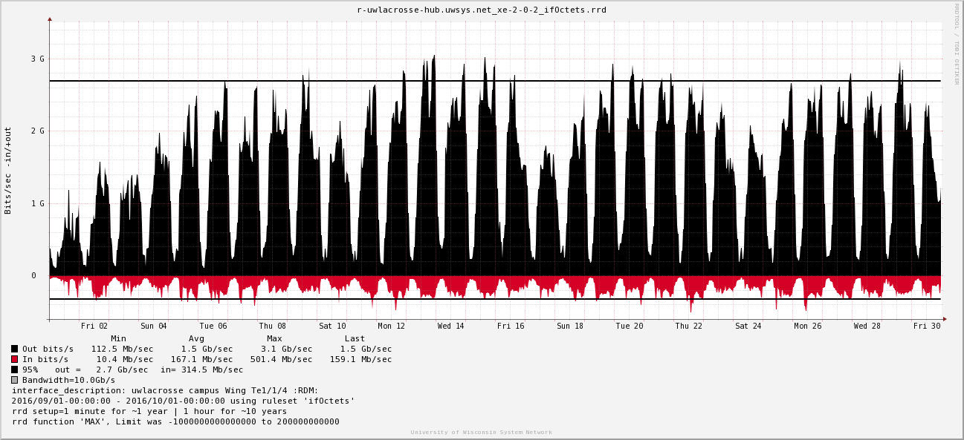
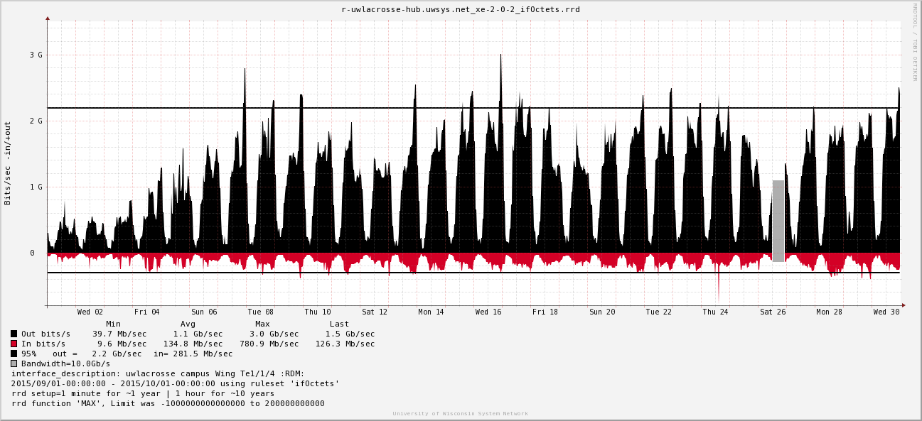
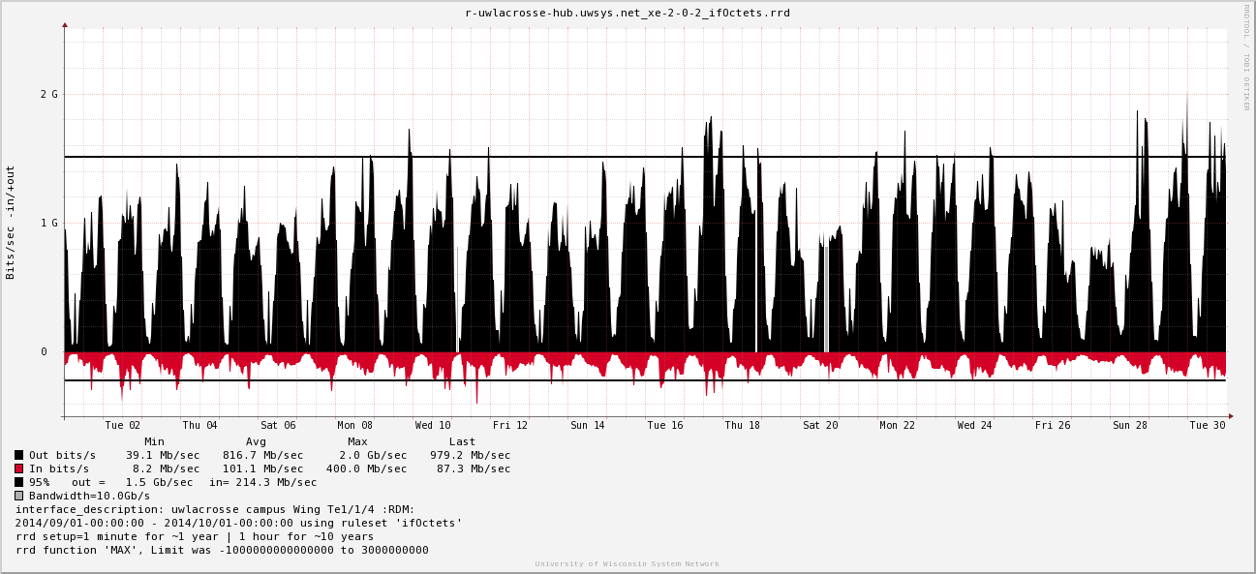
SysNet Traffic
Traffic metrics (95th Percentile)
FY 2017
2.7 Gb/s
FY 2016
2.2 Gb/s
FY 2015
1.5 Gb/s

Slide 11
Technology Improvements (FY 2015 – FY 2017)
From FY 2015 to FY 2017 There Were 1800 Wireless Access Points Added to Increase Coverage and Density Across Campus
FY 2016 Client Count of 30K Network Associated Devices and FY 2017 Client Count of 35K Network Associated Devices = 16.6% Increase
Deployment of Latest Advancement in Wireless Technology (802.11 AC Wave 2) Designed to Support Higher Density, Speeds, and Improved Quality of Service
Access Points Added to Every Resident Room, “Connected Anywhere... Fast”, Device Agnostic, Supports BYOD model, & Easy Wireless On-Boarding – Added Additional Wired Ports to Every Resident Room
Campus Internet access has been increased to accommodate the continued growth of devices and bandwidth needs (FY 2015 upgraded from 1Gb WiscNet to 10Gb SysNet circuit)
Three primary areas of network changes:
Increased Infrastructure Density (quantity of access points/switches and capability)
Increased Client Devices (16.6% increase of devices between FY 2016 and FY 2017)
Increased Network Usage (client devices “always online” and increased consumption)

Slide 12
Network Futures (FY 2018 – FY 2020)
Charter 10Gb Capacity in support of SpectrumU on Campus Network
Campus Fiber Infrastructure (redundancy and higher capacity)
Wing Data Center (higher availability)
Cellular Wireless over Wi-Fi
Augment cellular coverage using our Infrastructure
Core Network Refresh (higher performing backbone)
10% growth of Access Points per Year
Anticipated 20-25% Annual Network Usage Growth
1Gb to 10Gb connections to Access Points and Desktops
Refresh Edge Access Equipment (Switches & APs)
Support ”Internet of Things” (IoT) and Client Mobility
Anticipated 15-20% Annual Growth of Connected Devices

Slide 13
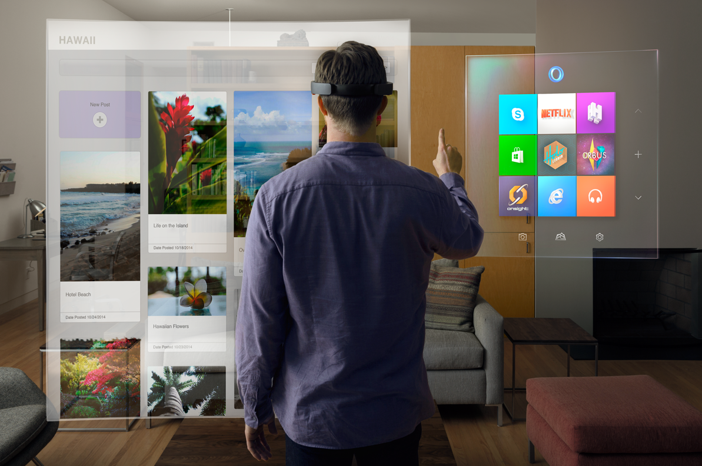
Ready for Tomorrow?

