Slide 1
UNIVERSITY OF WISCONSIN–MADISON
Palo Alto Enterprise Agreement
Notes:
GREETING APPROPRIATE FOR THE AUDIENCE

Slide 2
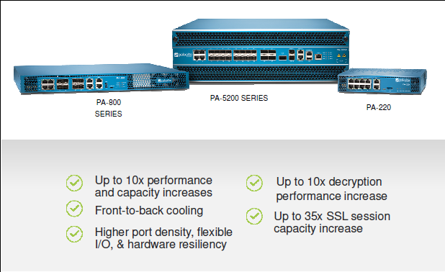
COST EFFECTIVE MANAGEMENT OF CYBERSECURITY RISK
UW-Madison has completed the purchase an enterprise licensing agreement that provides full coverage for intrusion prevention and new capabilities and that can be offered to UW System institutions.

Slide 3
ENTERPRISE AGREEMENT
What does the NGFW Initiative provide?
Added network defense against advanced and persistent threats
Management of mobile connections via an improved Global Protect VPN that includes prevention capability
Distributed IT security teams to manage firewalls through an easy to use interface
Focused cybersecurity operations capability to ensure sensors are monitored and malicious activity is managed.

Slide 4
EA DRILL DOWN
Licenses and Support through July 2020 – All you need is the hardware
Threat Prevention (TP)
PANDB-URL filtering (URL)
Global Protect (GP)
WildFire (WF)
Panorama CMS for unlimited number of users
Unlimited VM-300 licenses
Premium Support
Key Benefits
Share security information with other UW Campuses if desired
Automated Threat Prevention
Consistent security delivered from the cloud
Complete security delivered as a platform
Notes:
.

Slide 5
EA DRILL DOWN
WHAT THE EA IS NOT…
Hardware contracts
Hardware part replacement not covered under your hardware purchase
TRAPS endpoint security solution
Resident Engineer or dedicated Palo Alto engineering or program management support

Slide 6
BENEFITS, CHALLENGES AND WHAT’S NEXT?
Benefits
Common Platform
Aggregate risk reporting
Regionalized expertise
Economy of Scale
Challenges
Single Source for placing risk at an acceptable level (high/low watermark)
Monitor risk through Continuous Diagnostics and Mitigation
Annual re-evaluation of risk

Slide 7
THANK YOU.
Notes:
CLOSE WITH ENCOURAGEMENT TO MANAGE RISK APPROPRIATELY AND OFFER THE OFFICE OF CYBERSECURITY AS A RESOURCE.

