Slide 1
UWSysNet Transport and Fiber Updates
Dan Parenteau
8/10/2017

Slide 2
BOREAS-Net 2006

Slide 3
BOREAS-Net 2008

Slide 4
BOREAS-Net 2014

Slide 5
BOREAS-Net 2016

Slide 6
Ciena Waveserver
100G/200G Line Side WAN Ports
100G QSFP28 Ports
10G/40G QSFP+ Ports
10G/40G QSFP+ Ports

Slide 7
Infinera TM 4x100G Flexponder
Interfaces:
4x 100G QSFP28 client +
2x 100G/200G CFP2 line.
100GbE & OTU4 client support.
G.709 OTN compliance.
Optional staircase FEC.
HW ready Line side encryption.
80W including optics = 20W per 100G.
1-slot solution. 4x units in a TM-301/II (1.6T !).
Interop with TP100GOTN & TP100GOTN/II (@100G).
Interop with LIM-1-100G on XTC’s (@100G).
1 slot
Client side
Line side
4x OTU4/ 100GbE
(QSFP28)
2x 100G/200G (CFP2)
4x 100G Flexponder (FXP400GOTN)

Slide 8
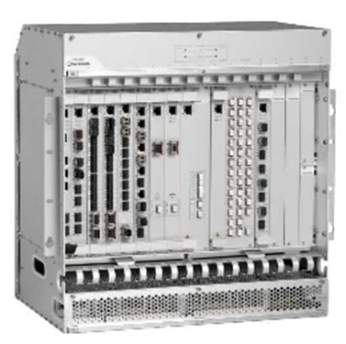
Infinera TM
TM-3000/II (11U)
Up to 16 full-sized Up to 10 half-sized
TM-301/II (3U)
Up to 4 full-sized Up to 4 half-sized
TM-102/II (1U)
One full-sized
One half-sized

Slide 9
Fond Du Lac Before

Slide 10
Fond Du Lac with City Fiber

Slide 11
Fond Du Lac after Cutover

Slide 12
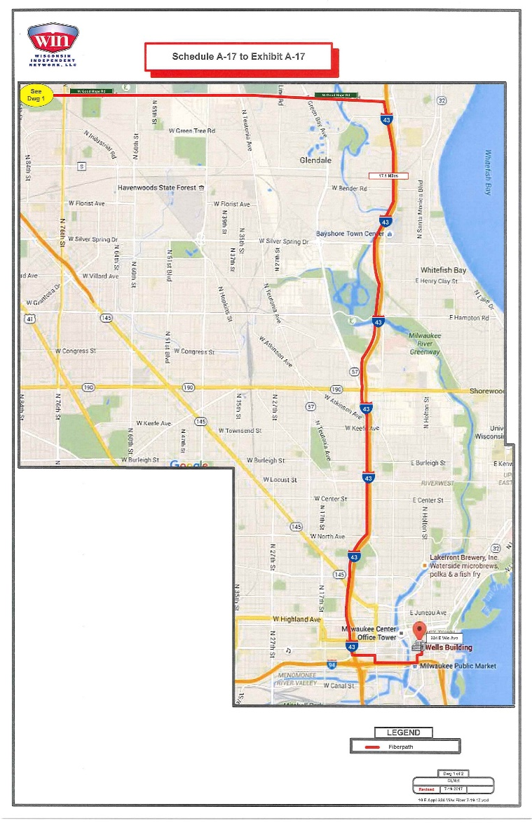
Fiber down Highway 41

Slide 13
UWSysNet Fiber Topology
Notes:
Mention Milwaukee Fiber Installation

Slide 14
Questions?
dan.parenteau@wisc.edu

