Slide 2
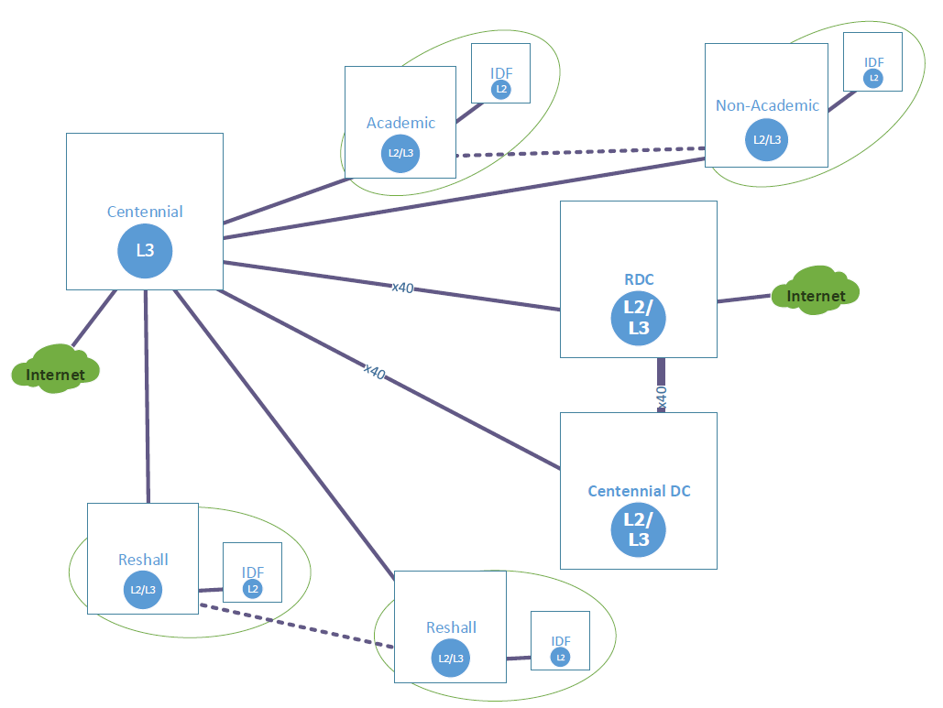

Slide 3
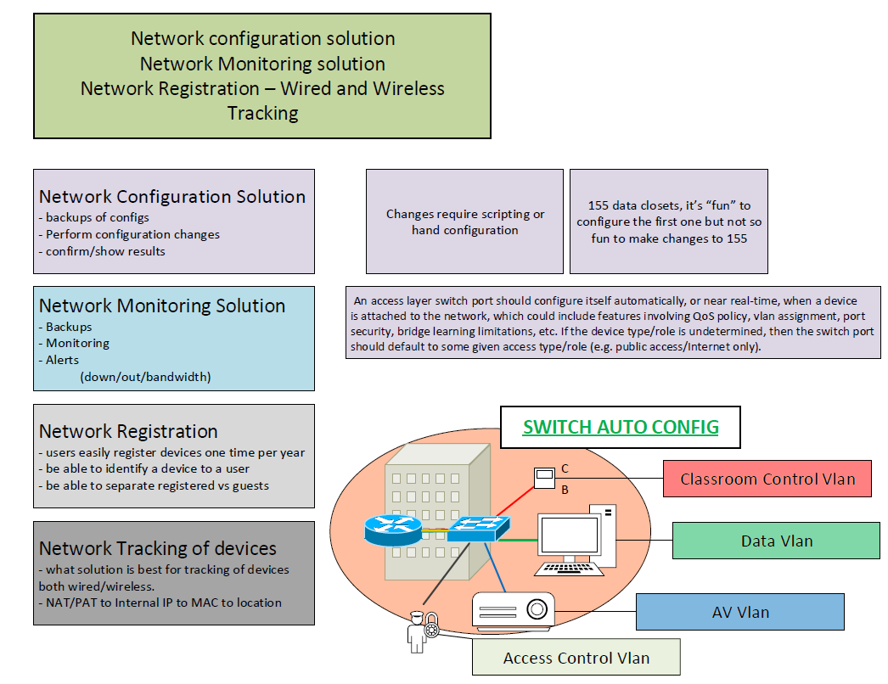

Slide 4
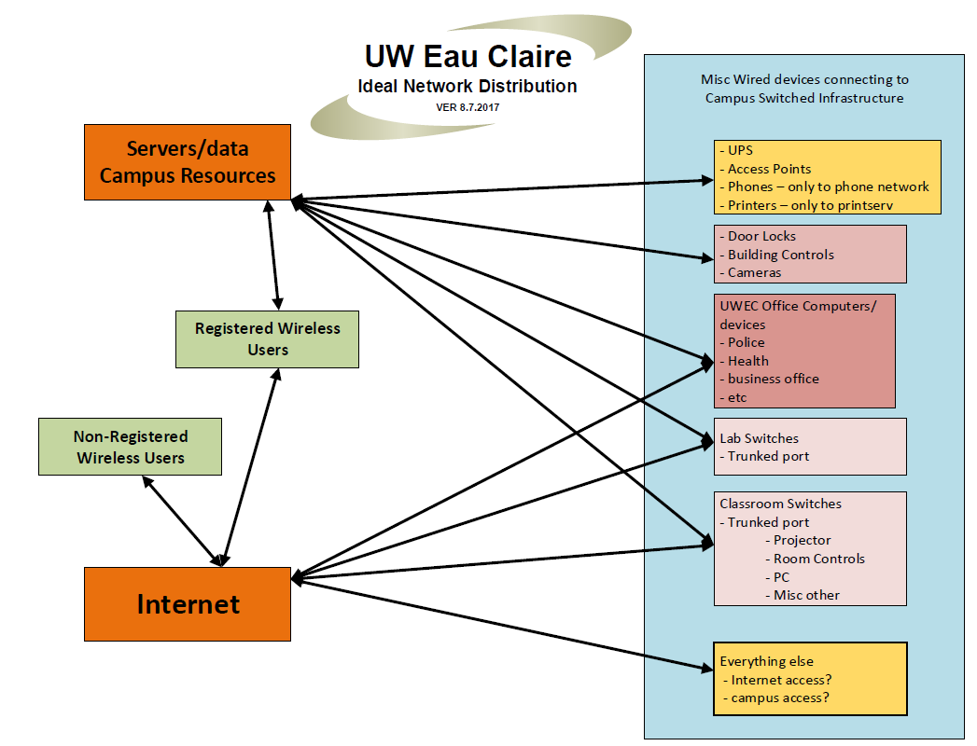

Slide 5
Daren Bauer – BAUERDP@uwec.edu
Kent Gerberich - GERBERIK@uwec.edu

