Slide 1
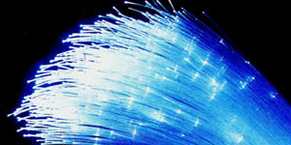
Optical Transport Review
UWSys Net Tech Meeting, 5/23/16
Bill Jensen (WEJ)

Slide 2
DWDM Transport Status
L1 Transport Review
Transport Management
Software Status
Future Upgrades

Slide 3
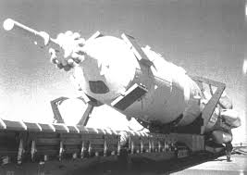
L1 Transport Review
Long haul is Infinera DTC/XTC/OTC equipment
Also comprised of Infinera ATN metro nodes
Passive per-span Snazzy muxes
Local passive DWDM/CWDM muxes

Slide 4
Transport Management
Long haul and metro Infinera devices are managed using Infinera Digital Network Administrator (DNA)
Local muxed and Snazzy muxed spans rely on standard router and switch management practices to determine status and health of optical spans.

Slide 5
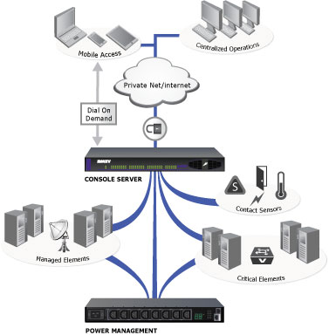
OOB Network Devices
Out of band network access is architected into each system to allow for accessing network devices during periods of planned and unplanned (fiber) outages
Cisco 1921 integrated services routers for UWSYSNET
Cisco 1811 integrated services routers for BOREAS
EOL so we need a suitable replacement

Slide 6
Infinera Software Updates
DNA was running at 8.2.1 until August 2015
Upgraded to 10.1 8/10/15
Upgrade to 11.0.2 began 9/29/15
DTC/XTC network nodes were running on IQNOS 8.2.1_0449 until mid-2015
Upgraded to 9.0.4 10/4/15
Upgraded to 11.0.3 10/25/15
Next upgrade no earlier than summer. Will take on the “new” year.quarter format (e.g. 16.2)

Slide 7
CWDM Overlay

Slide 8
UWSysnet Infinera Transport

Slide 9
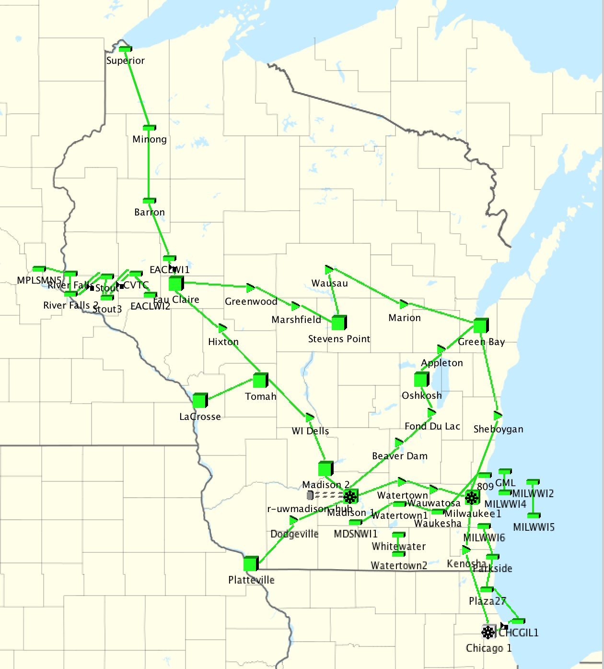
UWSysnet View in DNA

