Slide 1
BOREAS/UWSysNet Layer1 Transport Update
Bill Jensen
UW Madison WAN Team
wej@doit.wisc.edu

Slide 2
Topics
Evolution of BOREASnet and Wisconsin Layer 1 Transports
Timeline
Topology
Spectrum Overview
DWDM Channels
CWDM Channels
Creative Use of Technology
Reallocate Line Modules to create an shift & skip overlay
Nazzy Mux
Next Steps
Notes:
In the name of time, will limit the discussion to lit wdm transports.

Slide 3
Timeline
BOREASnet Turn Up
BOREAS Upgrade to 200G
BOREAS Upgrade to 700G
UWSysnet Deployment 20G-200G
BCCB Deployments
Present
Nov 7
September
Dec 20
2006
2007
2008
2009
2010
2011
2012
2013
2014
2015
2016
5 days
Initial Deployment
(OCG5)
Today
16 days
100G Upgrade
(OCG3)
BCCB
Upgrades
UWSysnet Upgrades
24 days
500G Upgrade
17 days
25 days
Notes:
2007 Boreasnet turned up. 100G capacity (OCG5)
2008-2009 OCG3 added for upgrade to 200G
2011-2013 bccb equipment was used to enhance select wisconsin segments and build up 100G transport uwec->uwgb->uwm. metro class gear was used to light up 10G services from uwmad->uwo->uwgb
Boreasnet had 200G of capacity along long most segments in early 2013. bccb long haul segments were 100G and increased some boreas segments to 300G
Boreas added 500G layer, bringing the longhaul capacity to 700G. xtc installs beginning mid-2013, ending fall 2014
bccb and other non-uw shared equipment was removed and replaced with uw-owned equipment along paths needed for uwsystem circuits. removing said non-uw owned equipment from the existing service path left some significant gaps in the network. the gaps were refilled with equal or improved infrastructure
planning and design was latter 2013 and early 2014. purchase and equipment reception by summer. deployment was summer/fall.

Slide 4
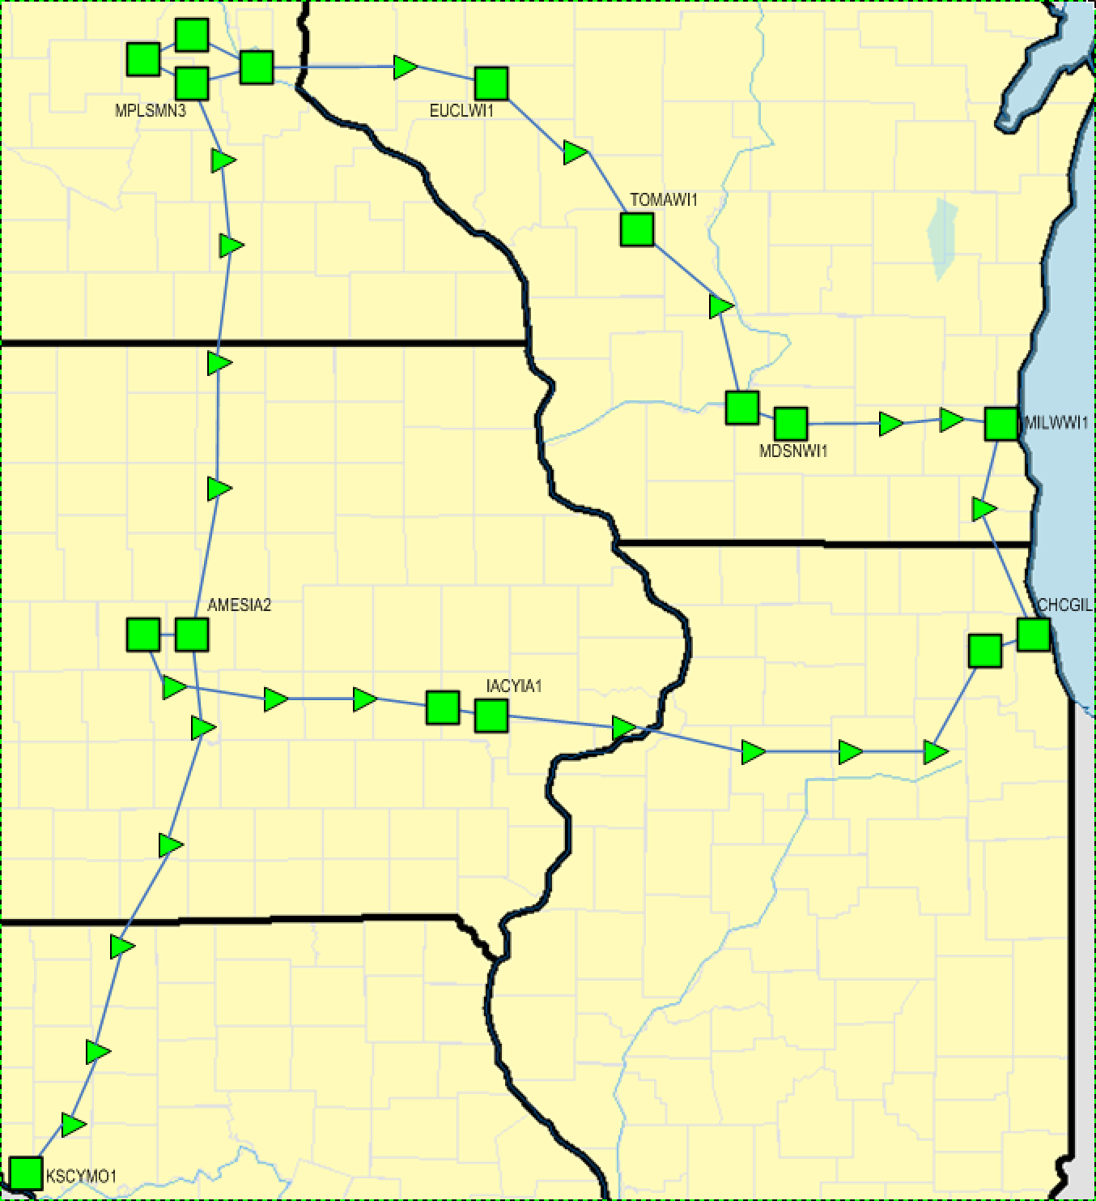
2013 BOREASnet Topology (Overall)

Slide 5
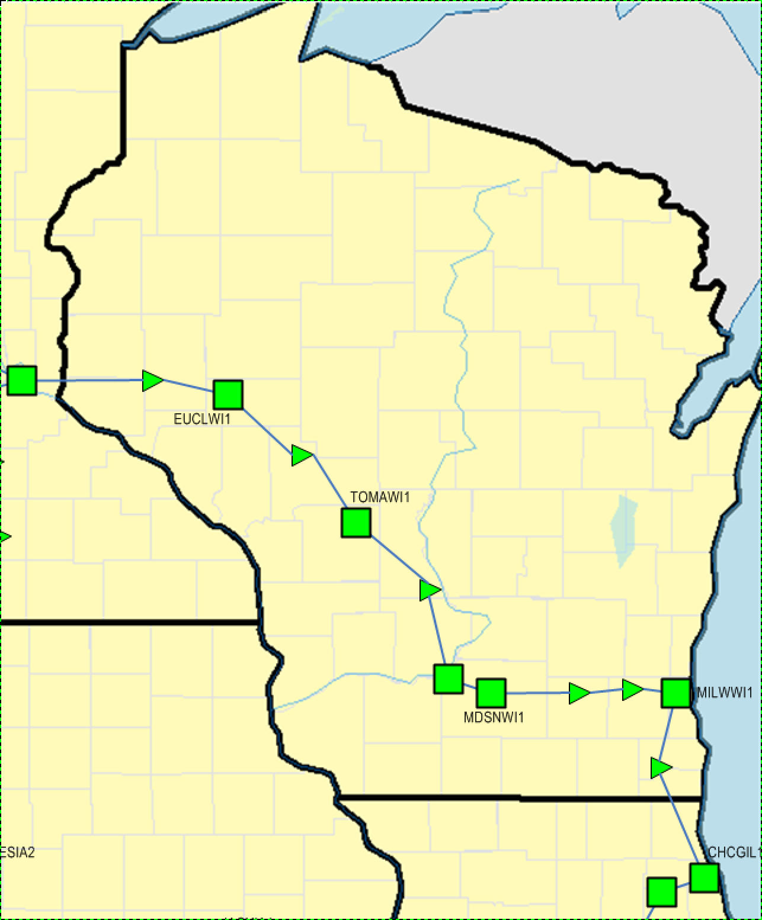
2013 BOREASnet Topology (WI)

Slide 6
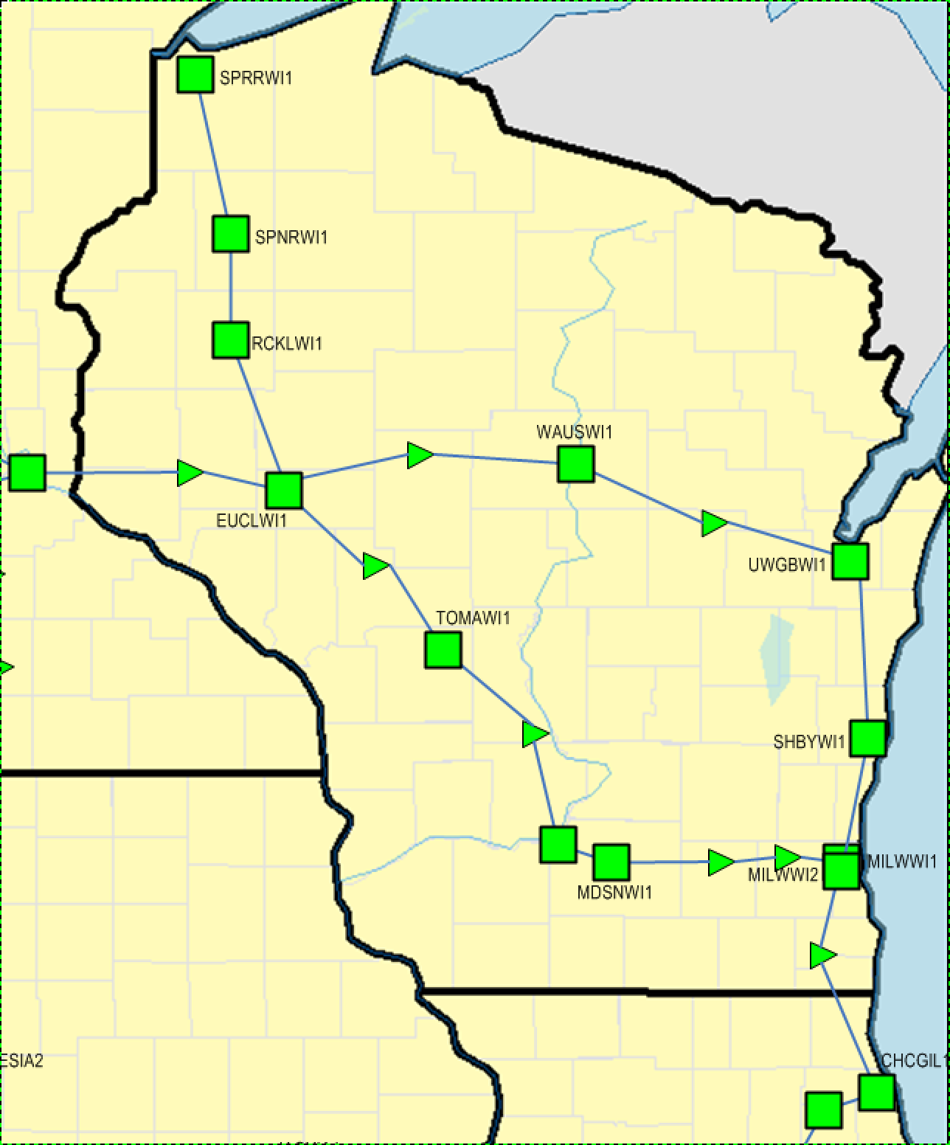
2013 Wisconsin Long Haul Transport

Slide 7
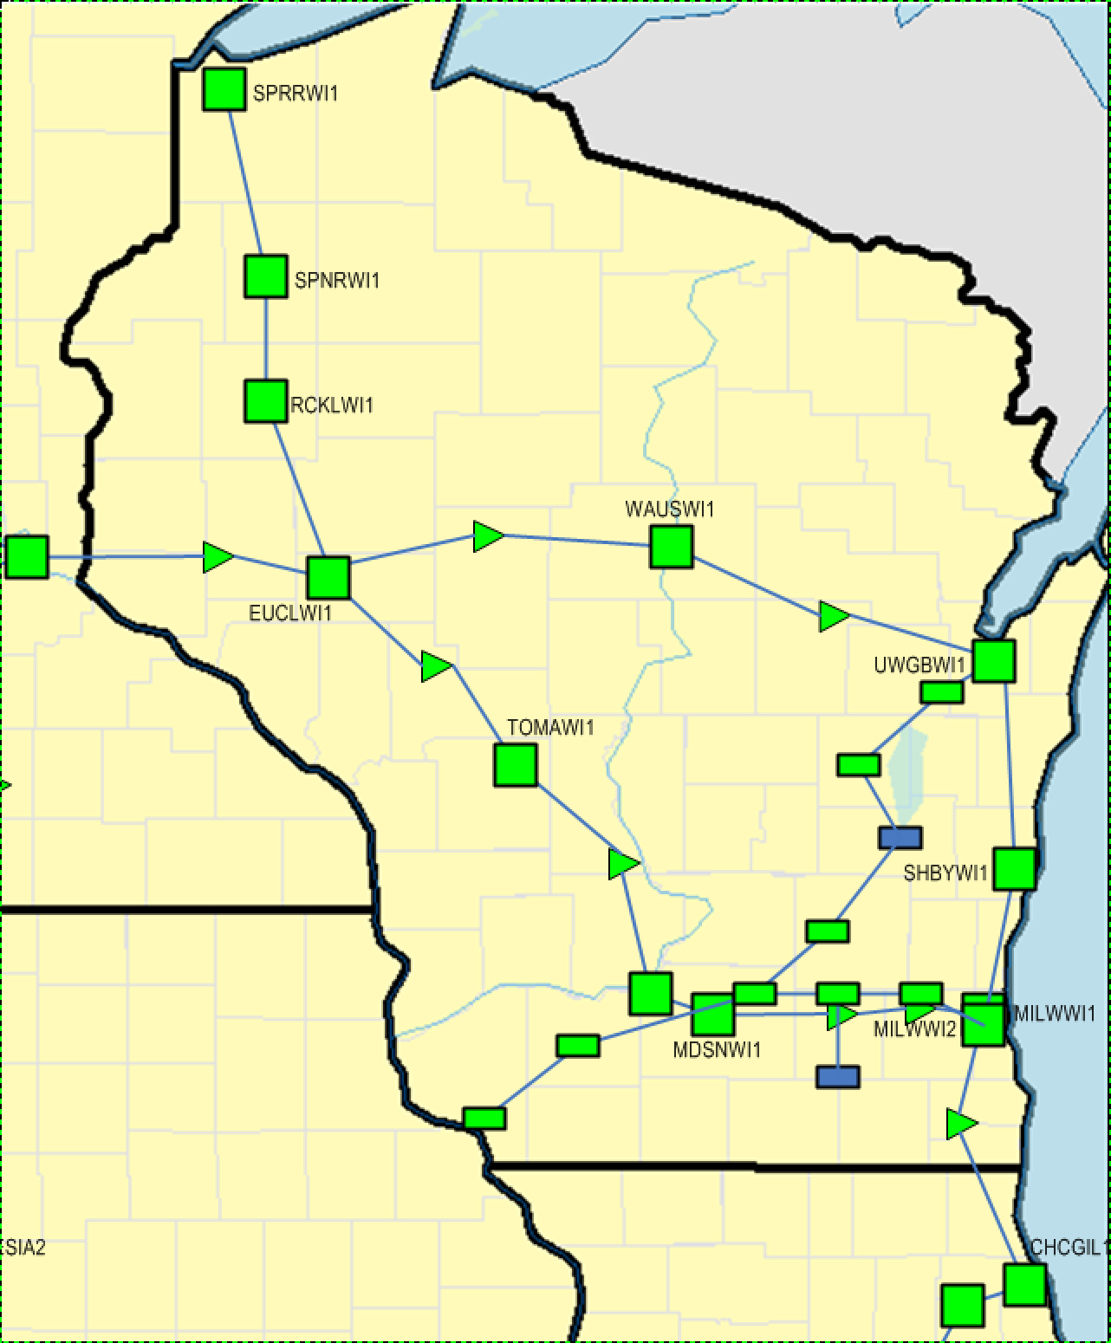
2013 Wisconsin LH+Metro Transport

Slide 8
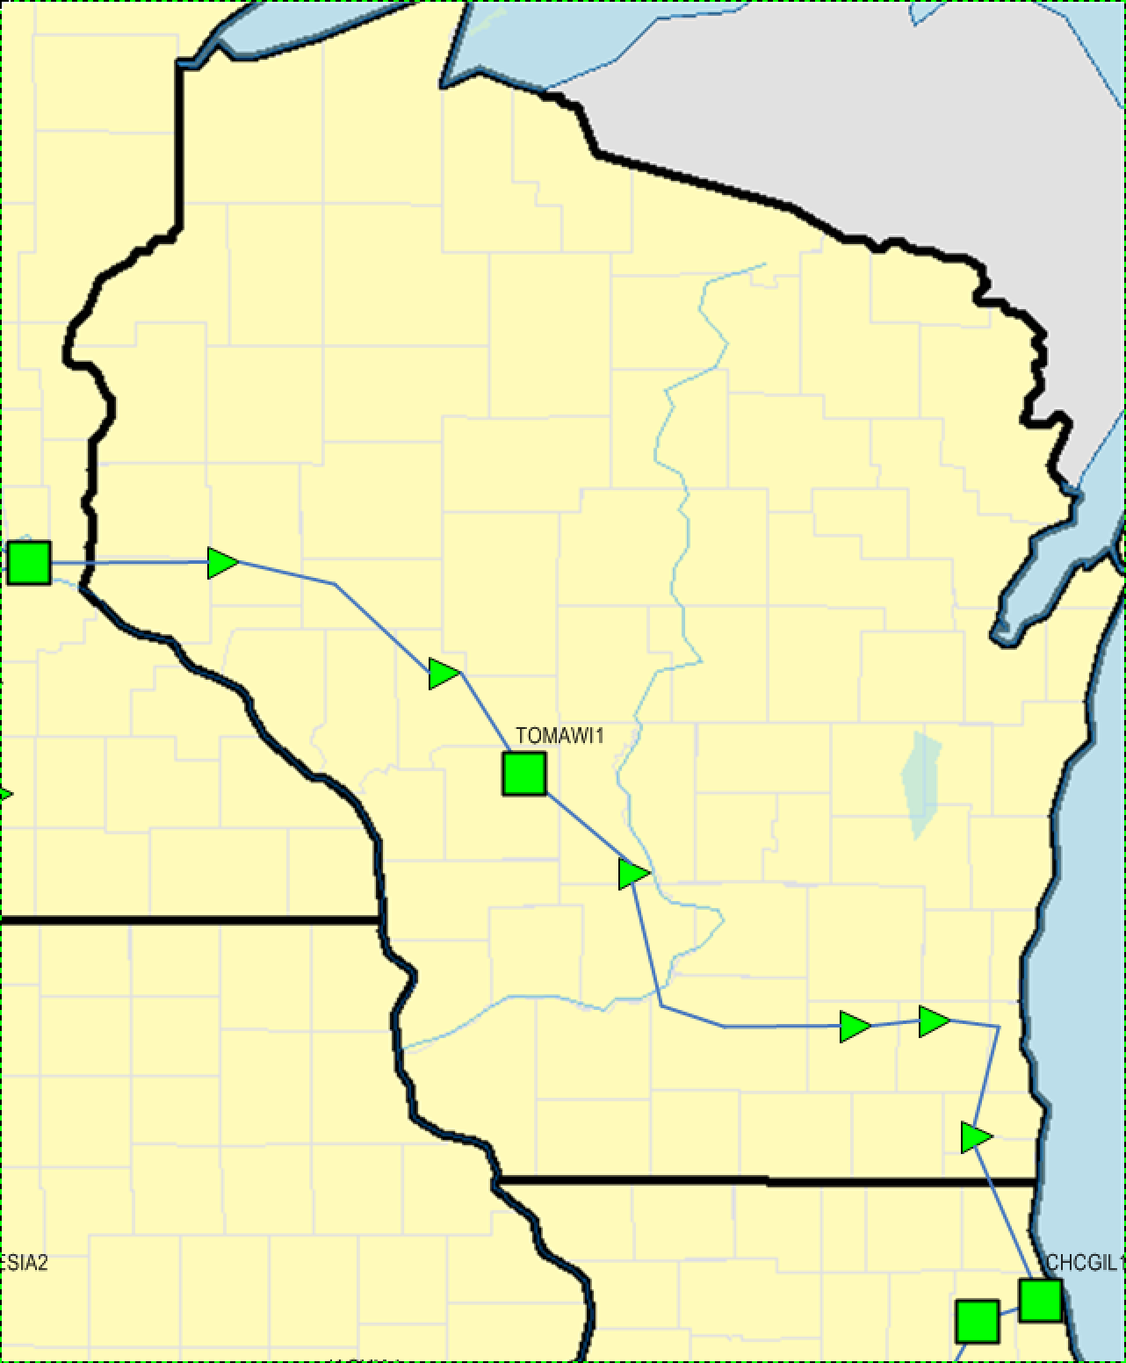
2014 Wisconsin Stripped Transport

Slide 9
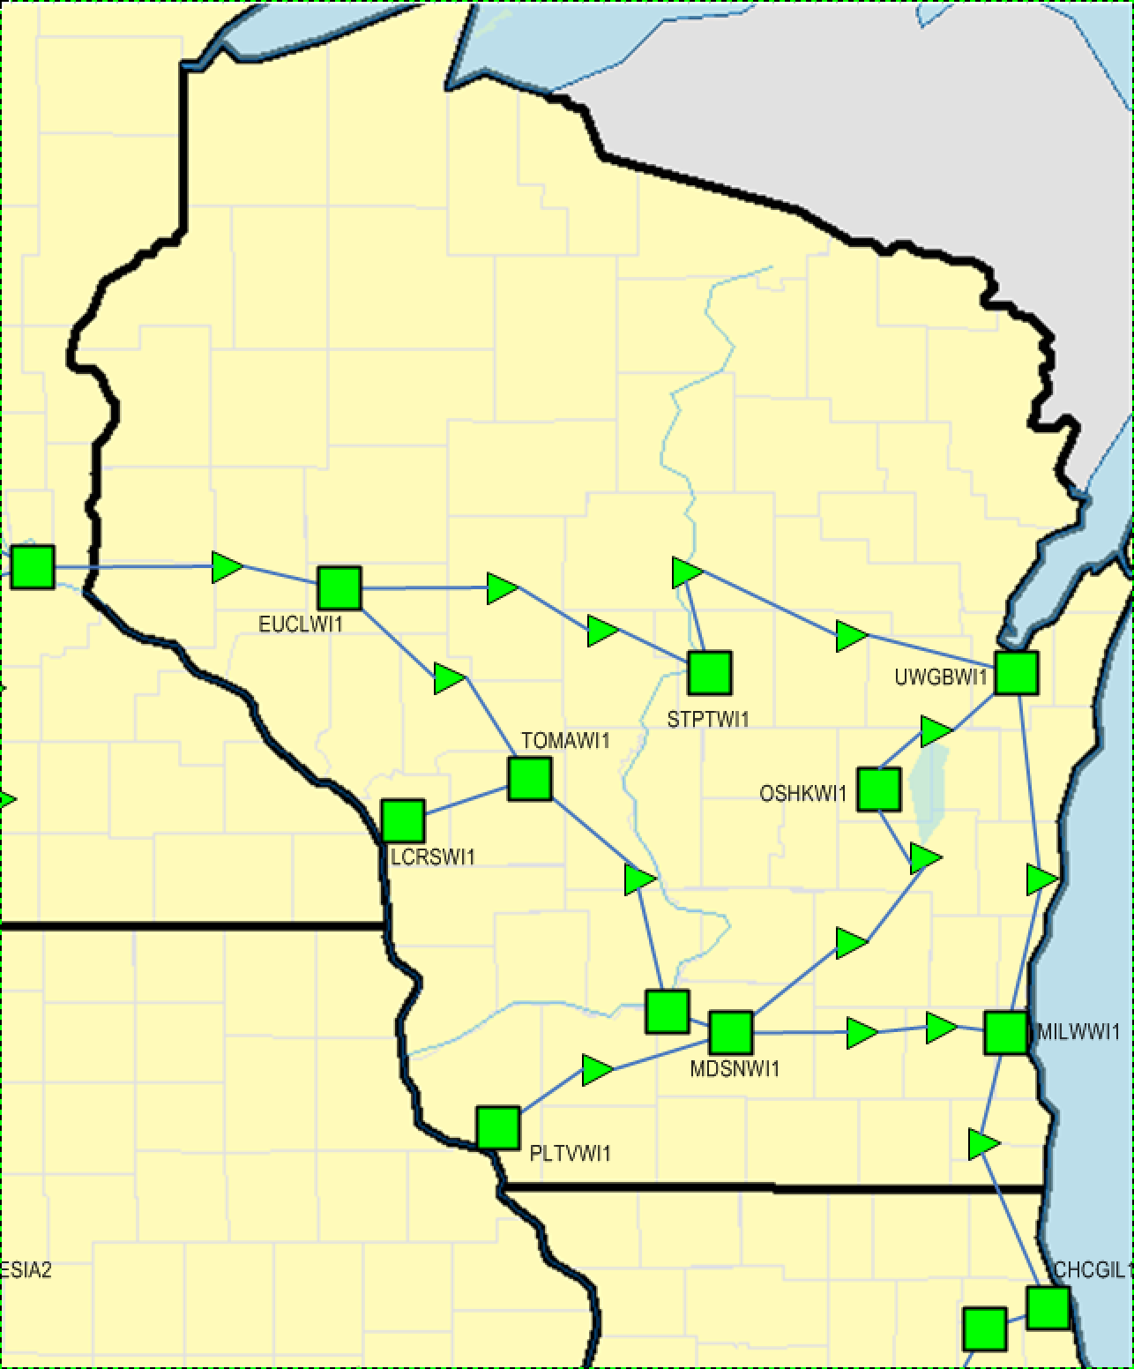
2014 UWSysnet Outfitted LH Transport

Slide 10
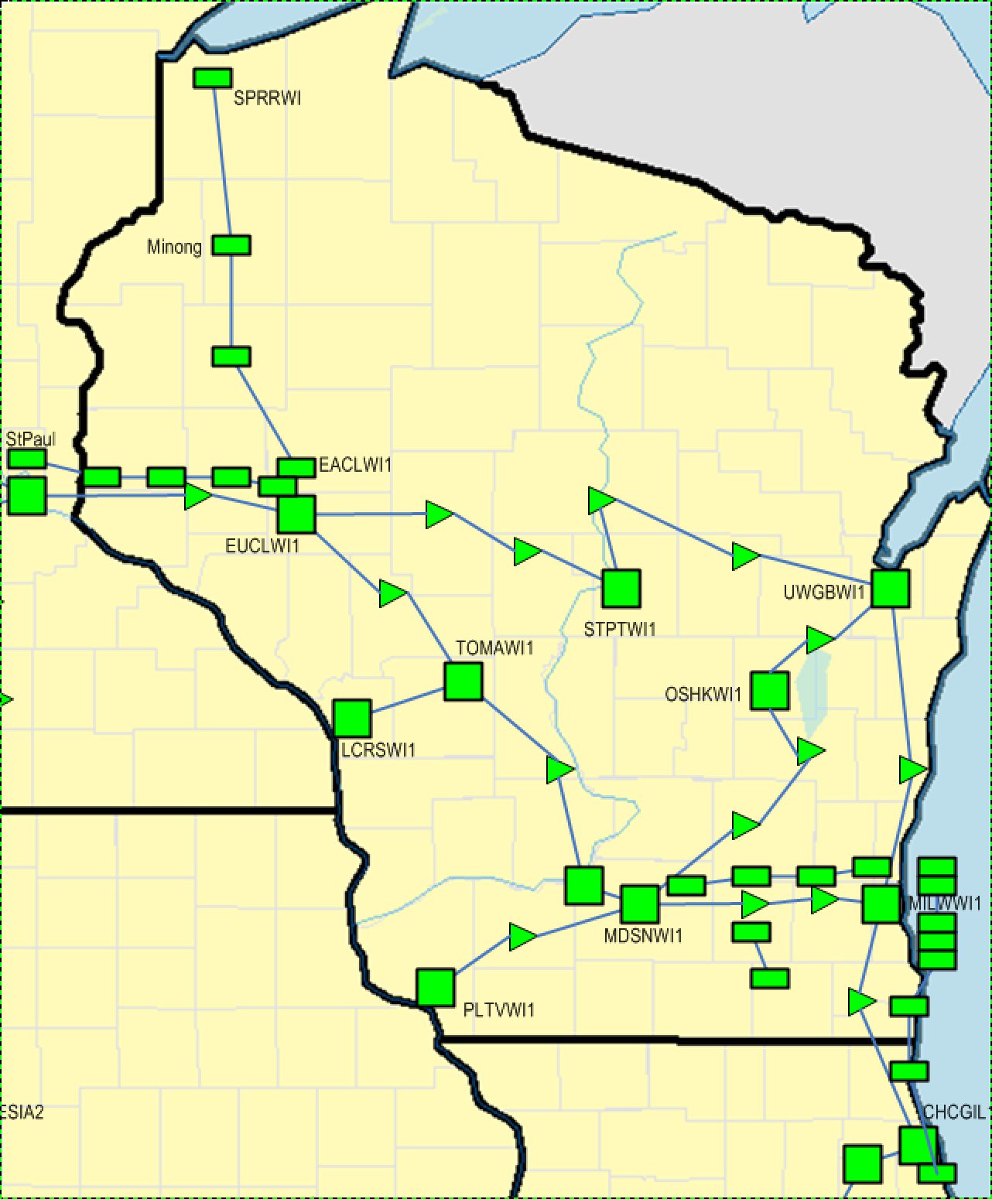
2014 UWSysnet Outfitted LH+Metro Transport

Slide 11
Creative Use of Technology
Reallocate Line Modules to create an shift & skip overlay
Shuffling Line Models along the Madison->EauClaire->Stevens Point->Green Bay
Nazzy Mux

Slide 12
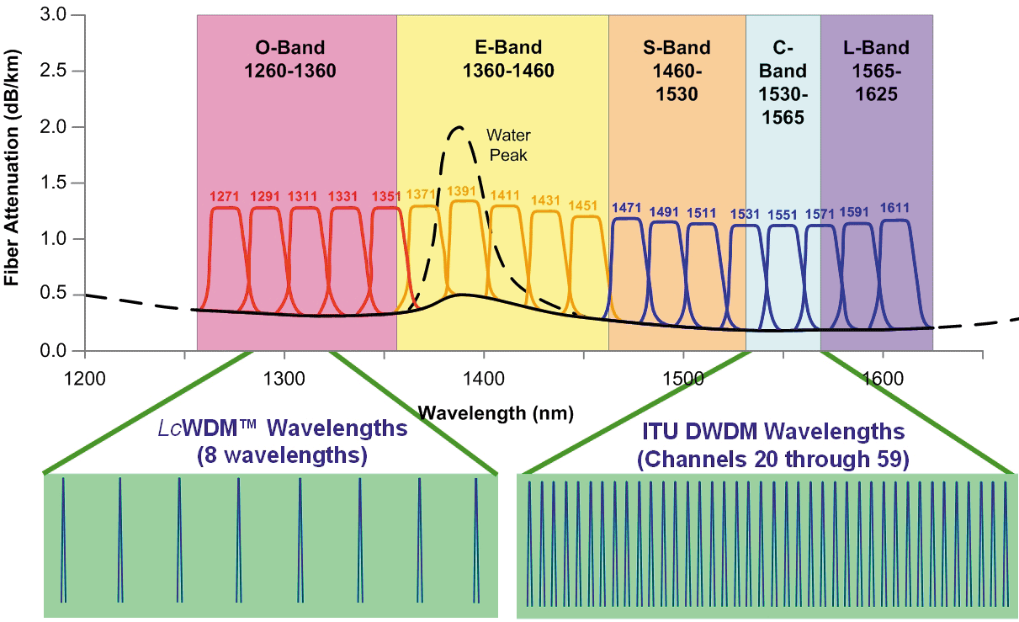
Overall SM Fiber Spectrum

Slide 13
DWDM Wavelengths Nested in CWDM Wavelengths
CWDM
wavelengths
DWDM
wavelengths
1471nm
1491nm
1511nm
1531nm
1551nm
1571nm
1591nm
1611nm

Slide 14
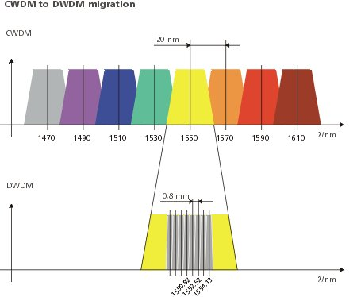
More DWDM Mapping
nm

Slide 15
Infinera DWDM Wavelength Plan
DLM-#-5
DLM-#-1
40-λ (10G)
DLM-#-7
DLM-#-3
DLM-#-6
DLM-#-2
80-λ (10G)
DLM-#-8
DLM-#-4
ITU-T G.692
wavelength
grid
195.9 1530.33
192.3 1558.98
(THz) (nm)
195.7 1531.90
195.5 1533.47
195.3 1535.04
195.1 1536.61
194.9 1538.19
194.7 1539.77
194.5 1541.30
194.3 1542.90
194.1 1544.50
193.9 1546.10
193.7 1547.72
193.5 1549.32
193.3 1550.92
193.1 1552.52
192.9 1554.13
192.7 1555.75
192.5 1557.36
192.1 1560.60
191.9 1562.23

Slide 16
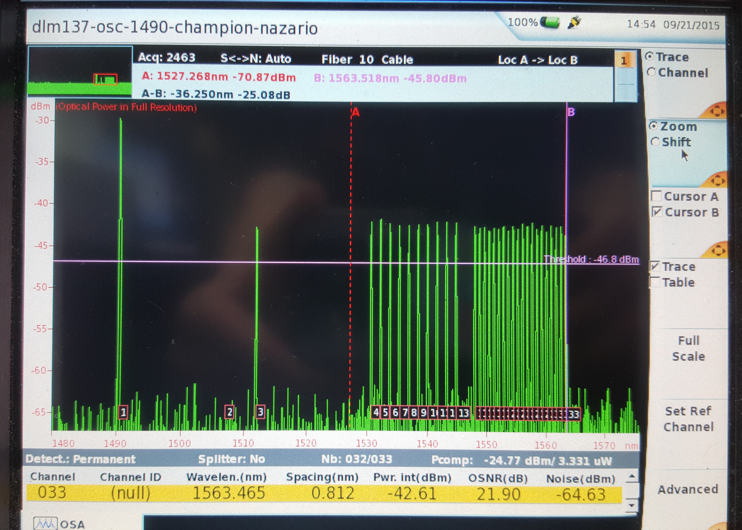
Mux Testing

Slide 17
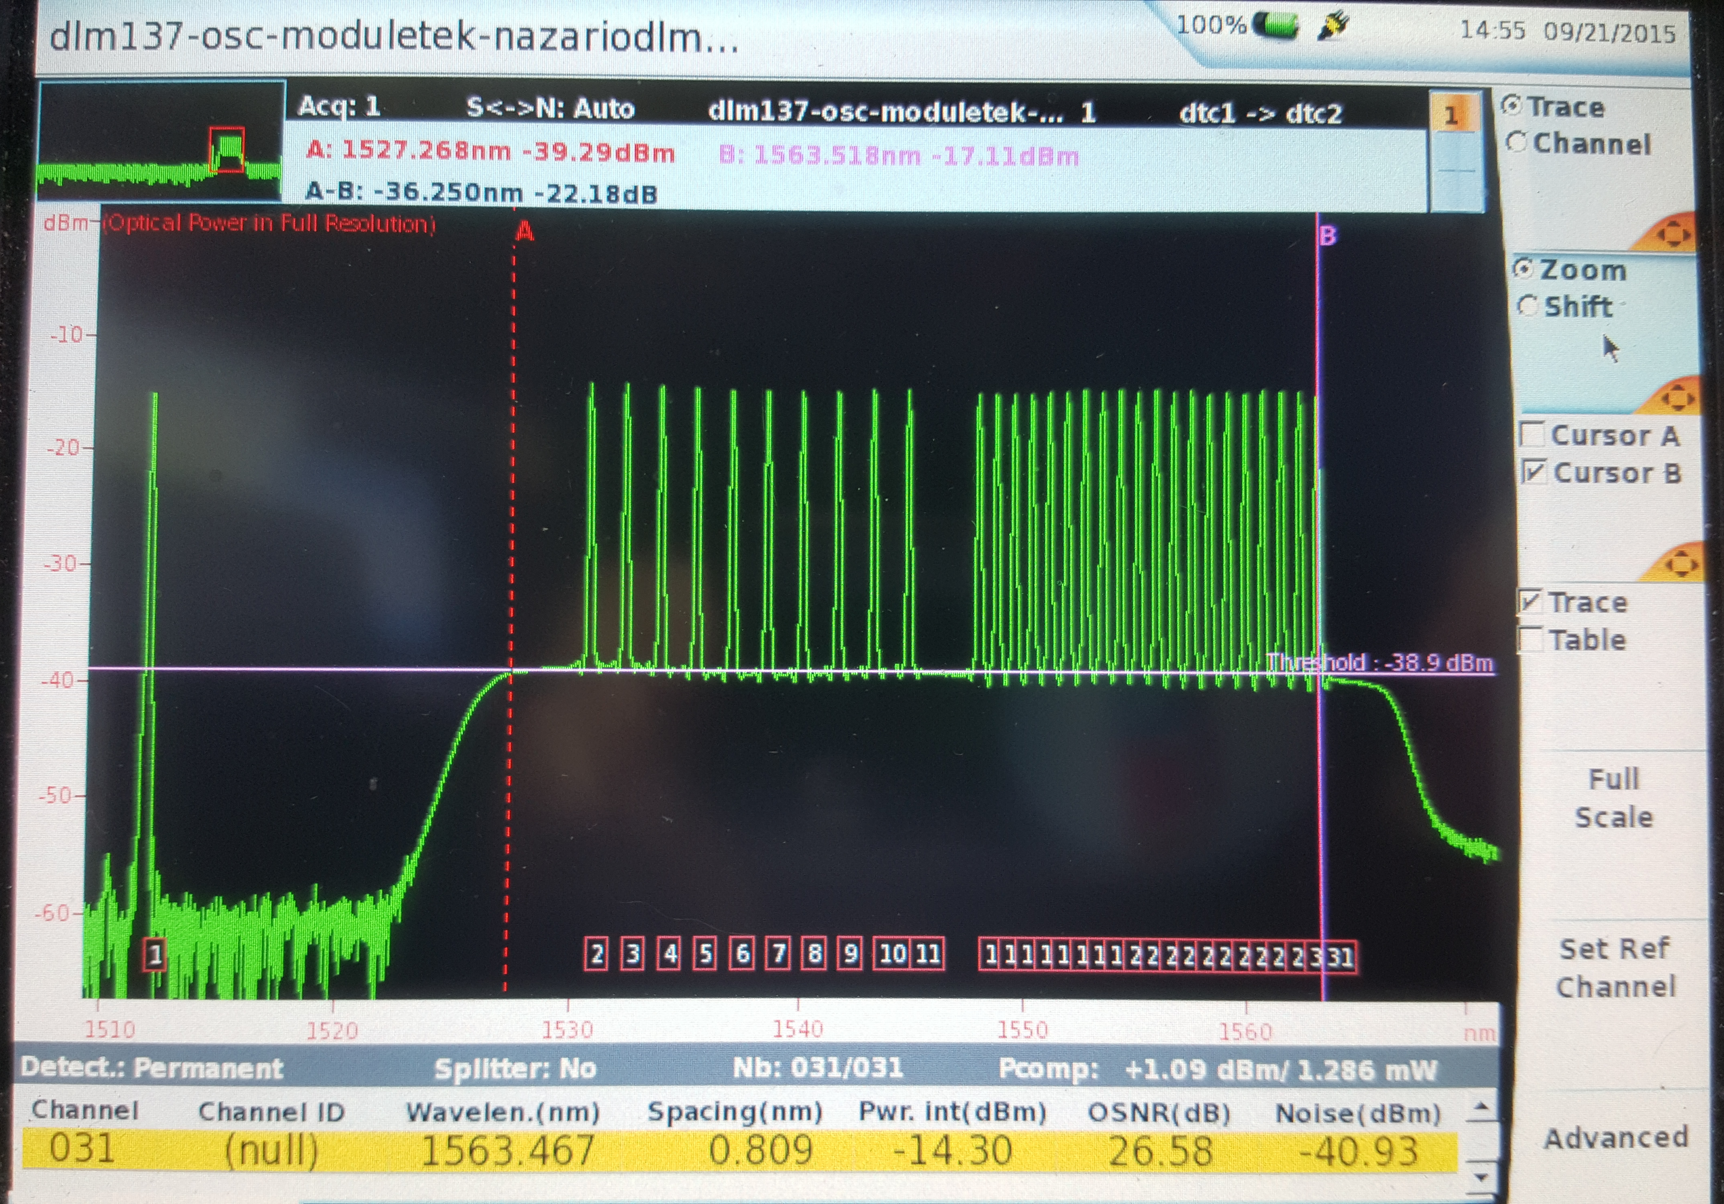
more Mux Testing

Slide 18
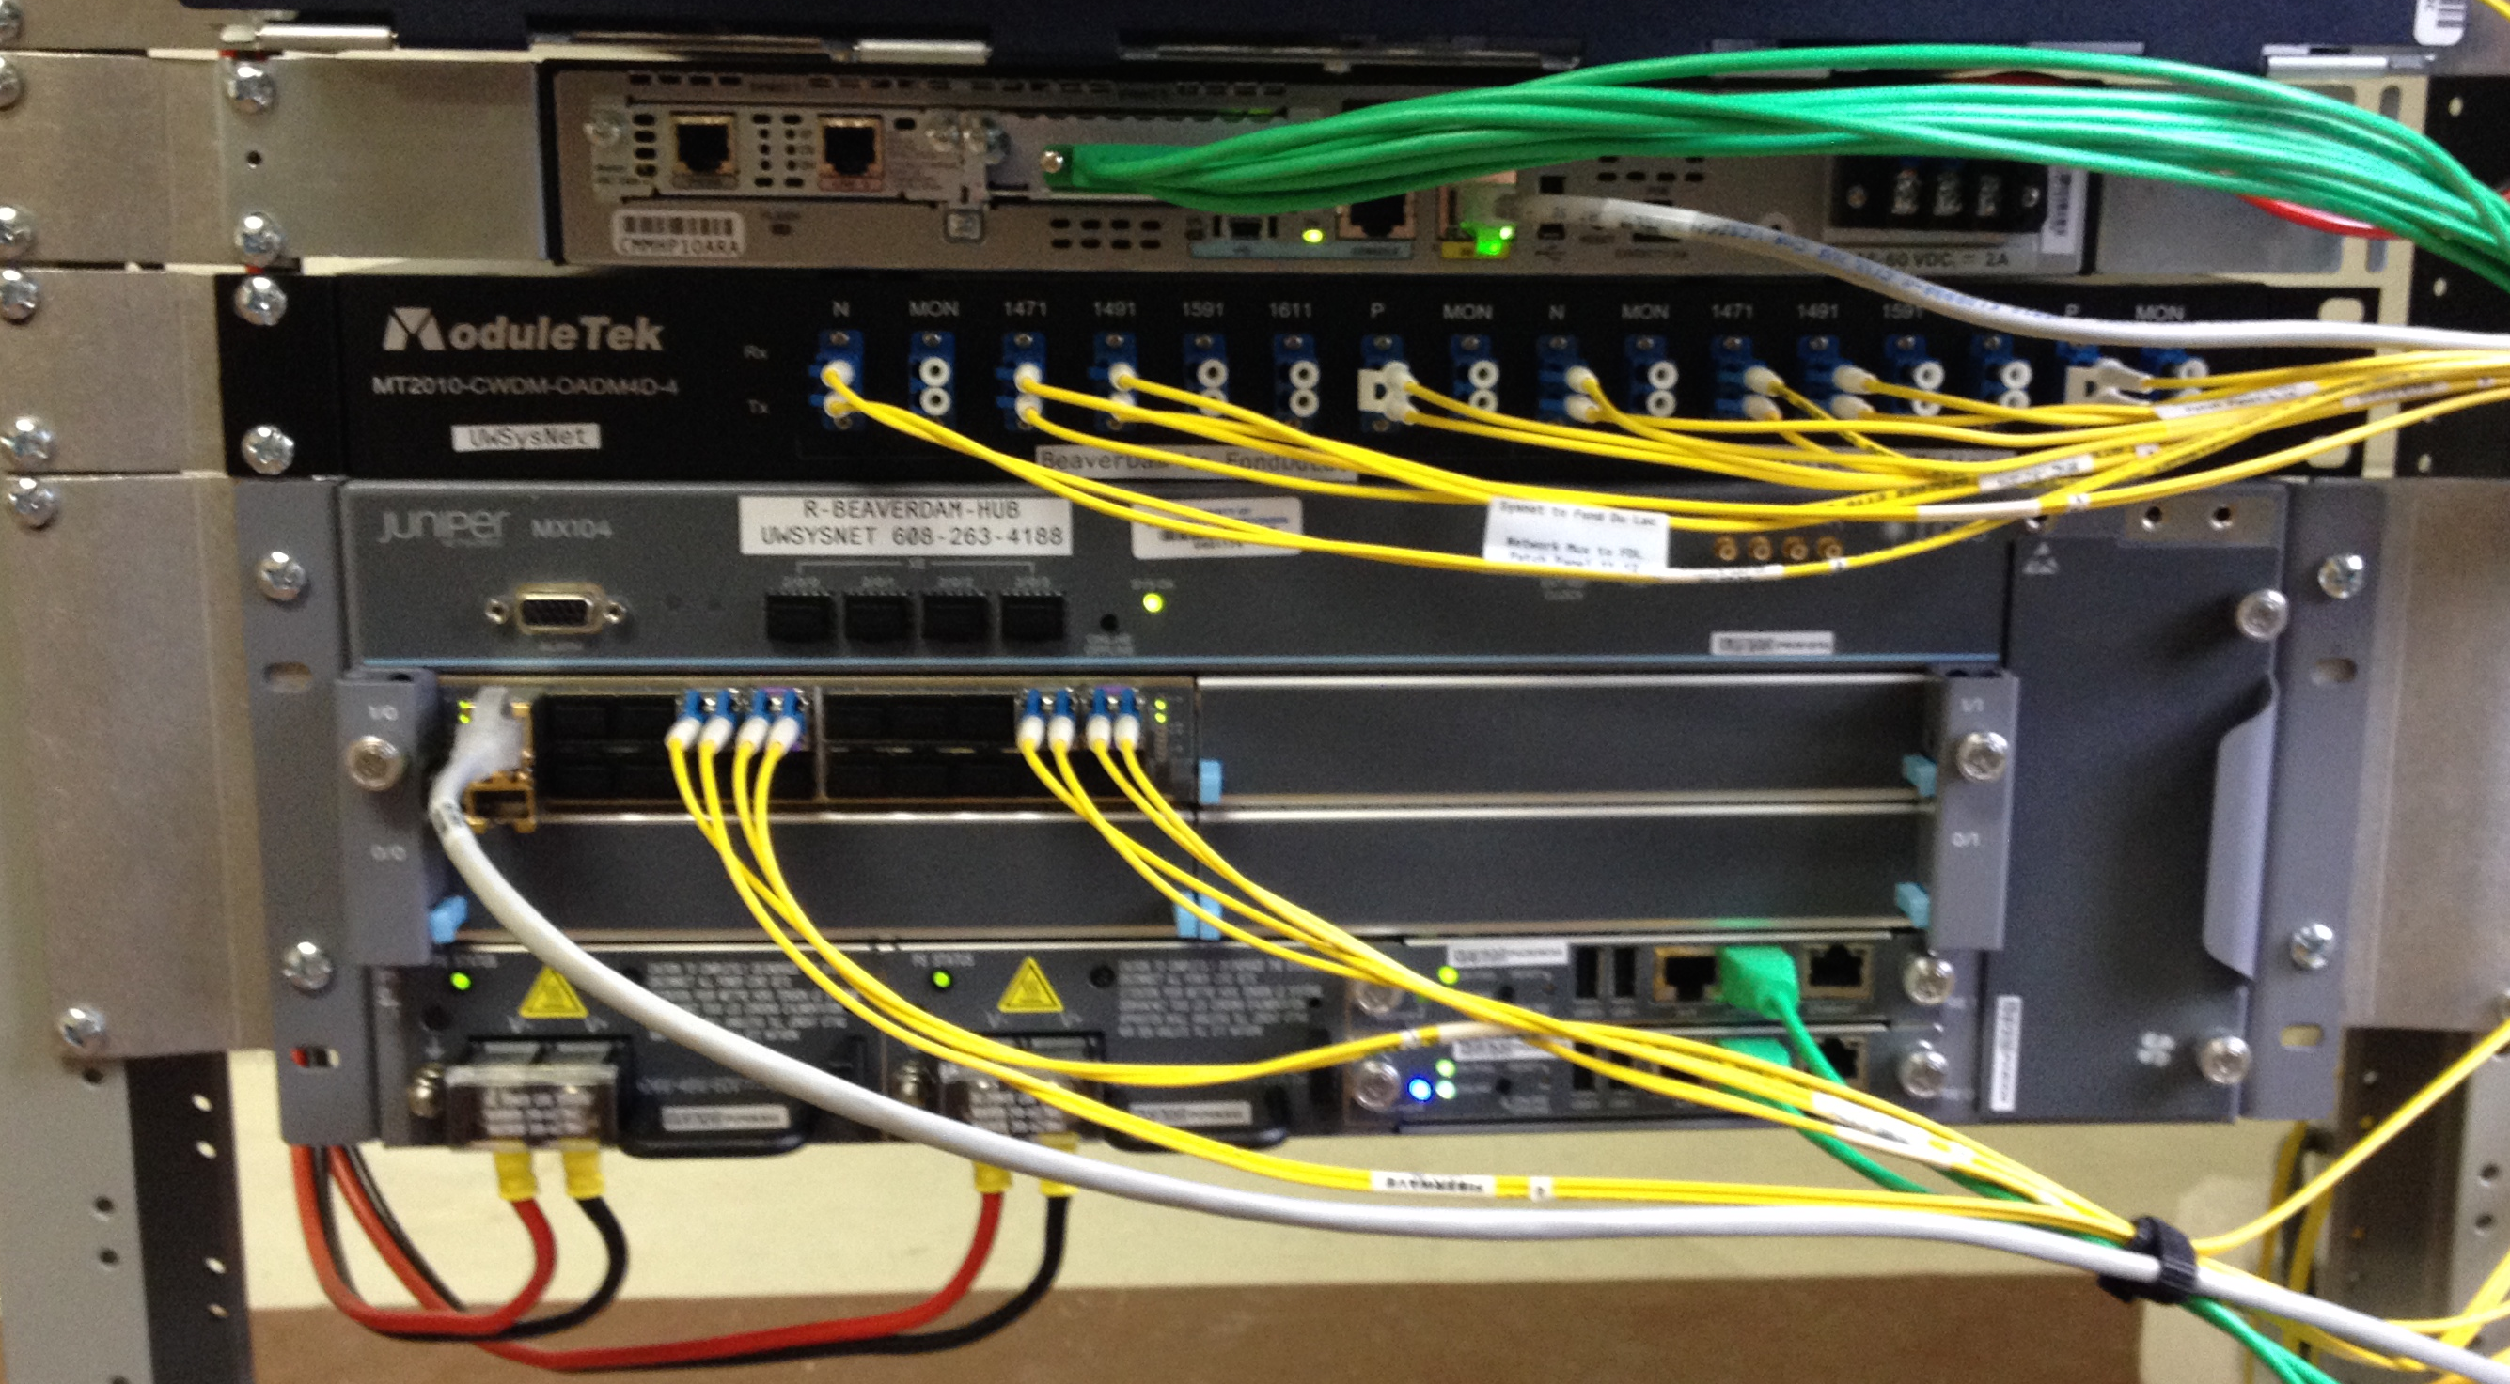
Example of an Installed Mux

Slide 19
Closeup of Nazario (Nazzy) Mux

Slide 20
Next Steps
Cleanup
A small amount of follow up labeling, etc.
Physical site cleanup (e.g. mke)
DC plant configuration
Documentation
Circuit Adds
For folks like Dan Dargel
Software upgrades
Software upgrades were delayed in favor of installation completion
Capacity Upgrades

Slide 21
Questions?

Slide 22
Thank You

Slide 23
Backup Slides

Slide 24
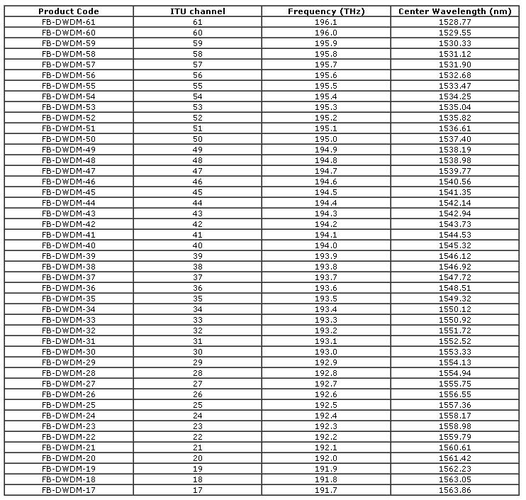

Slide 25
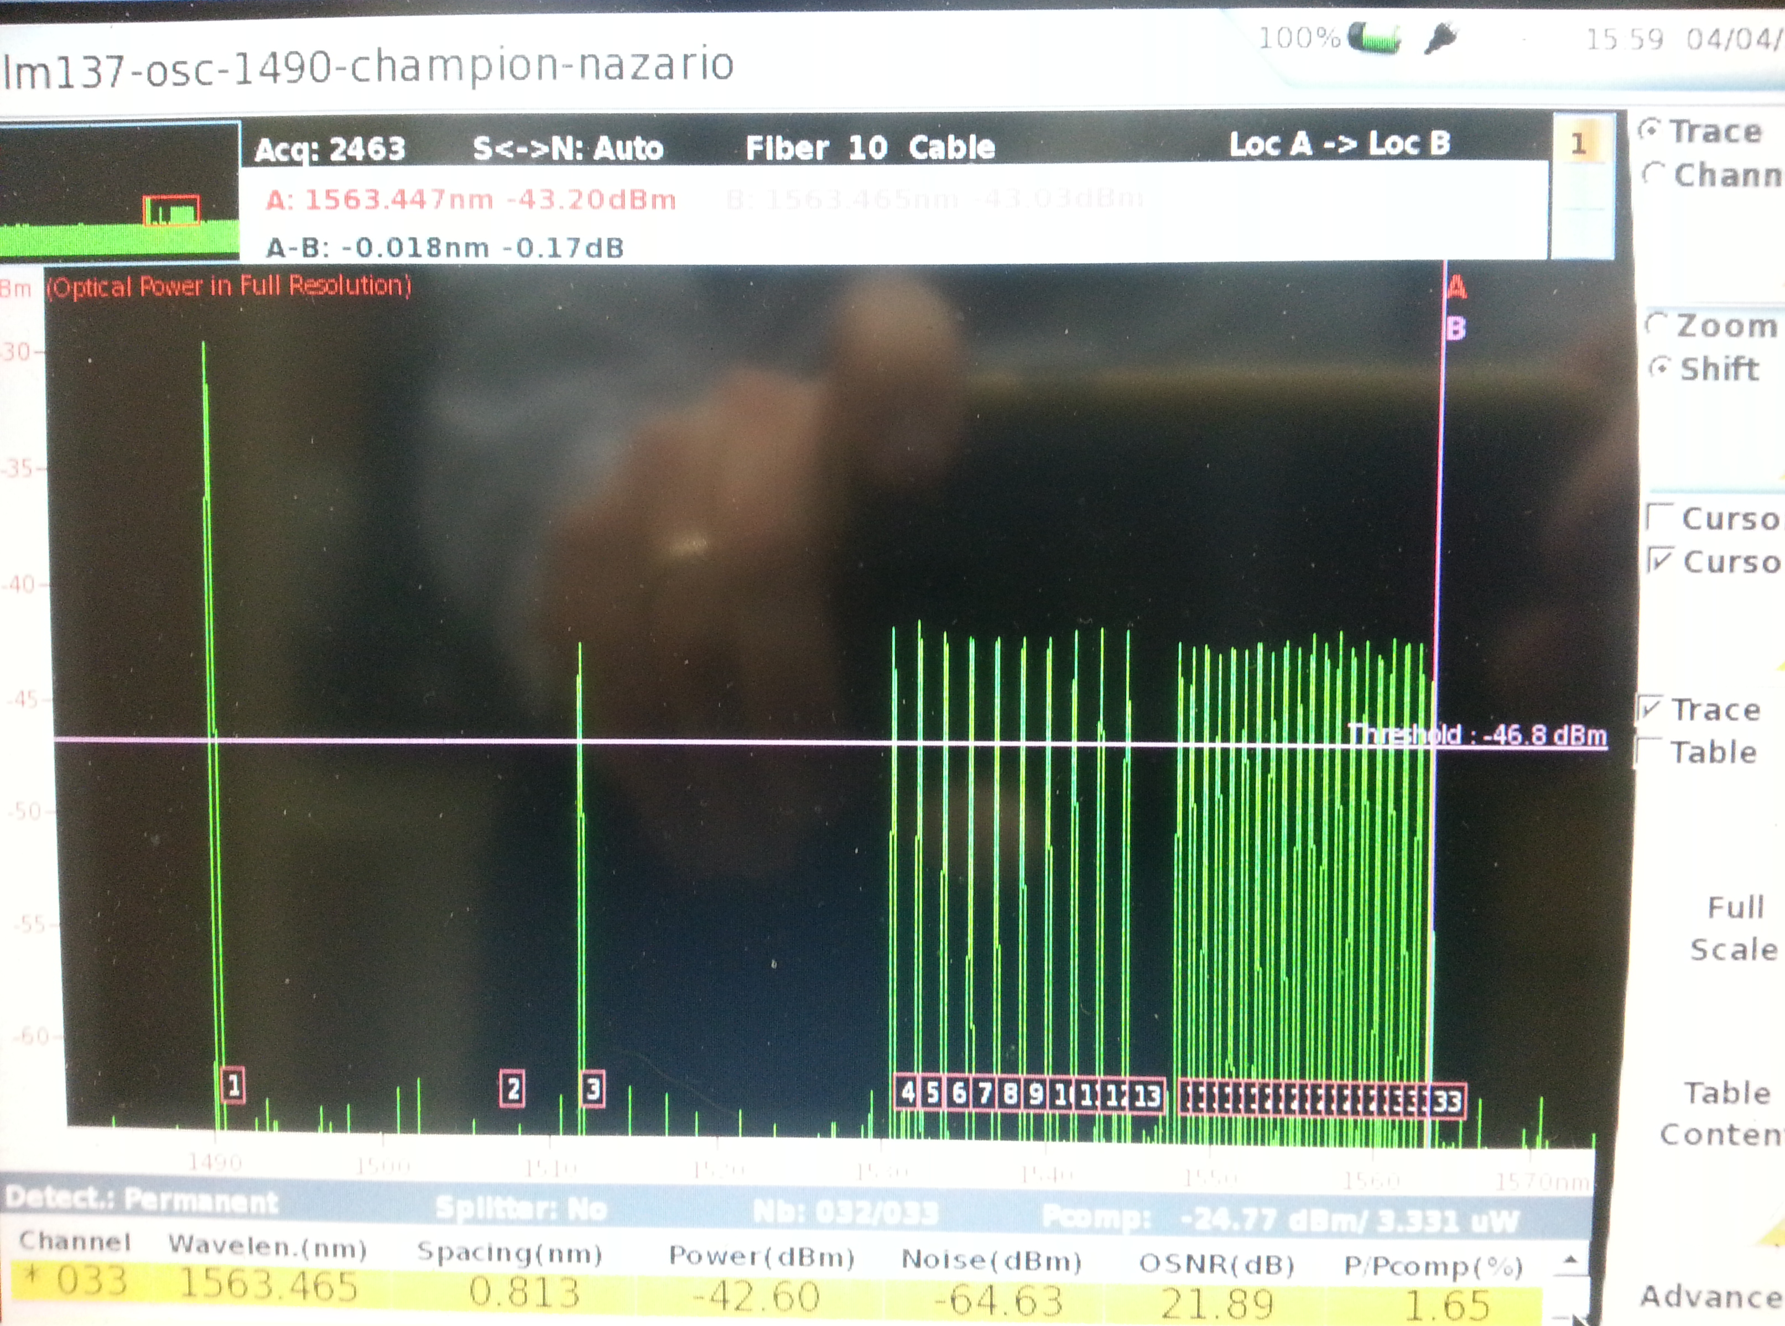

Slide 26
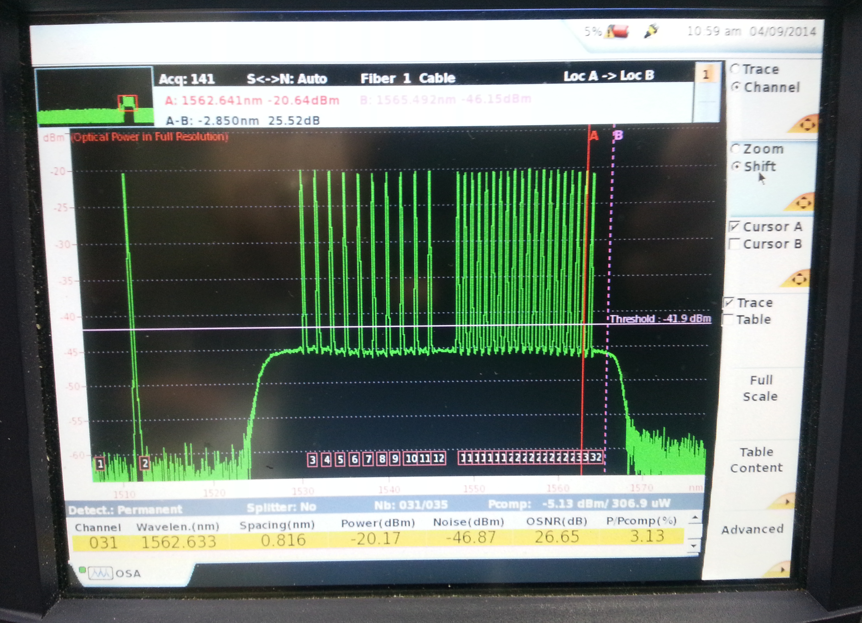

Slide 27
