Slide 1
UW System Network Operations Metrics
Patrick Christian
Mike Schlicht
9/23/2015

Slide 2
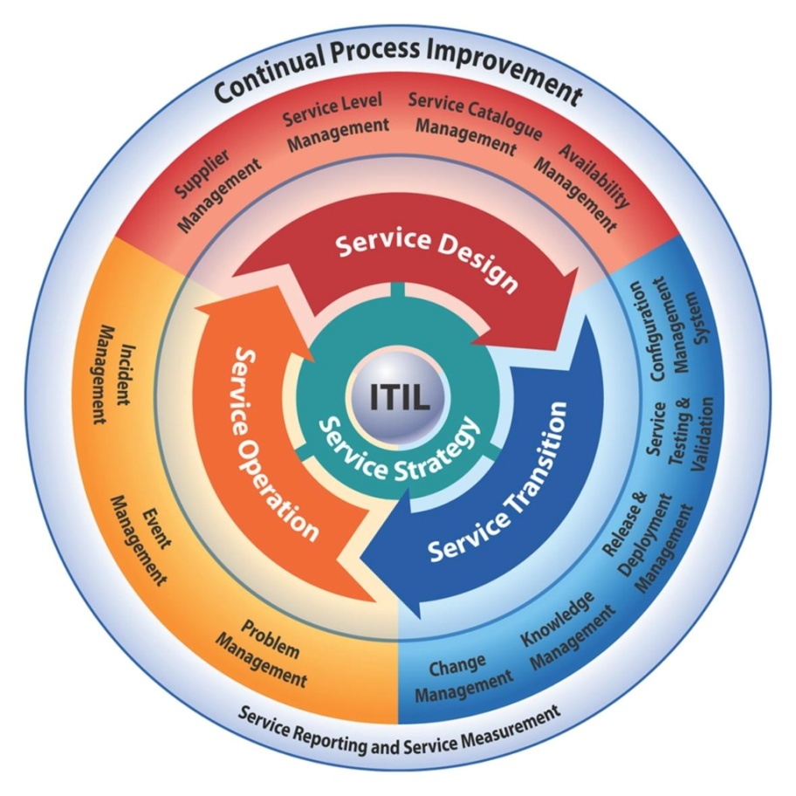
What gets measured gets managed

Slide 3
Significant event summary
UW/WiscNet network engineer deployment activities caused ~4 hours of campus "isolation" from world
~16 hour electrical (line card failure) event in IA City
~38.75 hours of commercial circuit downtime - particularly UW-Platteville's backup connection
Portion of fiber to UW-Platteville was not buried resulting in a 10.3 hour fiber repair
Several commercial power outages - most with minimal impact due to investment in DC power systems

Slide 4
Significant event summary
Various HVAC issues in pedestals & UWC locations
Significant unplanned fiber (cut) repairs
UWEC - UWC-BarronCO (~3.5 days) (weather decision)
Ames, IA (10 hours)
Kenosha (4.5 hours)
Several campuses had significant LAN issues that are not included in these statistics

Slide 5
Workload metrics
~6 months of activity after deployments
202 total # of tickets (calls)
72 planned events
130 unplanned events
…stated another way
94 service affecting events
108 non-service affecting events
Service affecting events = # of times when any component of the network operated in a degraded state

Slide 6
FY15 network availability
Many ways to calculate including planned + unplanned events vs. just unplanned vs. actual isolation of a campus network from world
99.947% availability

Slide 7
Root cause analysis

Slide 8
Root cause analysis

Slide 9
Questions?
patrick.christian@wisc.edu
mschlicht@uwsa.edu
Notes:
Procure optical hardware

