Slide 1
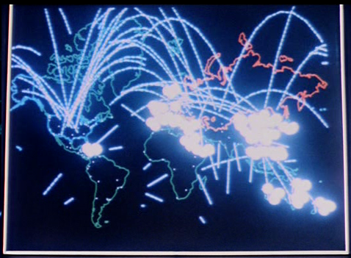
DDOS

Slide 2
DDOS
Volumetric
vs
Overwhelming
a service
Methods
Syn flood
Icmp flood
udp
Common amplification vectors
NTP 557
CharGen 359
DNS 179
QOTD 140
Quake 64
SSDP 31
Portmap 28
mDNS 10
SNMPv2 6

Slide 3
Infrastructure vulnerable to Volumetric Attack
Campus Network “last mile”
Firewalls, other traffic-impeding middleboxes
Monitoring
uwsys.net upstream transit
Etc.

Slide 4
Don’t be a participant
Filter
Block or rate-limit known vectors
Deprecate open recursive resolvers
Anti-spoofing
uRPF, ACLs
Monitor. Can you detect DDoS in your traffic?
UWSys has some monitoring and aggressive filters where plausible. (more from Michael later)

Slide 5
Example (volumetric) Motivations
On-line gaming / forums
Take a specific user offline
Revenge
Avoid exams
Disrupt online services
Create a distraction
Then hack machines while monitoring/staff is overwhelmed
Wreak havoc
Happened to Rutgers

Slide 6
Economics

Slide 8
But, I have a DR plan

Slide 9
But, I have a DR plan
Example: Resilient web hosting
Oh, so you want to make a change to DNS?
Where is your SOA?
Where are the authoritative servers?

Slide 10
Of the 15 major UW domains,
3 do not have any NS records off-site at all. Really.
9 still share fate with uwsys network
Only 3 have off-site (non uw-system) resiliency
Zero have SOA off-site.

Slide 11
DDOS Solution Space
Needed: a holistic approach
Cloud (me)
Network (Dan D., Michael H.)
Appliance (Greg P., Scott B.)

Slide 12
Pat
People
Processes
Technology

Slide 13
DDOS Detection

Slide 15
The Movies

Slide 16
Reality

Slide 17
Cloud Mitigation
Recall, (2) types of DDOS:
Application / Overwhelm a service
--------------------------
Volumetric Attack:
CDN hosting
Typically a dns redirect
DR Load balancing
“web application firewall”
(Reverse proxy)
Scrubbing

Slide 18
Scrubbing
Contract in place with a provider
Pre-configured GRE tunnel to scrubbing provider
Process netflow, Alert a human to look at it
Tell provider to scrub for a prefix (via BGP)
Scrubber announces more-specific prefixes (up to /24) to Internet, processes traffic, sends legitimate traffic back via GRE
Pricing models vary
amount of scrubbing capacity under contract
What the data rate of the clean traffic should be
Incidental overage vs long-duration

Slide 19
The era of unsolicited packets is over...
Can’t we just turn off / rate limit UDP?
QUIC
Google’s experiment to replace TCP+TLS+SPDY

